Slide 1
What makes human beings unique?
UNIT B
We can make our dreams reality!
Notes:
In the speaker notes you find easy-to-consult short sentences that sum up the instructions presented in the Lesson Plan.

Slide 2
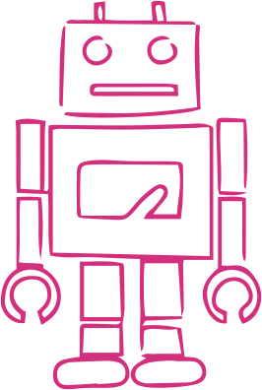
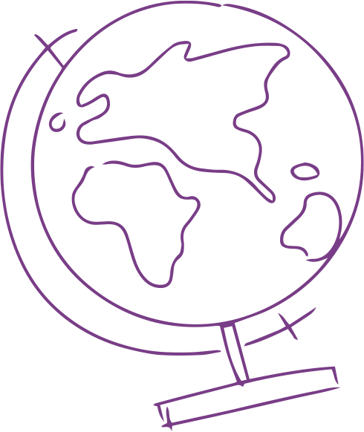
For how long do you think humans dreamt of flying?
ACTIVITY B1
Notes:
Check pupils’ opinions about how long they think humans dreamt of flying.

Slide 3
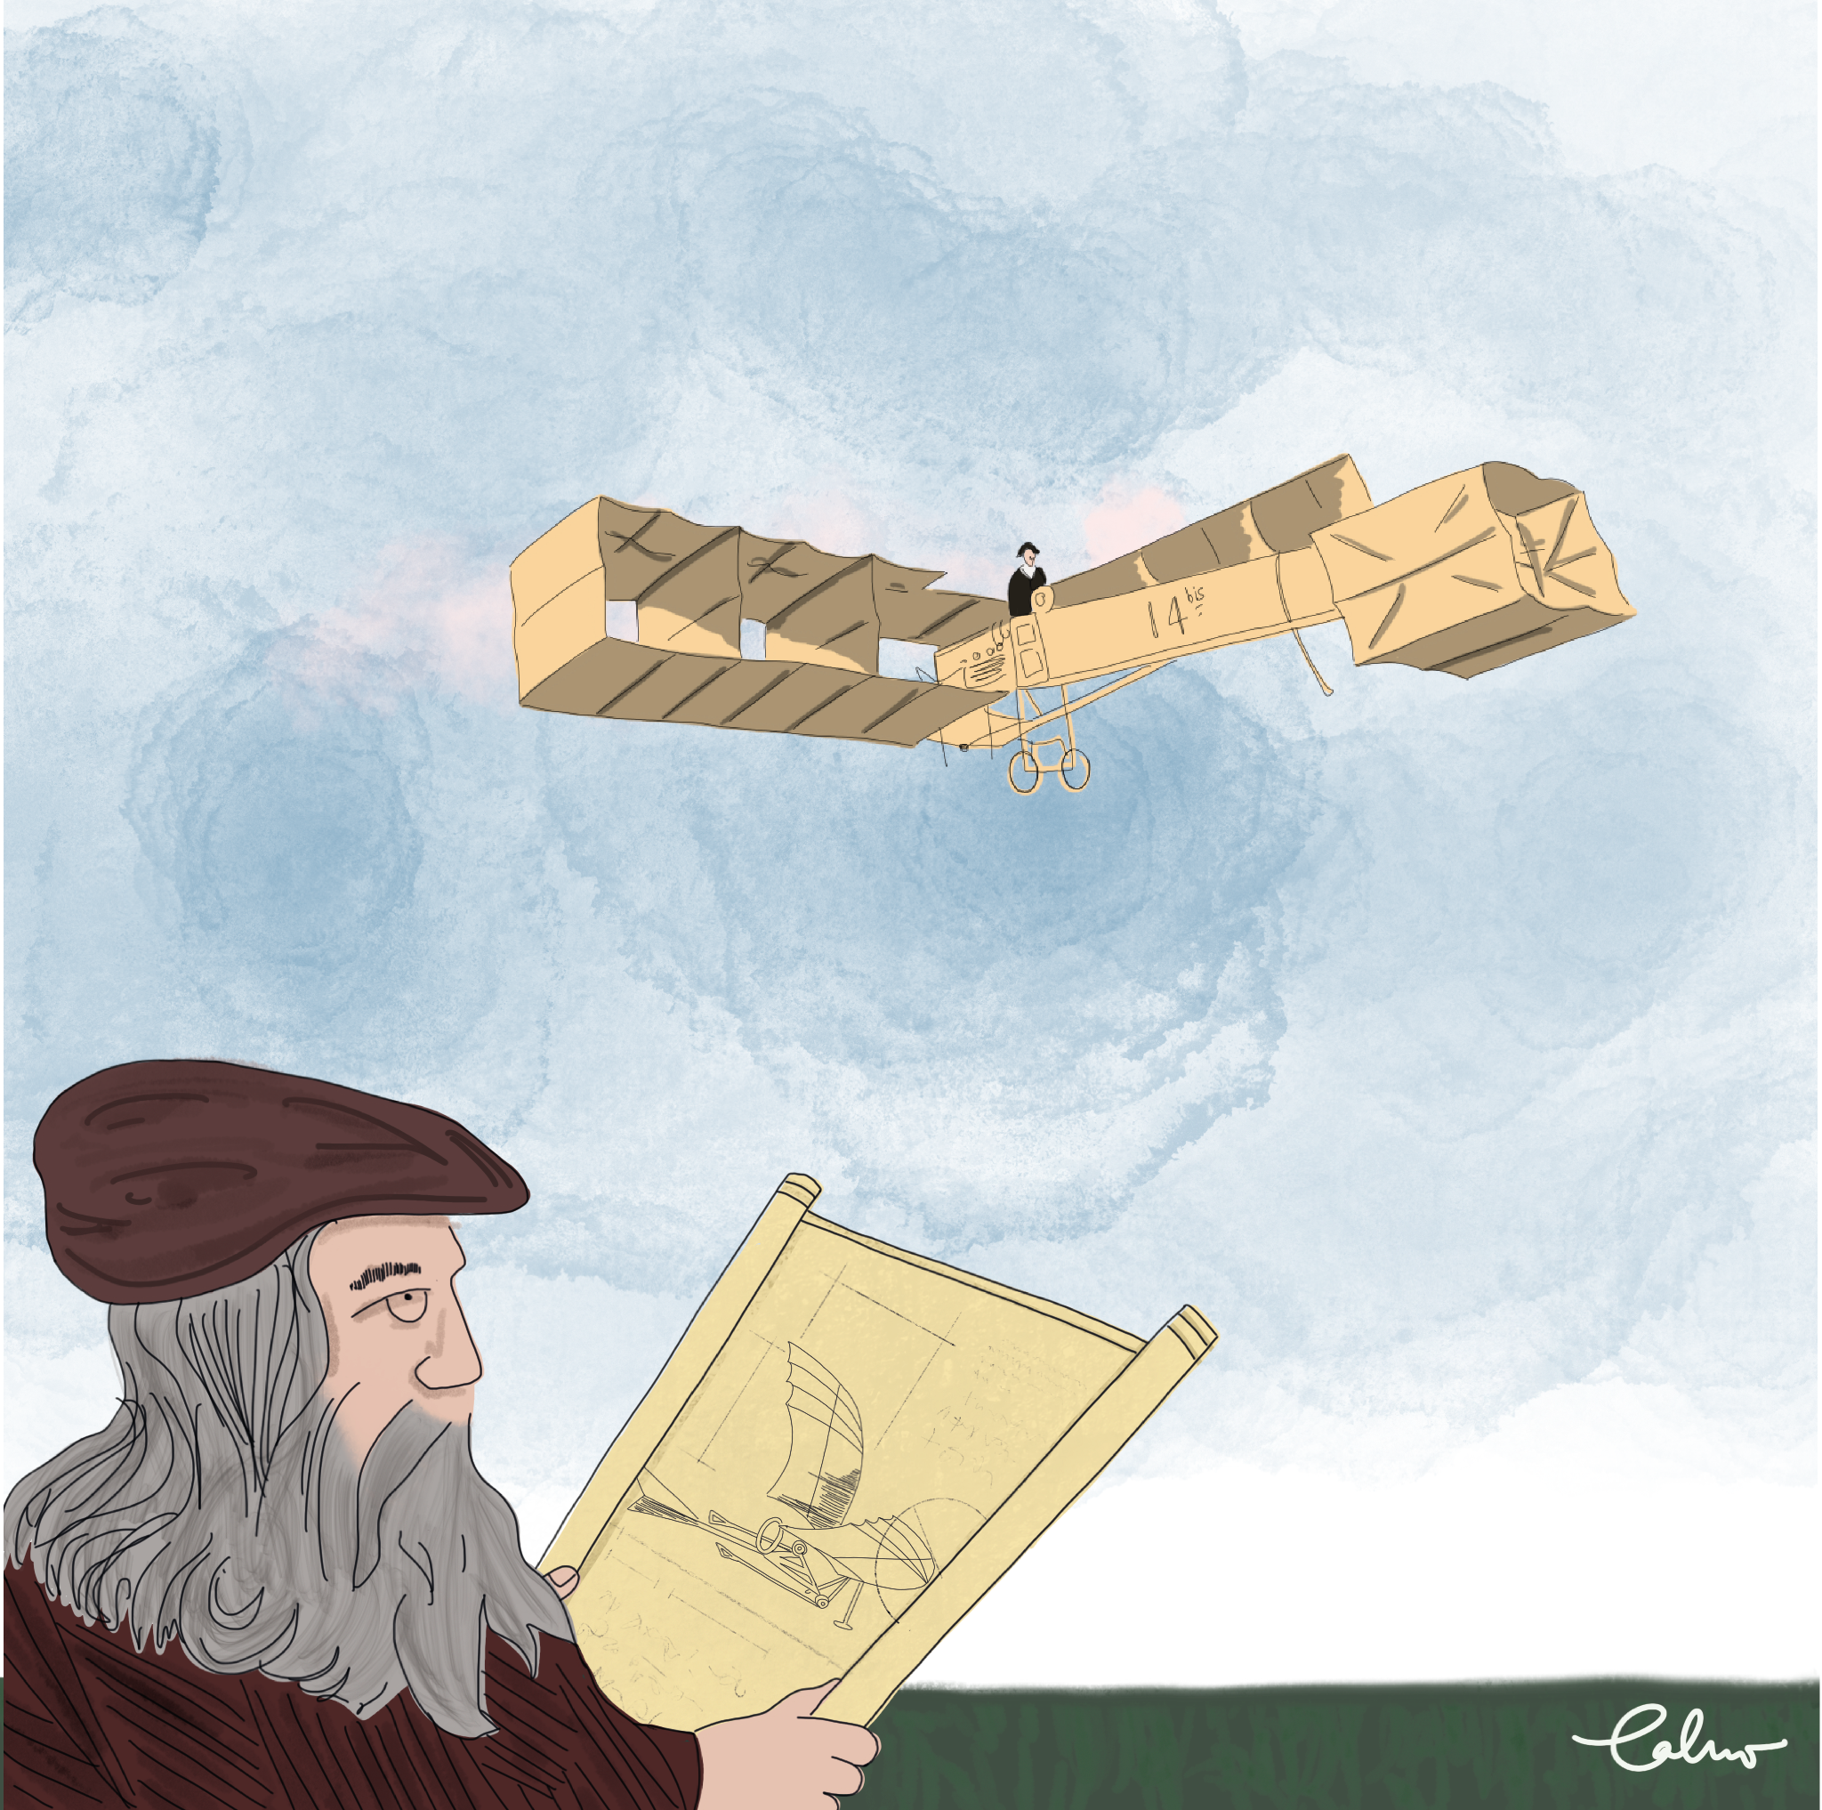
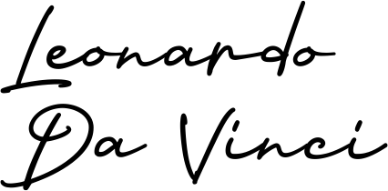
ACTIVITY B1
Notes:
Ask pupils “What do you think is the relationship between the men and the airplanes represented in the image?”. Then, invite pupils to read the short texts and complete activity #B1.1 on the student sheet.

Slide 4
ACTIVITY B1
What human traits allowed these inventors to come up with those ideas?
Notes:
Ask pupils the question on the slide. Then, ask “What substance do airplanes use to fly?” and “Does flying have negative environmental consequences?”

Slide 5
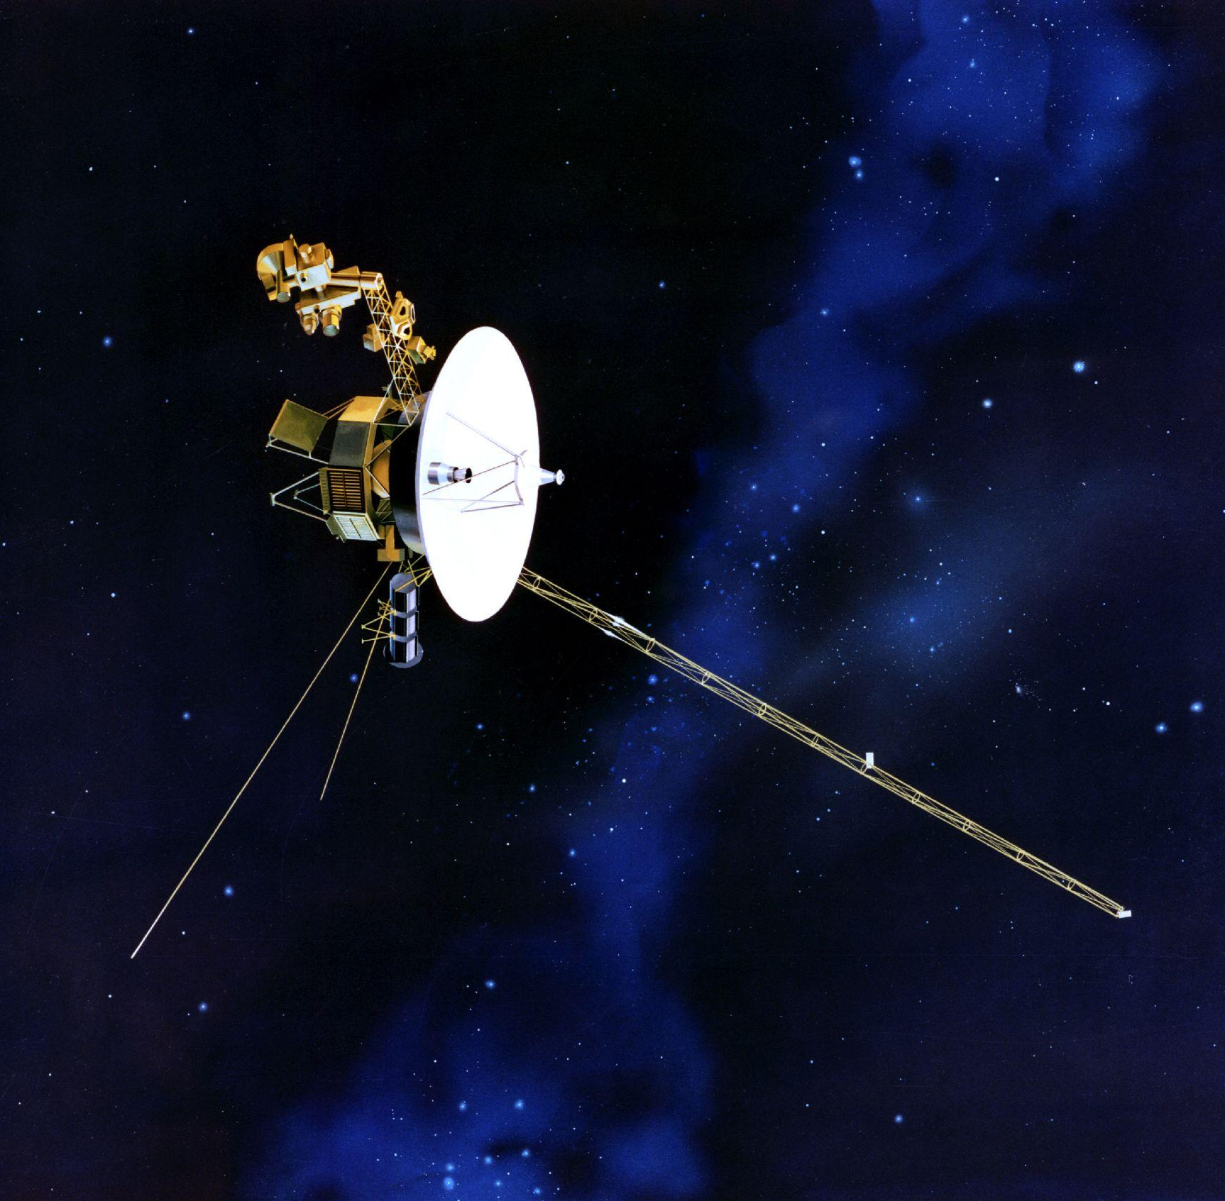
ACTIVITY B1
After the sky, the universe is the limit!
500 years after Da Vinci’s dream of flying machines,
in 1997, the twin Voyager 1 and 2 spacecrafts were launched!
Mission: Explore areas beyond our planet!
Notes:
Highlight to pupils how humans have been continued to dream and to explore further places that we have never been before. Give the voyager 1 and 2 spacecrafts, and space exploration as examples.

Slide 6
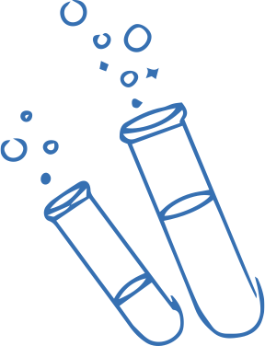
Let’s look at some other inventions!
ACTIVITY B2
Notes:
Invite pupils to discover another 5 inventions.

Slide 7
ACTIVITY B2
Notes:
Challenge pupils to recognize the inventions shown on the slide and to describe their functions. Then, request pupils to choose their favourite invention.

Slide 8
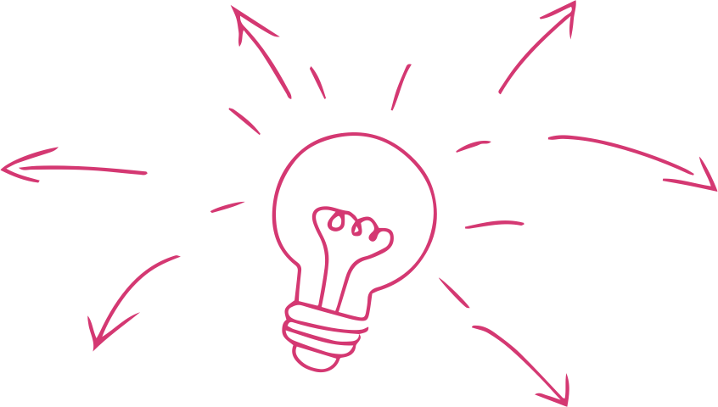
Let’s discover the inventors behind the inventions?
ACTIVITY B2
Notes:
Invite the students to discover the inventors behind their favourite inventions.

Slide 9
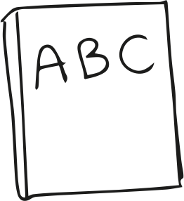
Reading Time
ACTIVITY B2
Inventor’s Biography
Notes:
Give to each student the inventors’ biography of their favourite invention. Then, ask pupils to complete activity #B2.1 on the student sheet.

Slide 10
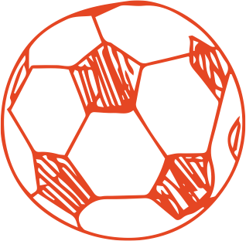
Creativity Time!
ACTIVITY B2
Create an artistic production about your favourite invention and inventor
Tip: Feel free to chose any kind of art you like
Notes:
Ask pupils to create an artistic production (handcraft or digitally) about their chosen scientist.

Slide 11
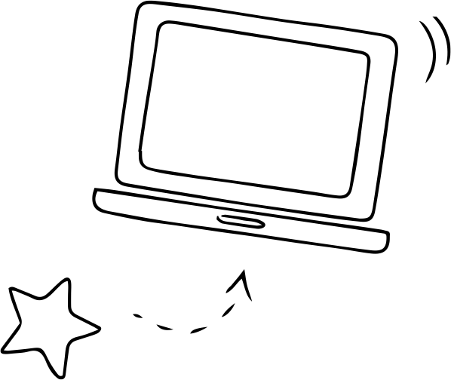
Sharing Time
Let’s form Teams!
ACTIVITY B2
Introduce your creation and the inventor to your group
Notes:
Separate the students into small groups (3-4 students). Pupils will share with the other students in the group their artistic production and will exchange information about the inventors. Ask pupils to complete activity #B2.2 on the student sheet as long as they find new information about the other inventors.

Slide 12
ACTIVITY B2
Discussion Time
Notes:
Tell pupils that they are going to discuss a theme together.

Slide 13
ACTIVITY B3
What do people want the world to be in the future?
Notes:
Present the discussion by asking pupils the question on the slide.

Slide 14
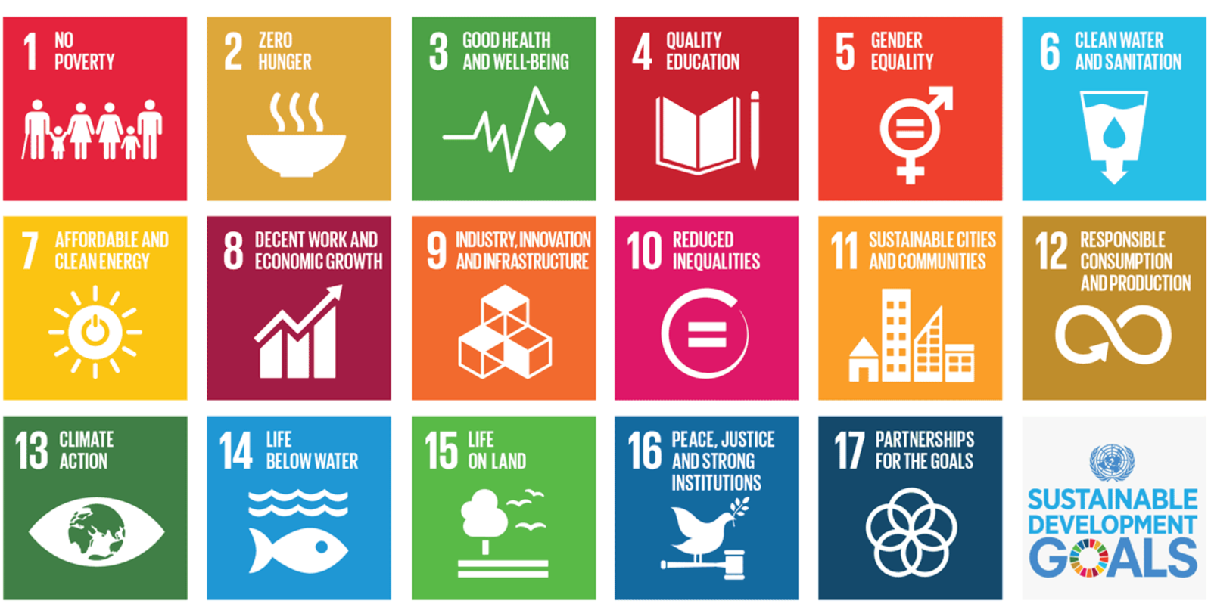
ACTIVITY B3
The Sustainable Development Goals
Goal commitment between several countries
17 Goals
Main Goal: Promote the protection of our planet and decent life for all by 2030.
Notes:
Briefly introduce the Sustainable Development Goals (SDGs).

Slide 15
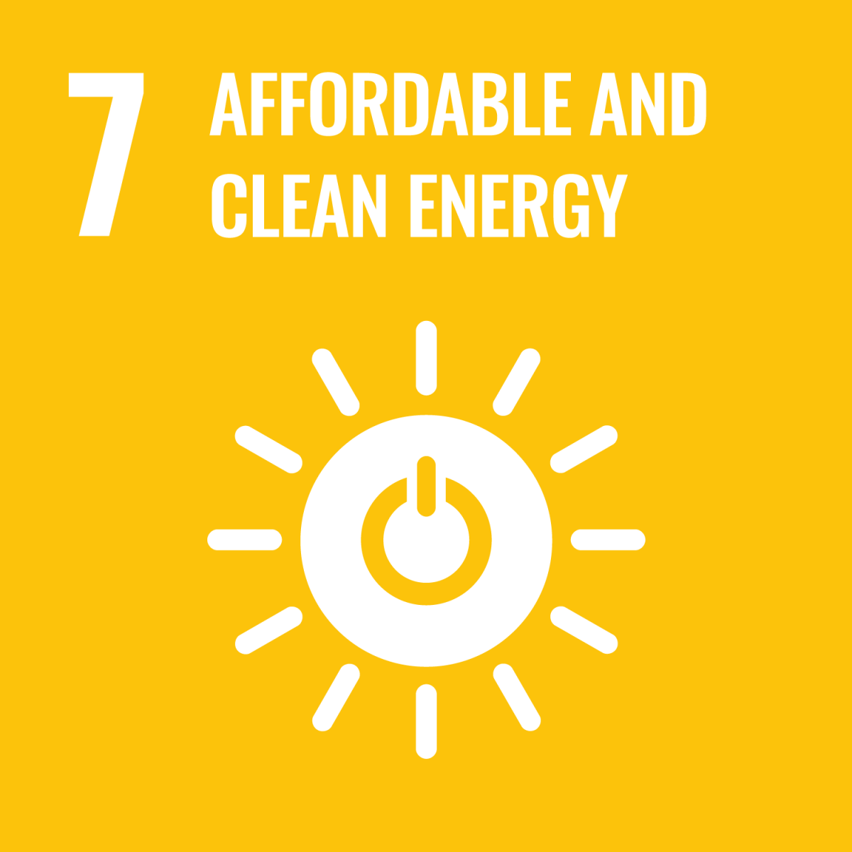
ACTIVITY B3
Let’s dig into
GOAL 7!
Notes:
Inform pupils that you are going to focus on Goal 7: Affordable and Clean Energy.

Slide 16
ACTIVITY B3
Reading Time
‘’Energy: A Challenge For The 21st Century’’
Notes:
Ask pupils to read the text “Energy: A Challenge For The 21st Century” in activity #B3.1 on the student sheet.

Slide 17
ACTIVITY B3
Discussion Time
What are the impacts of fossil fuels?
Can you name one example of climate change effects?
Notes:
Ask pupils the questions on the slide.

Slide 18
ACTIVITY B3
Climate Change
Patagonia Andes
Upsala Glacier 1928
Upsala Glacier 2004
Notes:
Show the Upsala glacier, on slide 18, as an example of a consequence of climate change.

Slide 19
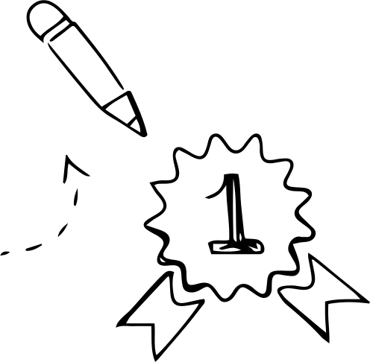
Conclusion
MAIN MESSAGES
It may take many years from imagining something to creating it - inventions take time.
It is difficult to invent something on your own, most scientists and inventors work in multidisciplinary teams.
What is the most interesting thing you have learned with this lesson?
Notes:
Reiterate the key messages and ask pupils what skills they have used to design their prototype. Invite them to write down what they have learnt with this lesson on the student sheet.

Slide 20
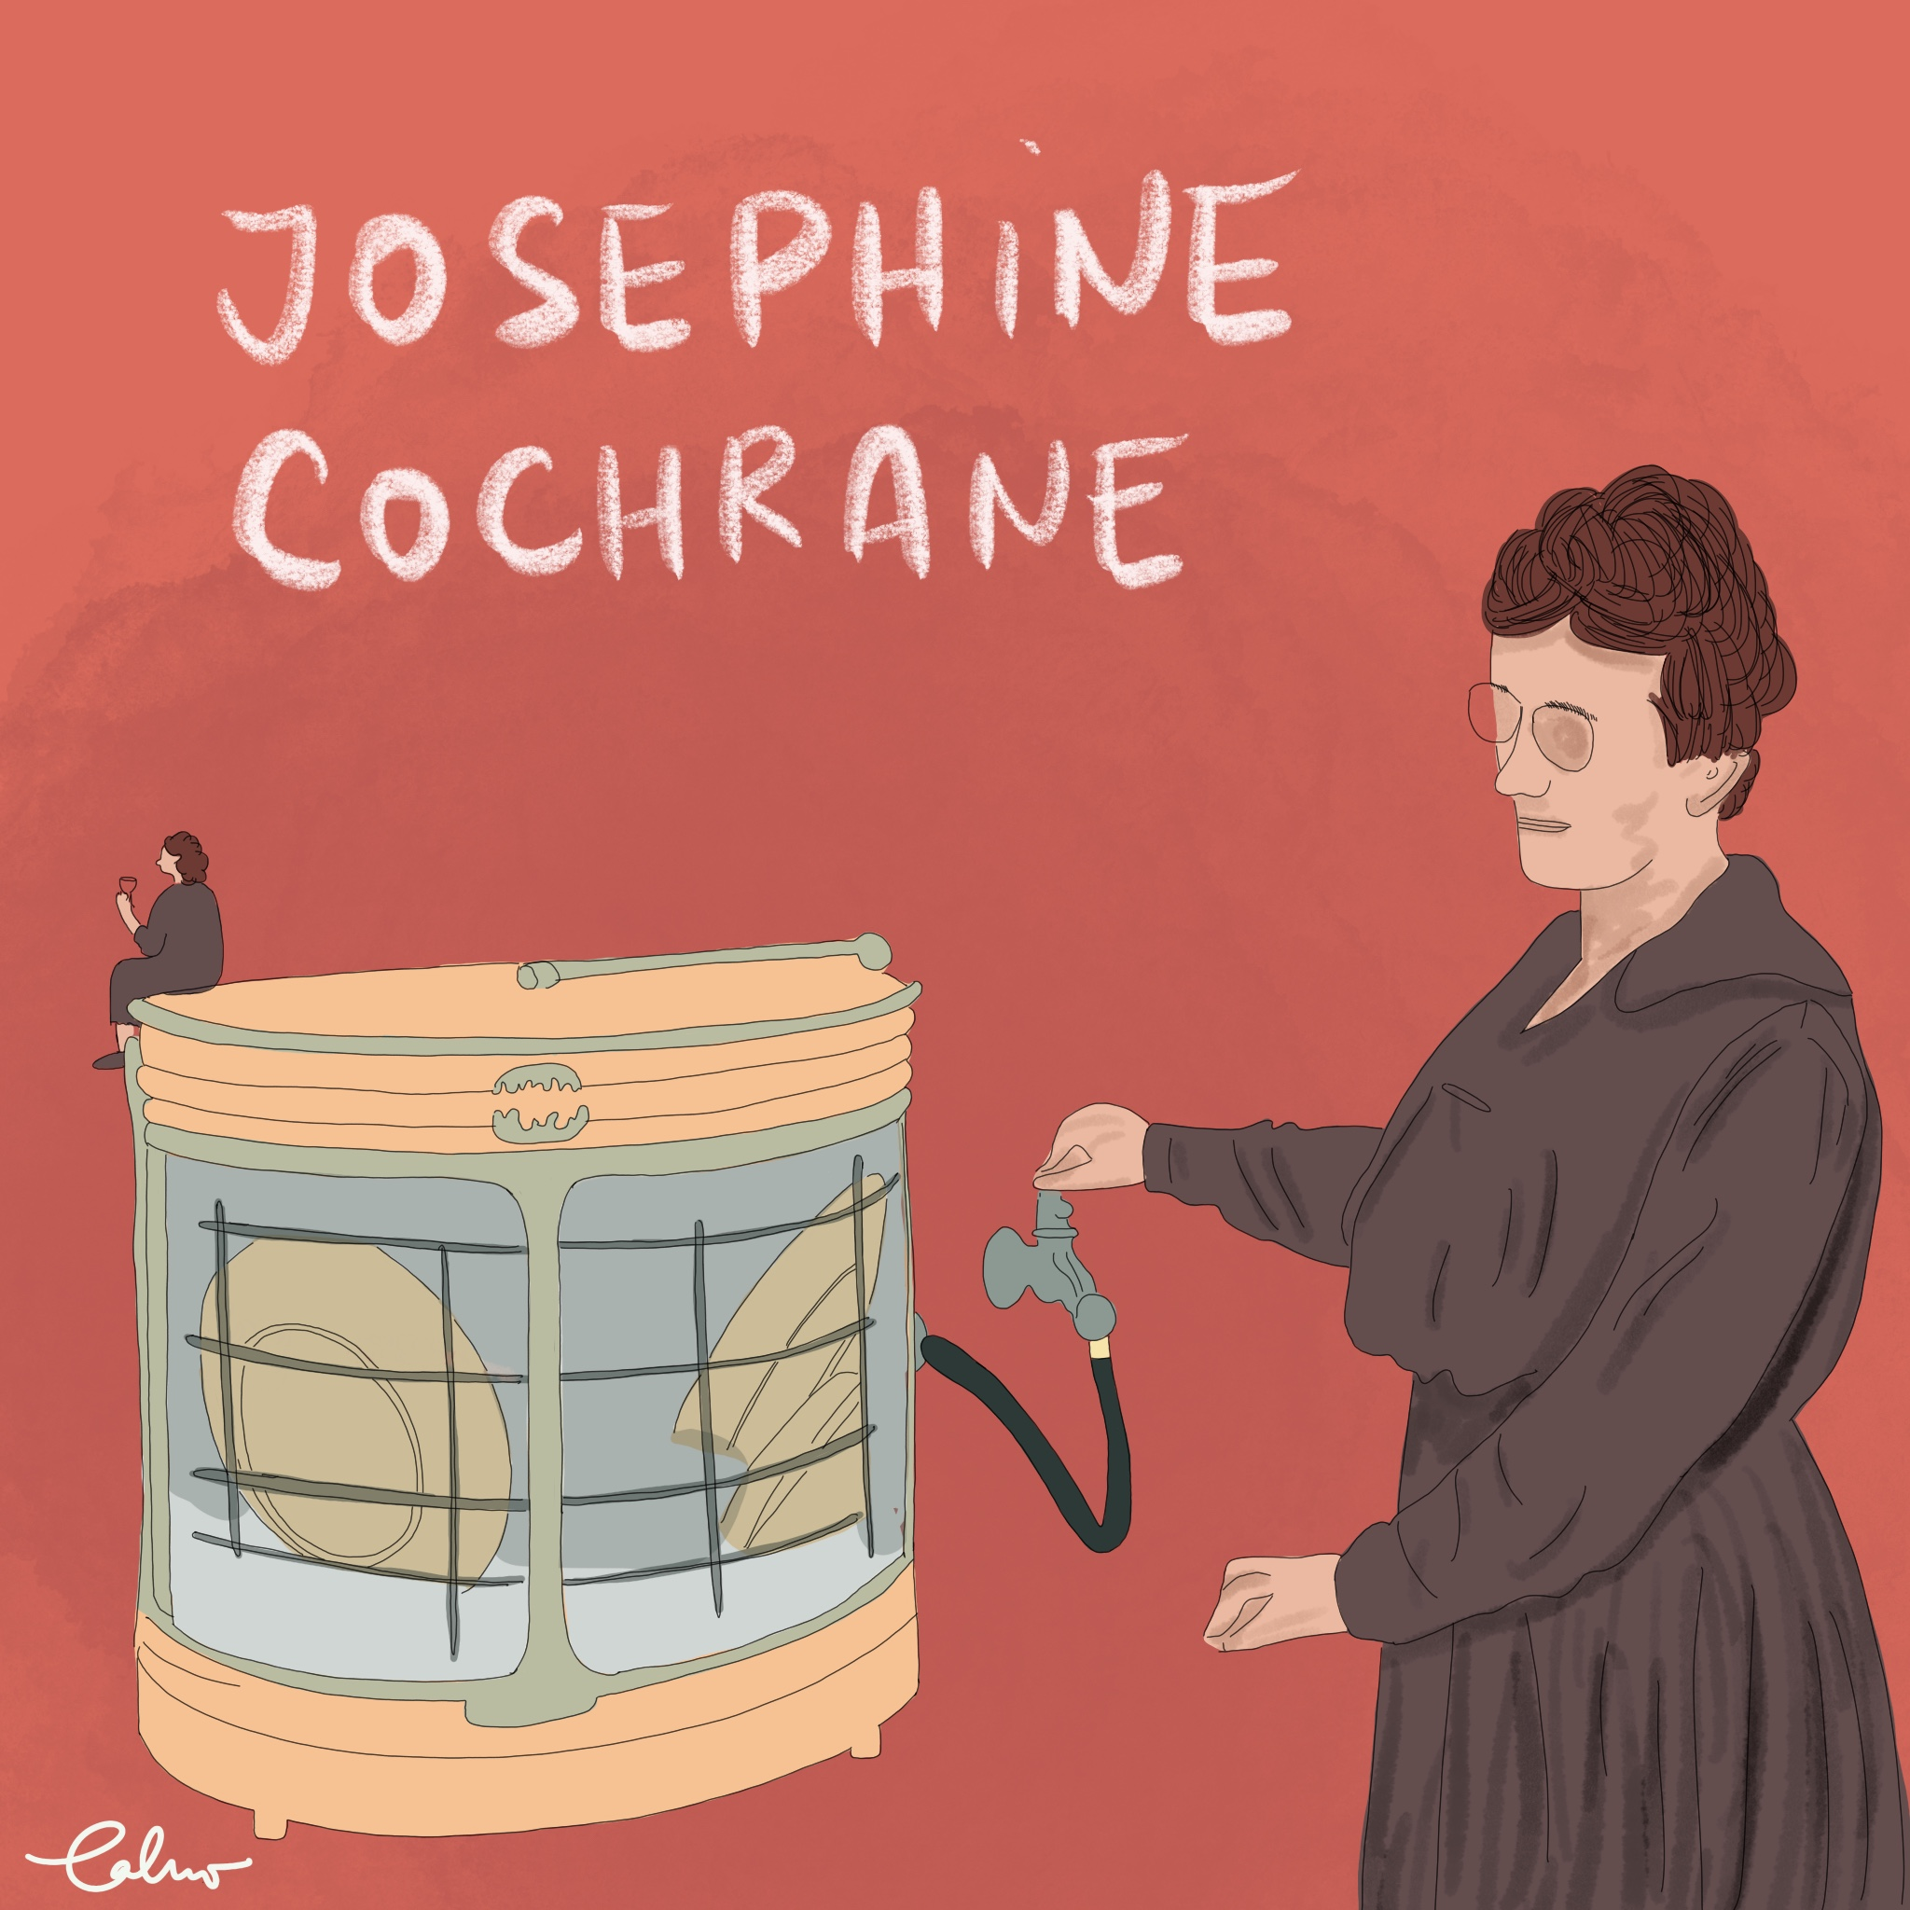
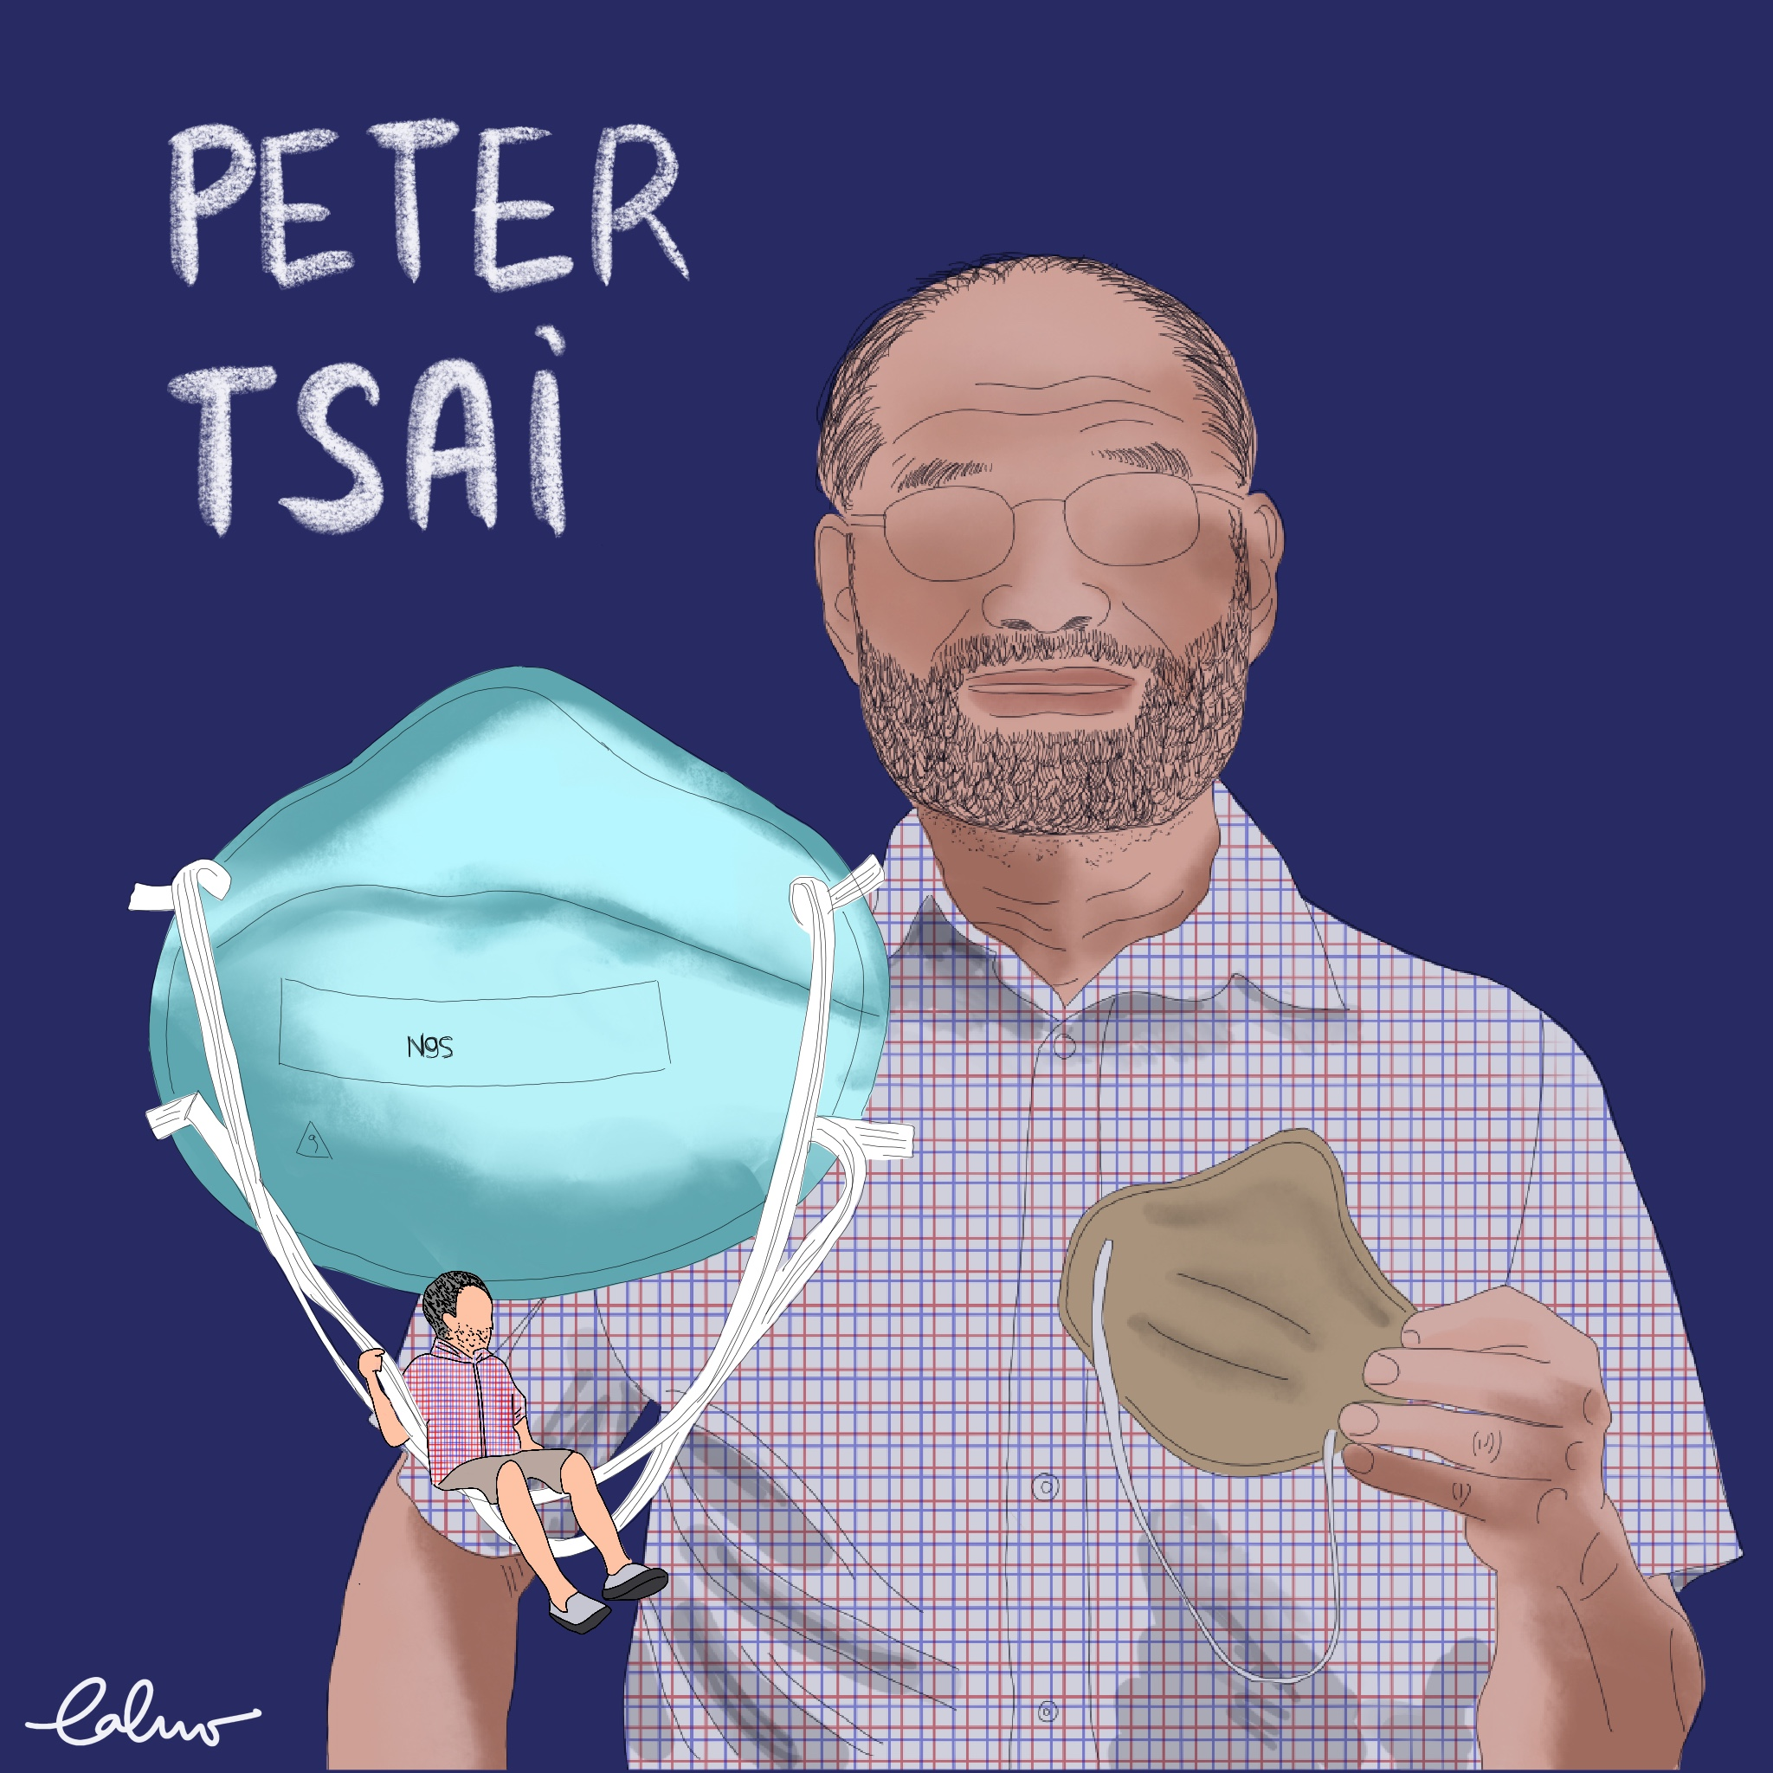
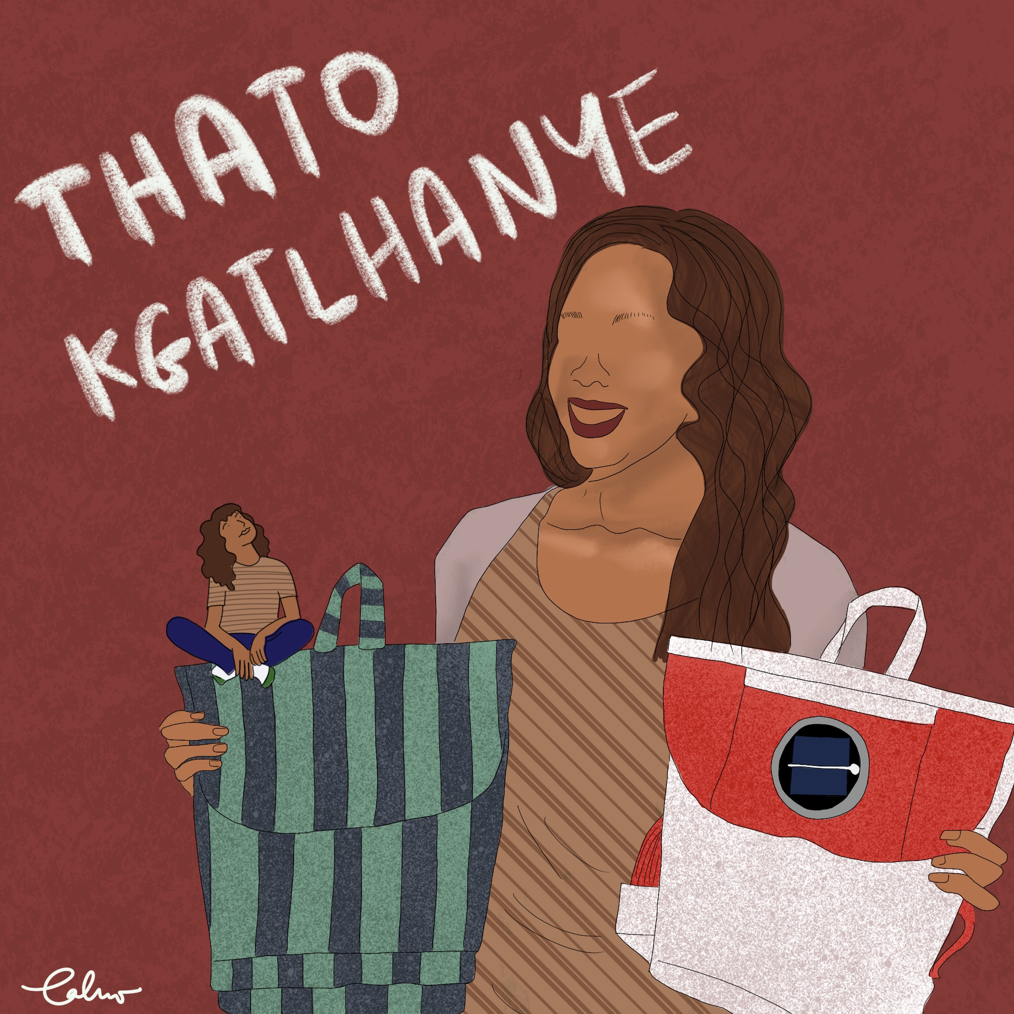
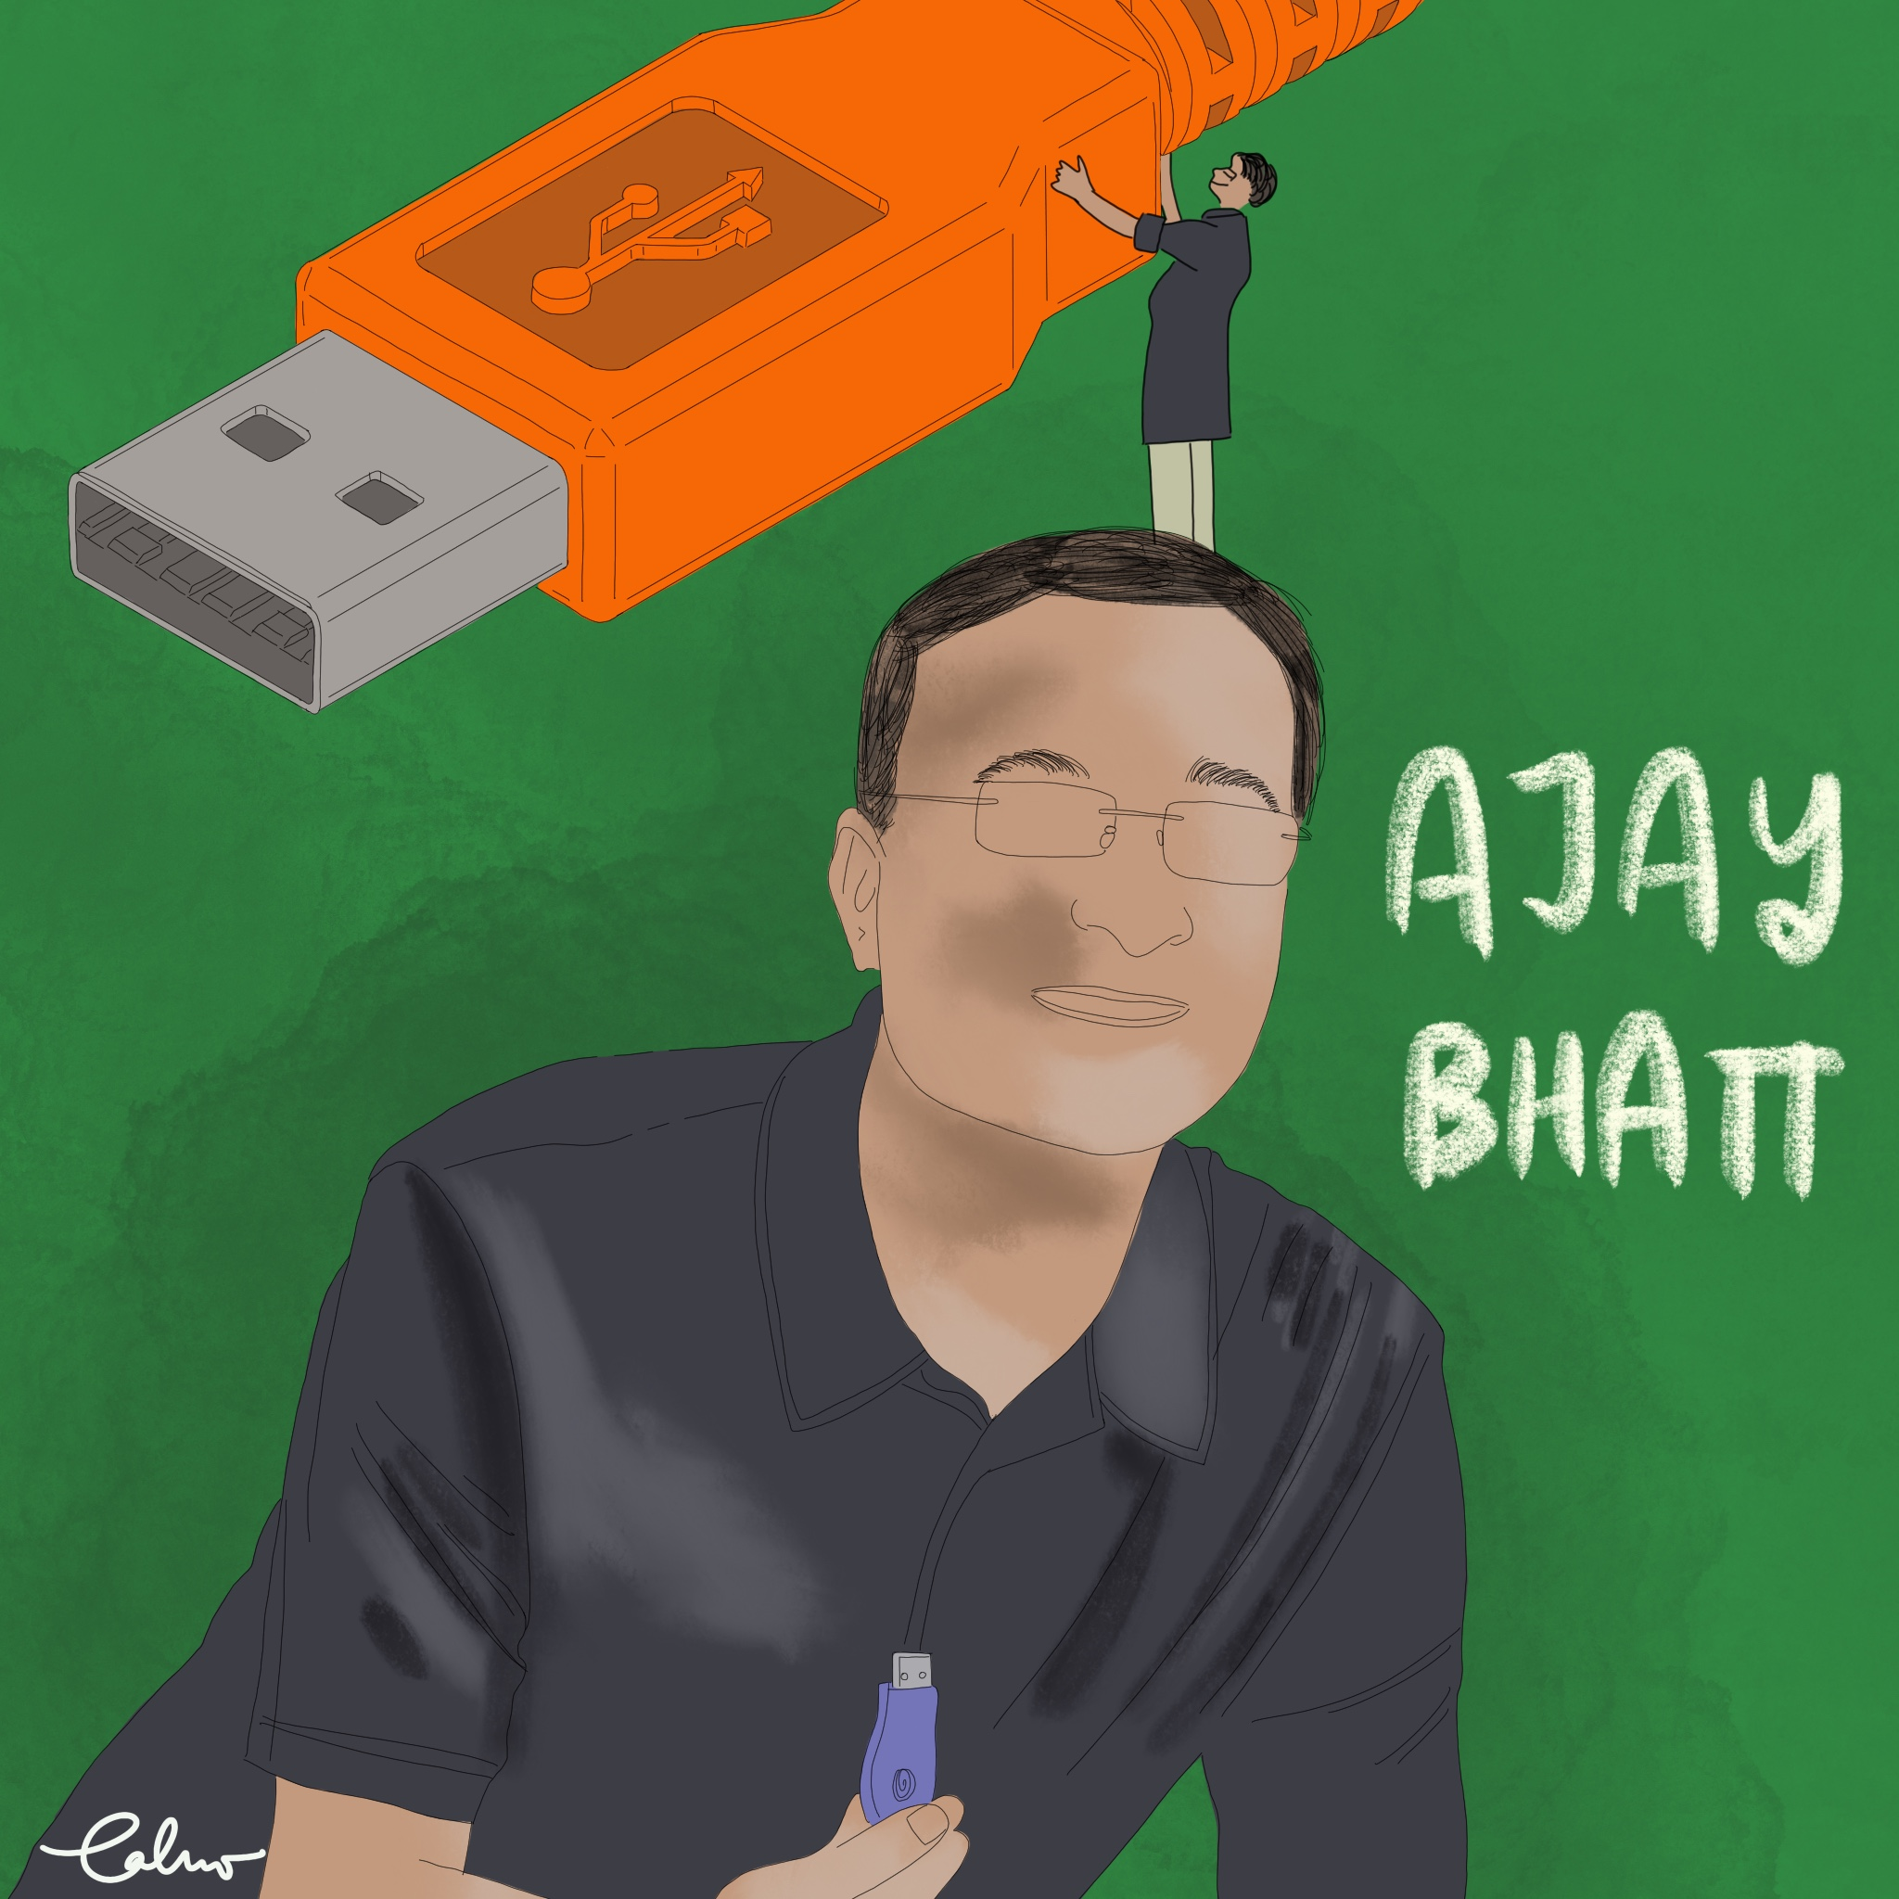
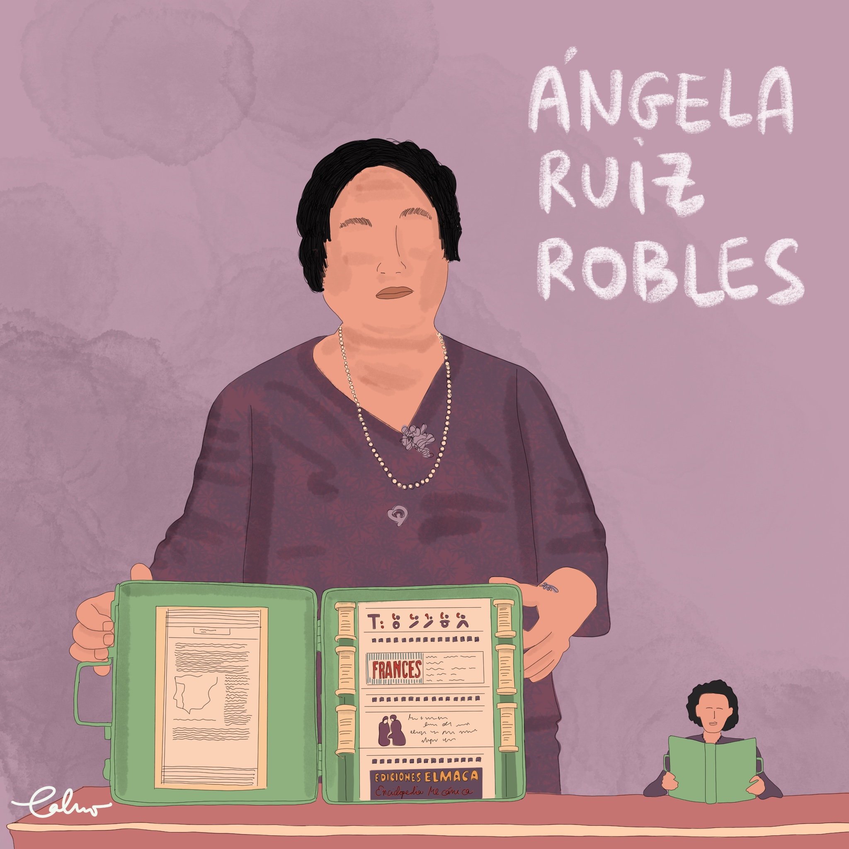
ACTIVITY B2
Extra Resource: Inventors’ Biographies
Notes:
Inventors’ biographies for easy consultation

Slide 21
ACTIVITY B2
Josephine Cochrane was born in the United States of America in 1839. It is unknown if she studied engineering but she may have been exposed to it through her father. While Josephine was wealthy and had servants, she decided to invent this machine because her favourite dishes got cheapped frequently while washing up. She build the machine prototype with the help of a mechanic in a shed behind her house. Her dishwasher was a box with compartment for the dishes with a motor that sprayed soapy water on them. Initially she though this invention would be mostly wanted by house wifes (who did most of the house work at the time) but her first clients were hotels and restaurants as they need lots of clean tableware.

Slide 22
ACTIVITY B2
Peter Tsai was born in Taiwan in 1952. He grew up in Taiwan and later moved to the USA to pursue a doctoral degree. Peter studied many different subjects such as chemical engineering, mathematics and physics. He then became a material scientist and a teacher at the University of Tennessee. There he led the team who developed the N95 face mask. These masks are very effective because they filter out contaminants unlike other face coverings, such as cotton masks. The material consists of both positive and negative charges, which are able to attract a variety of particles (from dust to viruses) and trap at least 95% of them before they go through the mask. In 2020, there was lack of N95 respirators due to the COVID pandemic so Peter came out of retirement to study the best way to clean and re-use them.

Slide 23
ACTIVITY B2
Thato Kgatlhanye was born in South Africa in 1992. She studied brand management in South Africa and did an internship in New York. At the age of 18, Thato founded a company together with a school friend. The company produces school bags fitted with a solar panel that charges during the day and can then produce light. The bags are also eco-friendly as each of them is made of 20 recycled plastic bags. Thato’s mother gave her the inspiration for these school bags: her mother had to study by candlelight because there was no electricity. Thato wishes to help pupils who do not have easy access to light to study with her solar powered school bags and her companies sells bags to many different countries in the world.

Slide 24
ACTIVITY B2
Ajay Bhatt was born in 1957 in India. He studied both in India and
the United States of America to become a computer architect. He was the lead of a team that created the universal serial bus technology (USB). His inspiration to create this device came from the difficulties his wife experienced when printing documents at home. At that time, each device needed a different plug to connect to the computer and it was often not easy to plug and unplug them. With USB, we can now easily connect devices (printers, mouse, keyboard, etc) to computers and we can even recharge some of them, such as phones. Ajay and his team won a big award and there is even a TV advert for the company where he is portrayed by an actor.

Slide 25
ACTIVITY B2
Ángela Ruiz Robles was born in Spain in 1895. She studied to be a
teacher and taught many different subjects such as typing and
accounting. Angela wrote and publish many books to help pupils
learn and study. She was very dedicated to her pupils and noticed
that the books they had to carry were too heavy. To address the weight issue she created a prototype of a mechanical encyclopedia which could contain many topics. It had rolls of film with tiny text and illustrations which were made visible by a magnifier glass. This mechanical device was the precursor of the electronic books available today. Angela won many awards for this invention but her book was never produced. You can see the prototype at the National Museum of Science and Technology in Spain.

