Slide 1
Feel free to add your own slides or adapt existing slides to your preferences!
By selecting “New slide” you can easily add a new slide in the correct theme (with footers and page numbers). You can also use “Layout” to select various layouts using the standard slide theme.
Module 1
Fusion Basics

Slide 2
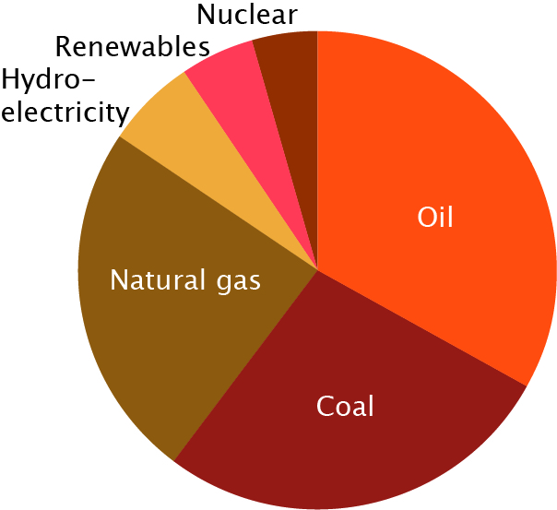
1.1 Energy and its role in our world
The energy mix
  Renewable vs non-renewable
Source: BP Statistical Review of World Energy, 2020.

Slide 3
Classroom exercise 1.1
(a) Estimate what percentage of your country’s energy is created by renewable energy sources such as solar, wind, hydro, etc. Explain how you reached your estimate. Did you make any assumptions?
(b) Compare your estimate with the estimate of at least one other student. Do the estimates differ a lot? Compare the reasoning behind the estimates: did you make different assumptions?
(c) Look up the energy mix of your country. Compare your estimates to the data. Were your estimates close?

Slide 4
Classroom exercise 1.1 - answers
Discuss!

Slide 5
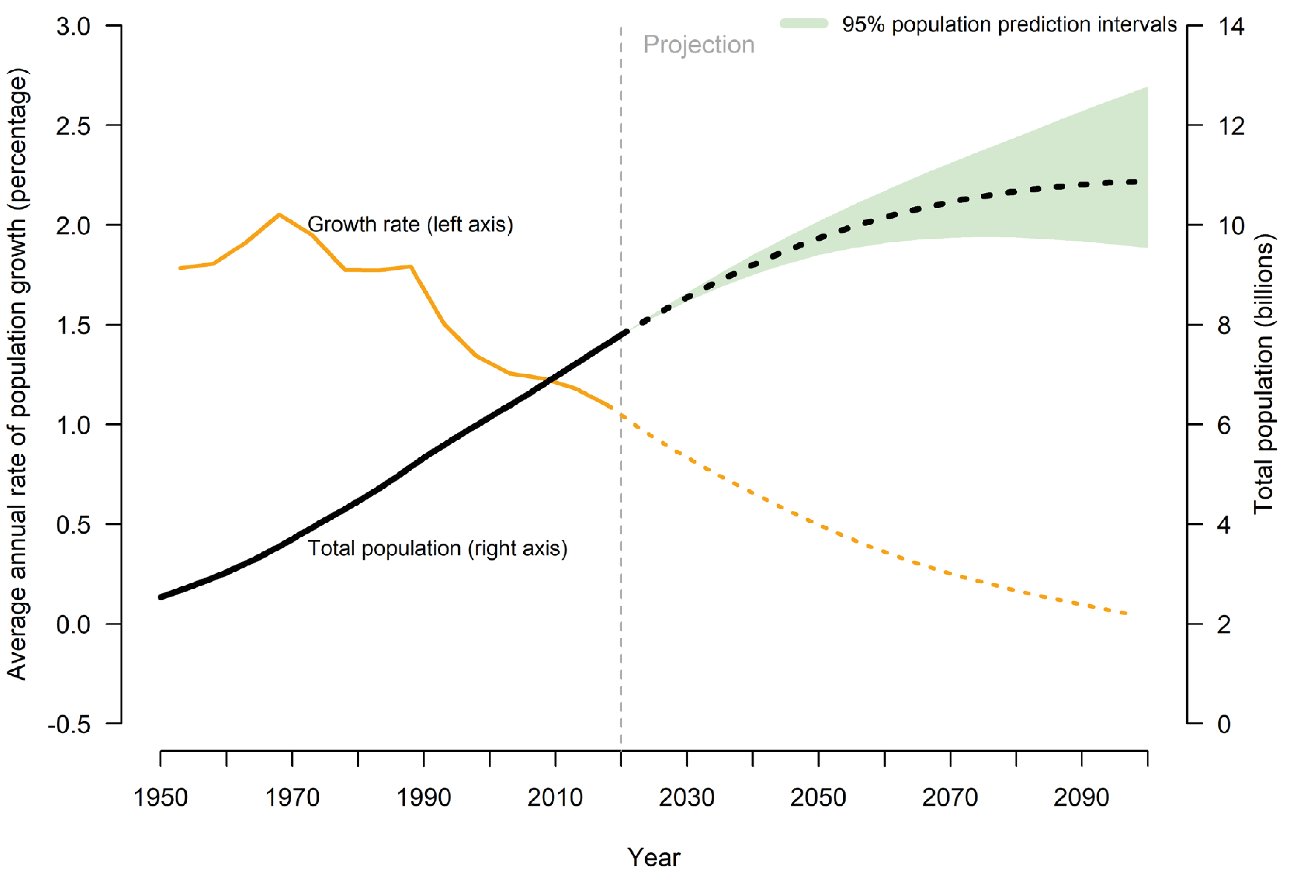
The energy problem
Problem
  Increasing population
  Increasing energy use
  Environmental harmful
  sources
Source: United Nations, Department of Economic and Social Affairs, Population Division (2019). World Population Prospects 2019: Highlights. ST/ESA/SER.A/423.

Slide 6
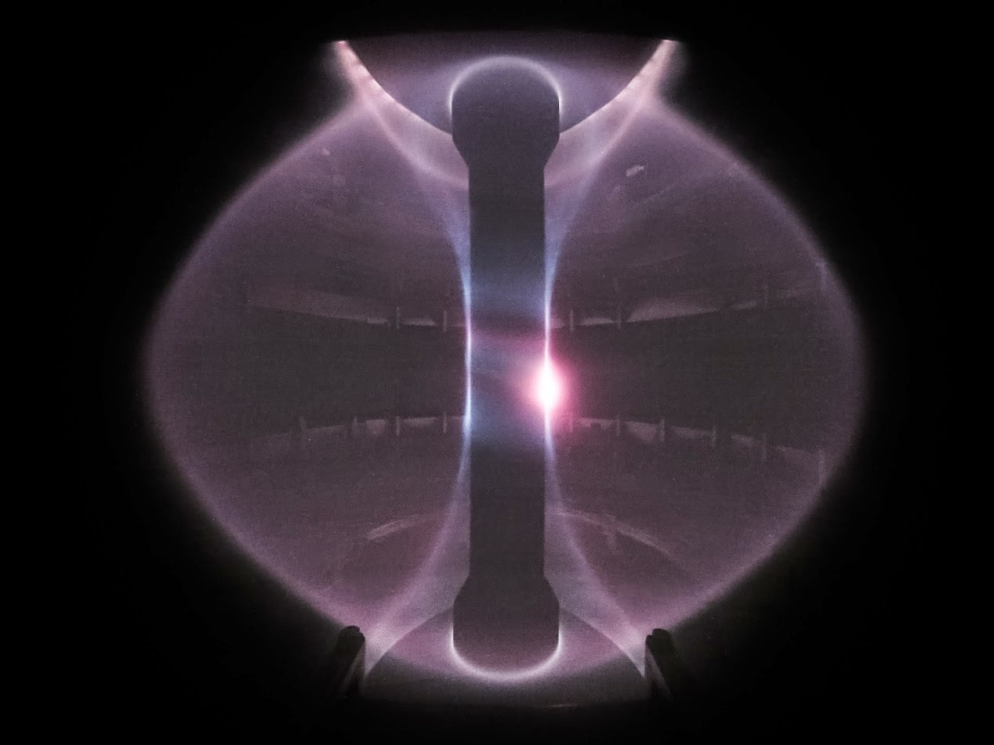
The energy problem
Solutions
  Decreasing energy needs
  Increasing sustainable sources
How?
  Better storage
  Alternative energy sources
  Backup solution: Nuclear fusion!
Source: CCFE

Slide 7
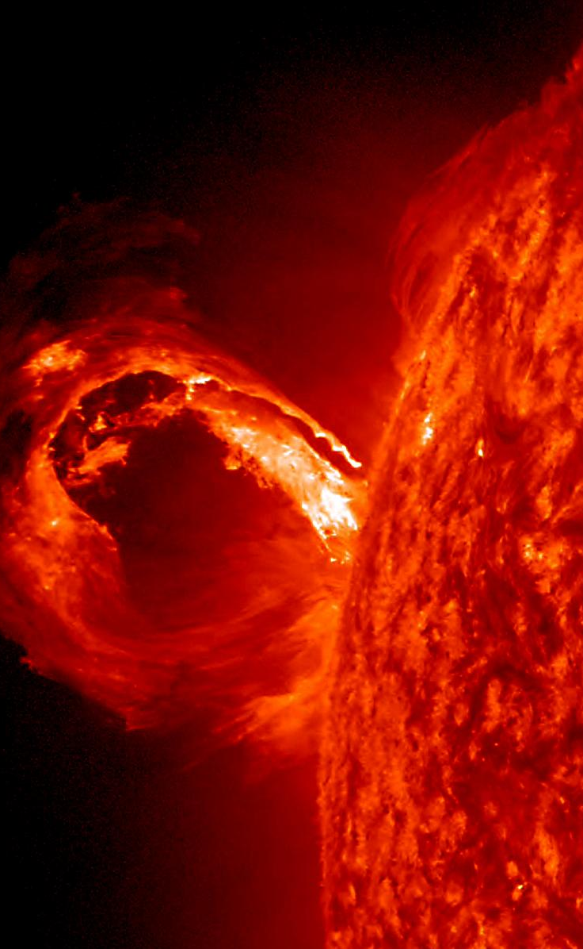
1.2 Fusion inside our own sun
The Sun
  Star
  Held together by gravity
  Immense pressure
  In equilibrium
Gets its energy from fusion!
  Let’s take a really close look!
Source: NASA

Slide 8
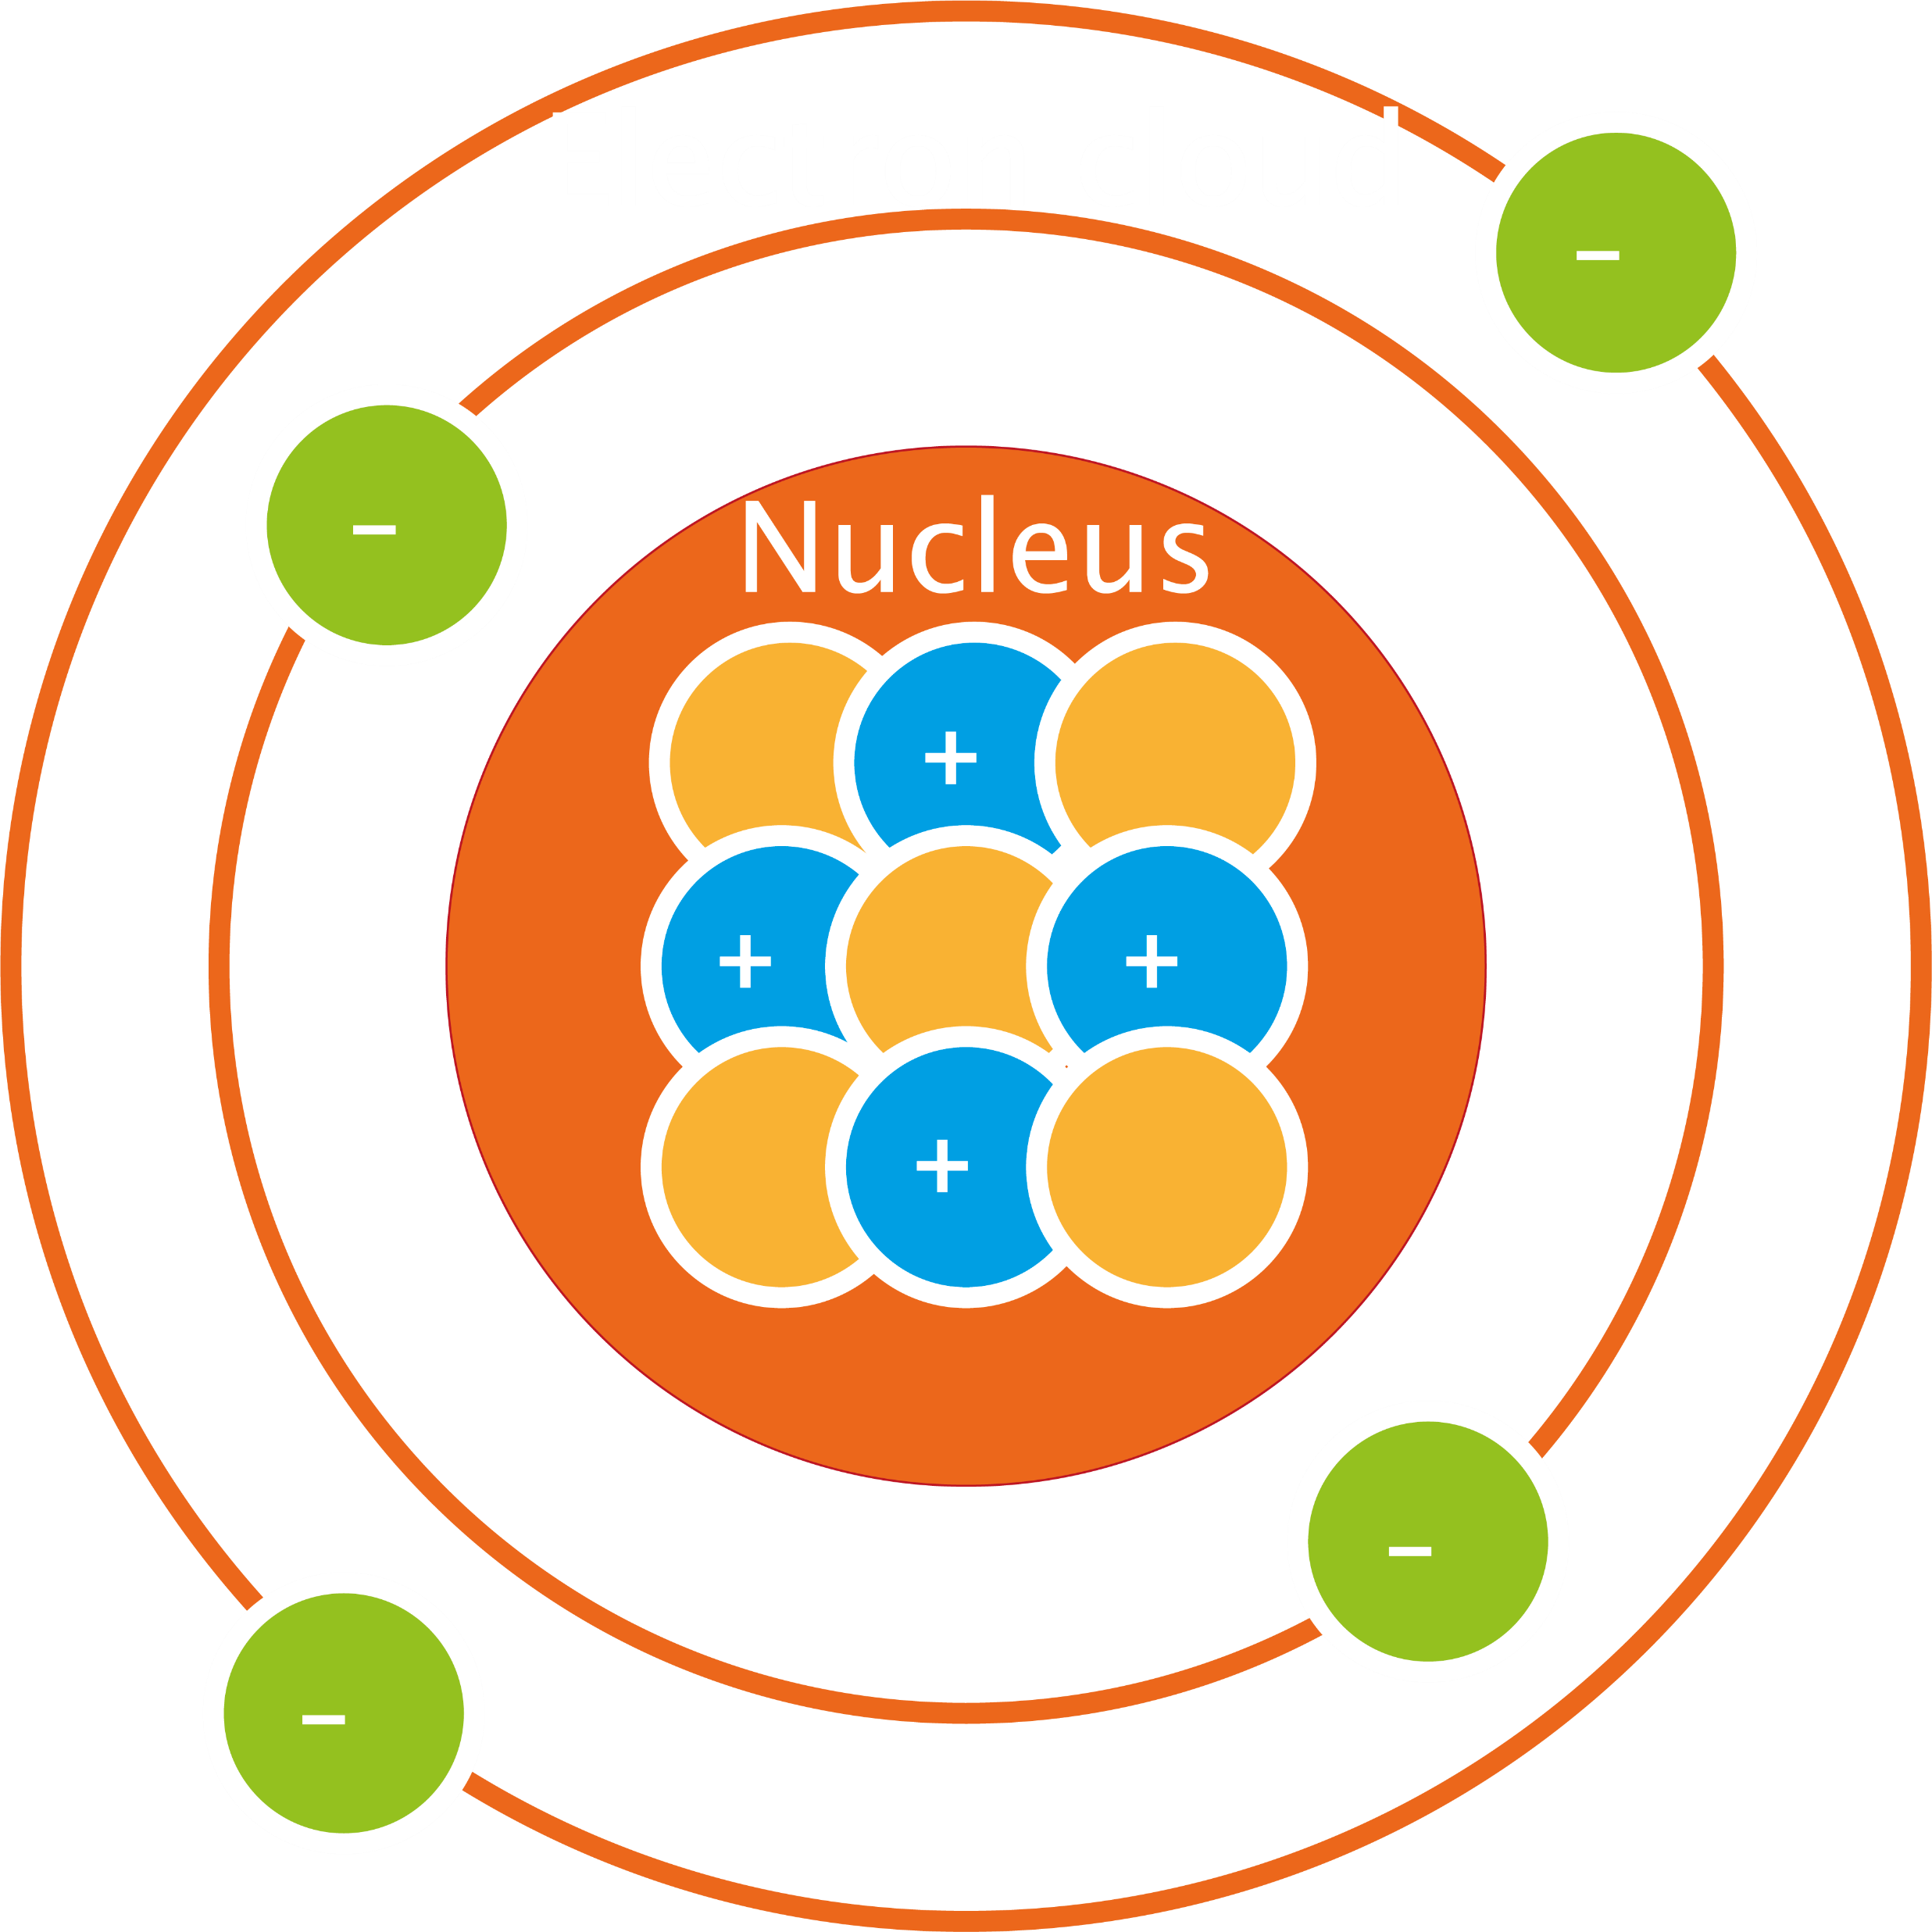
Inside the atom
Nucleus
  Proton: determines which element,
  positive charge
  Neutron: determines which isotope,
  no charge
Electron cloud
  Electron: determines charge/ion,
  negative charge

Slide 9
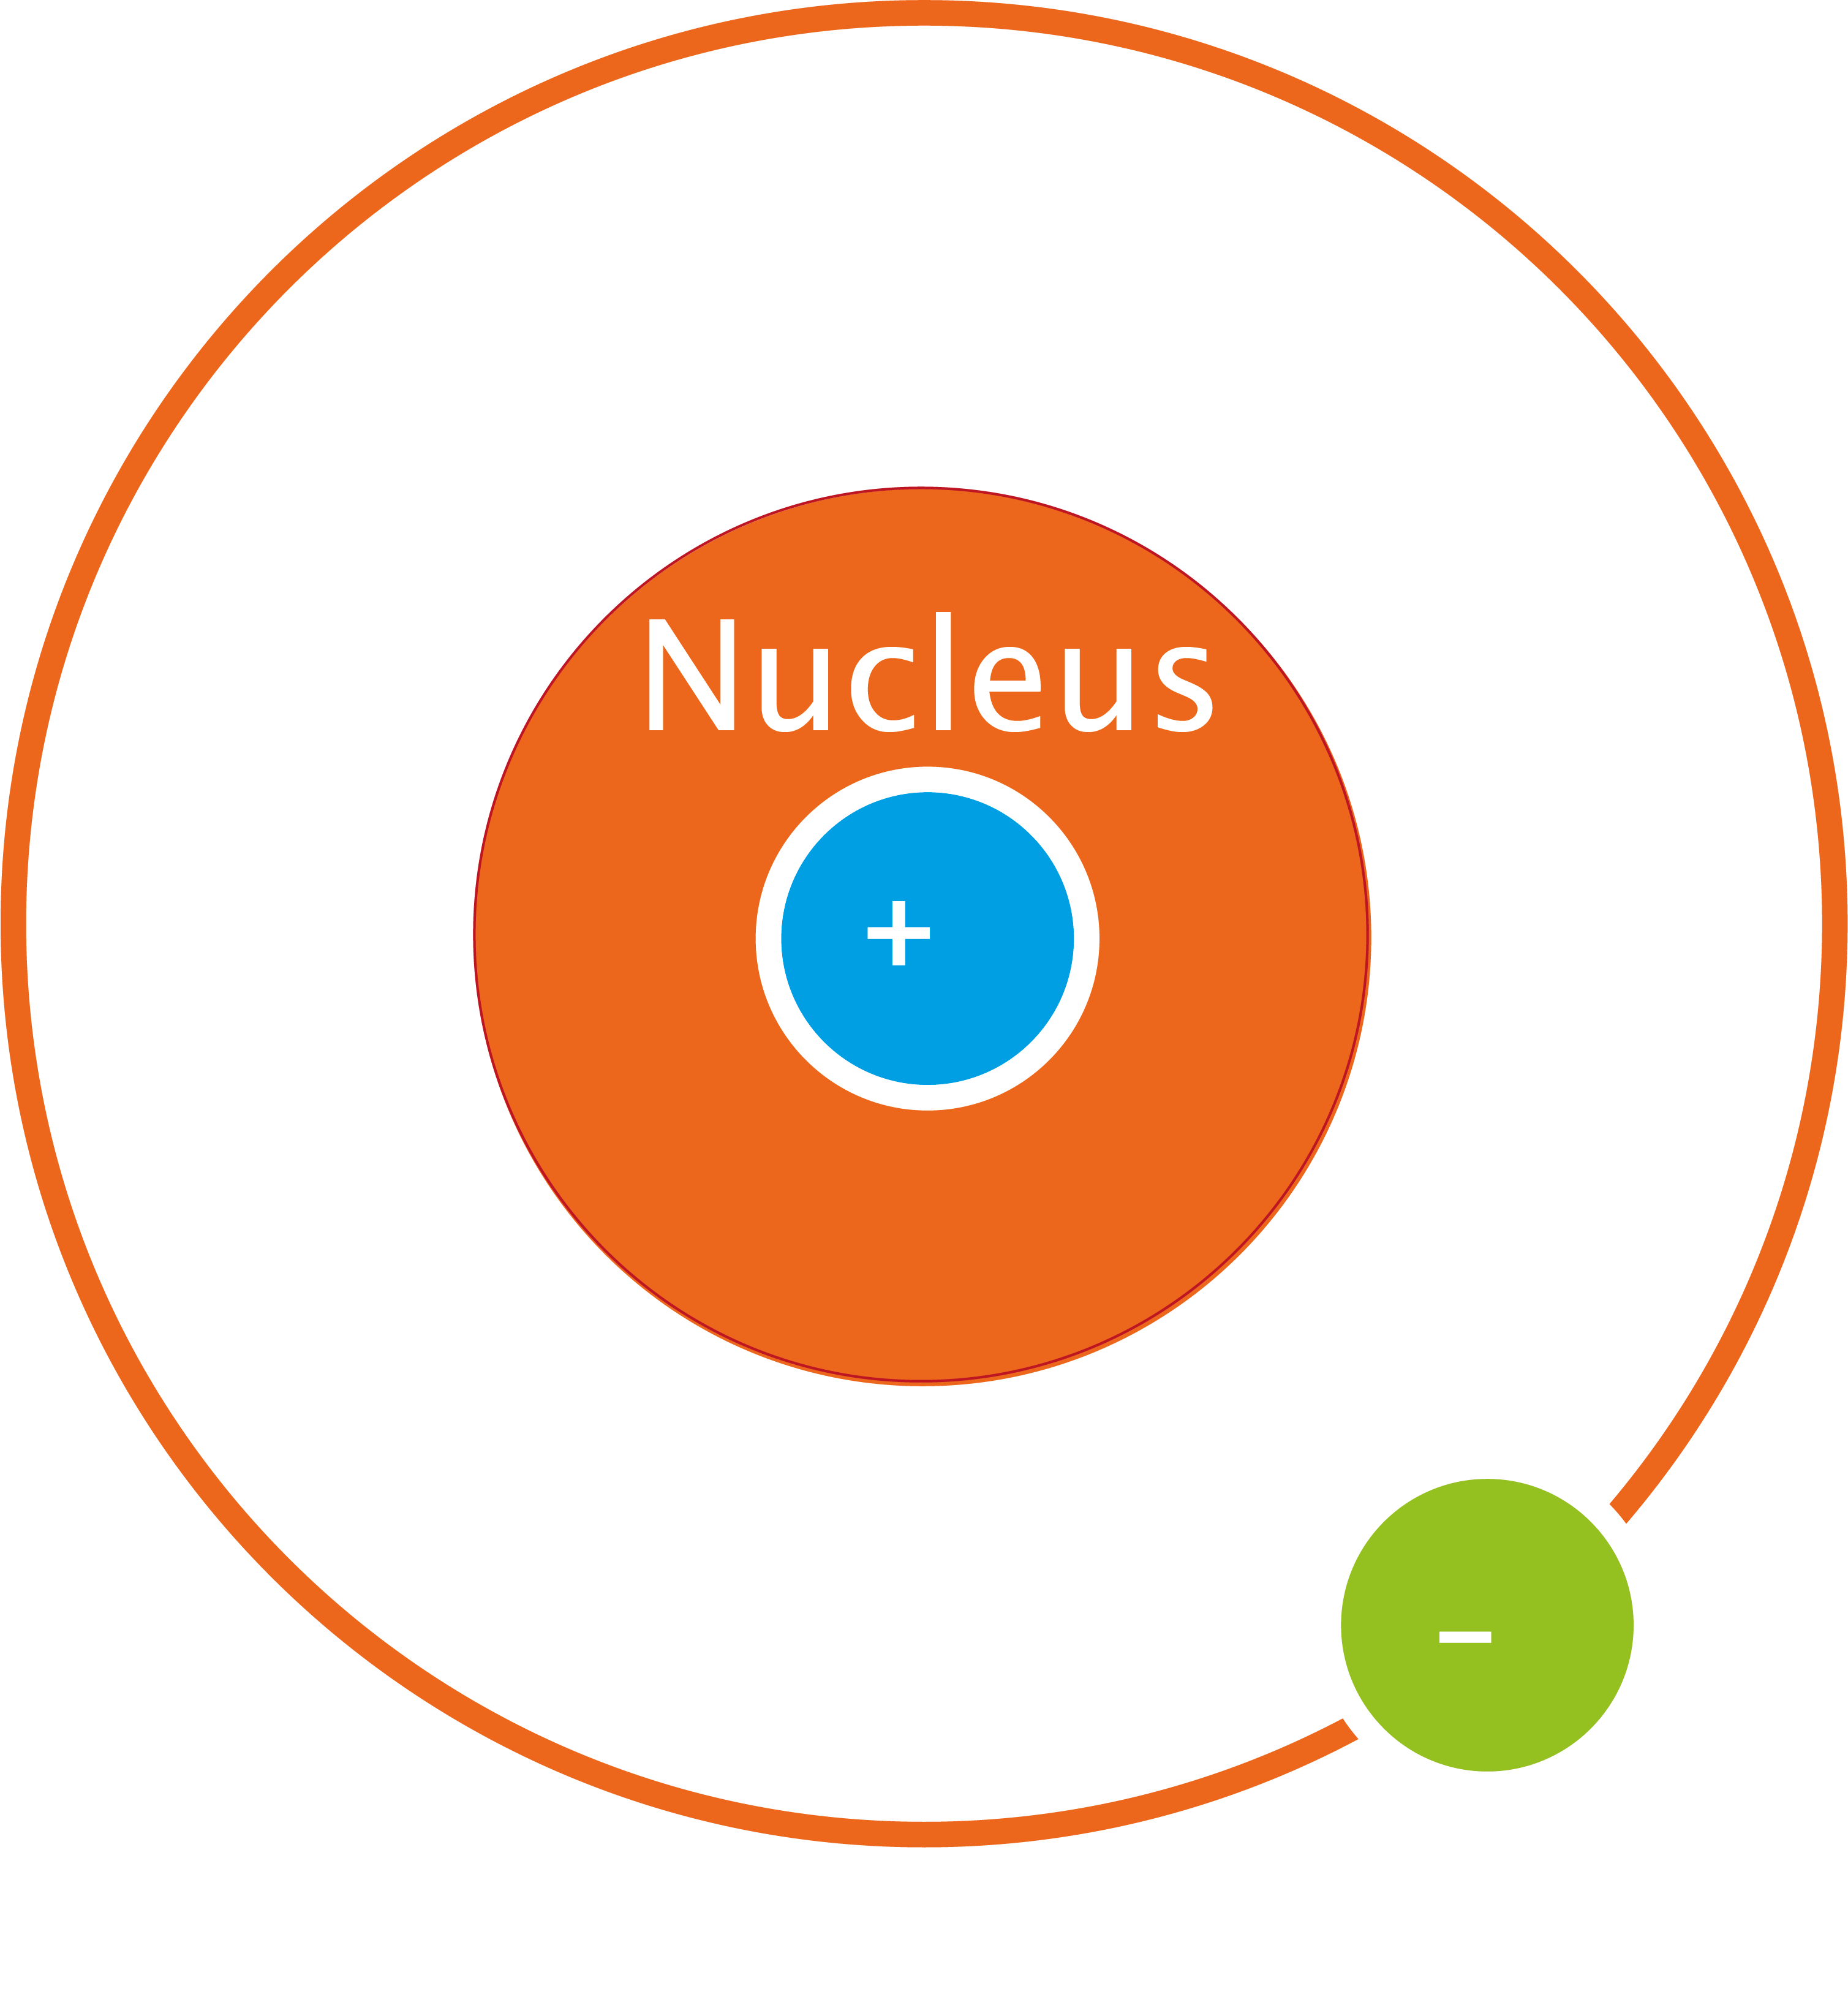
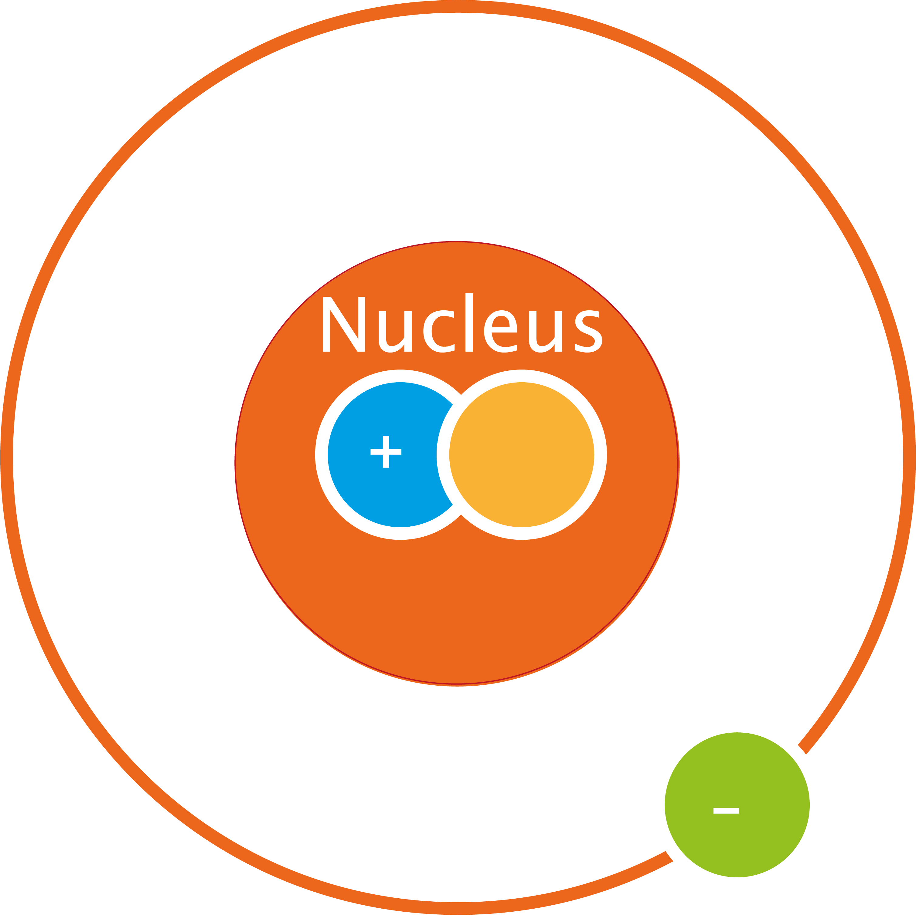
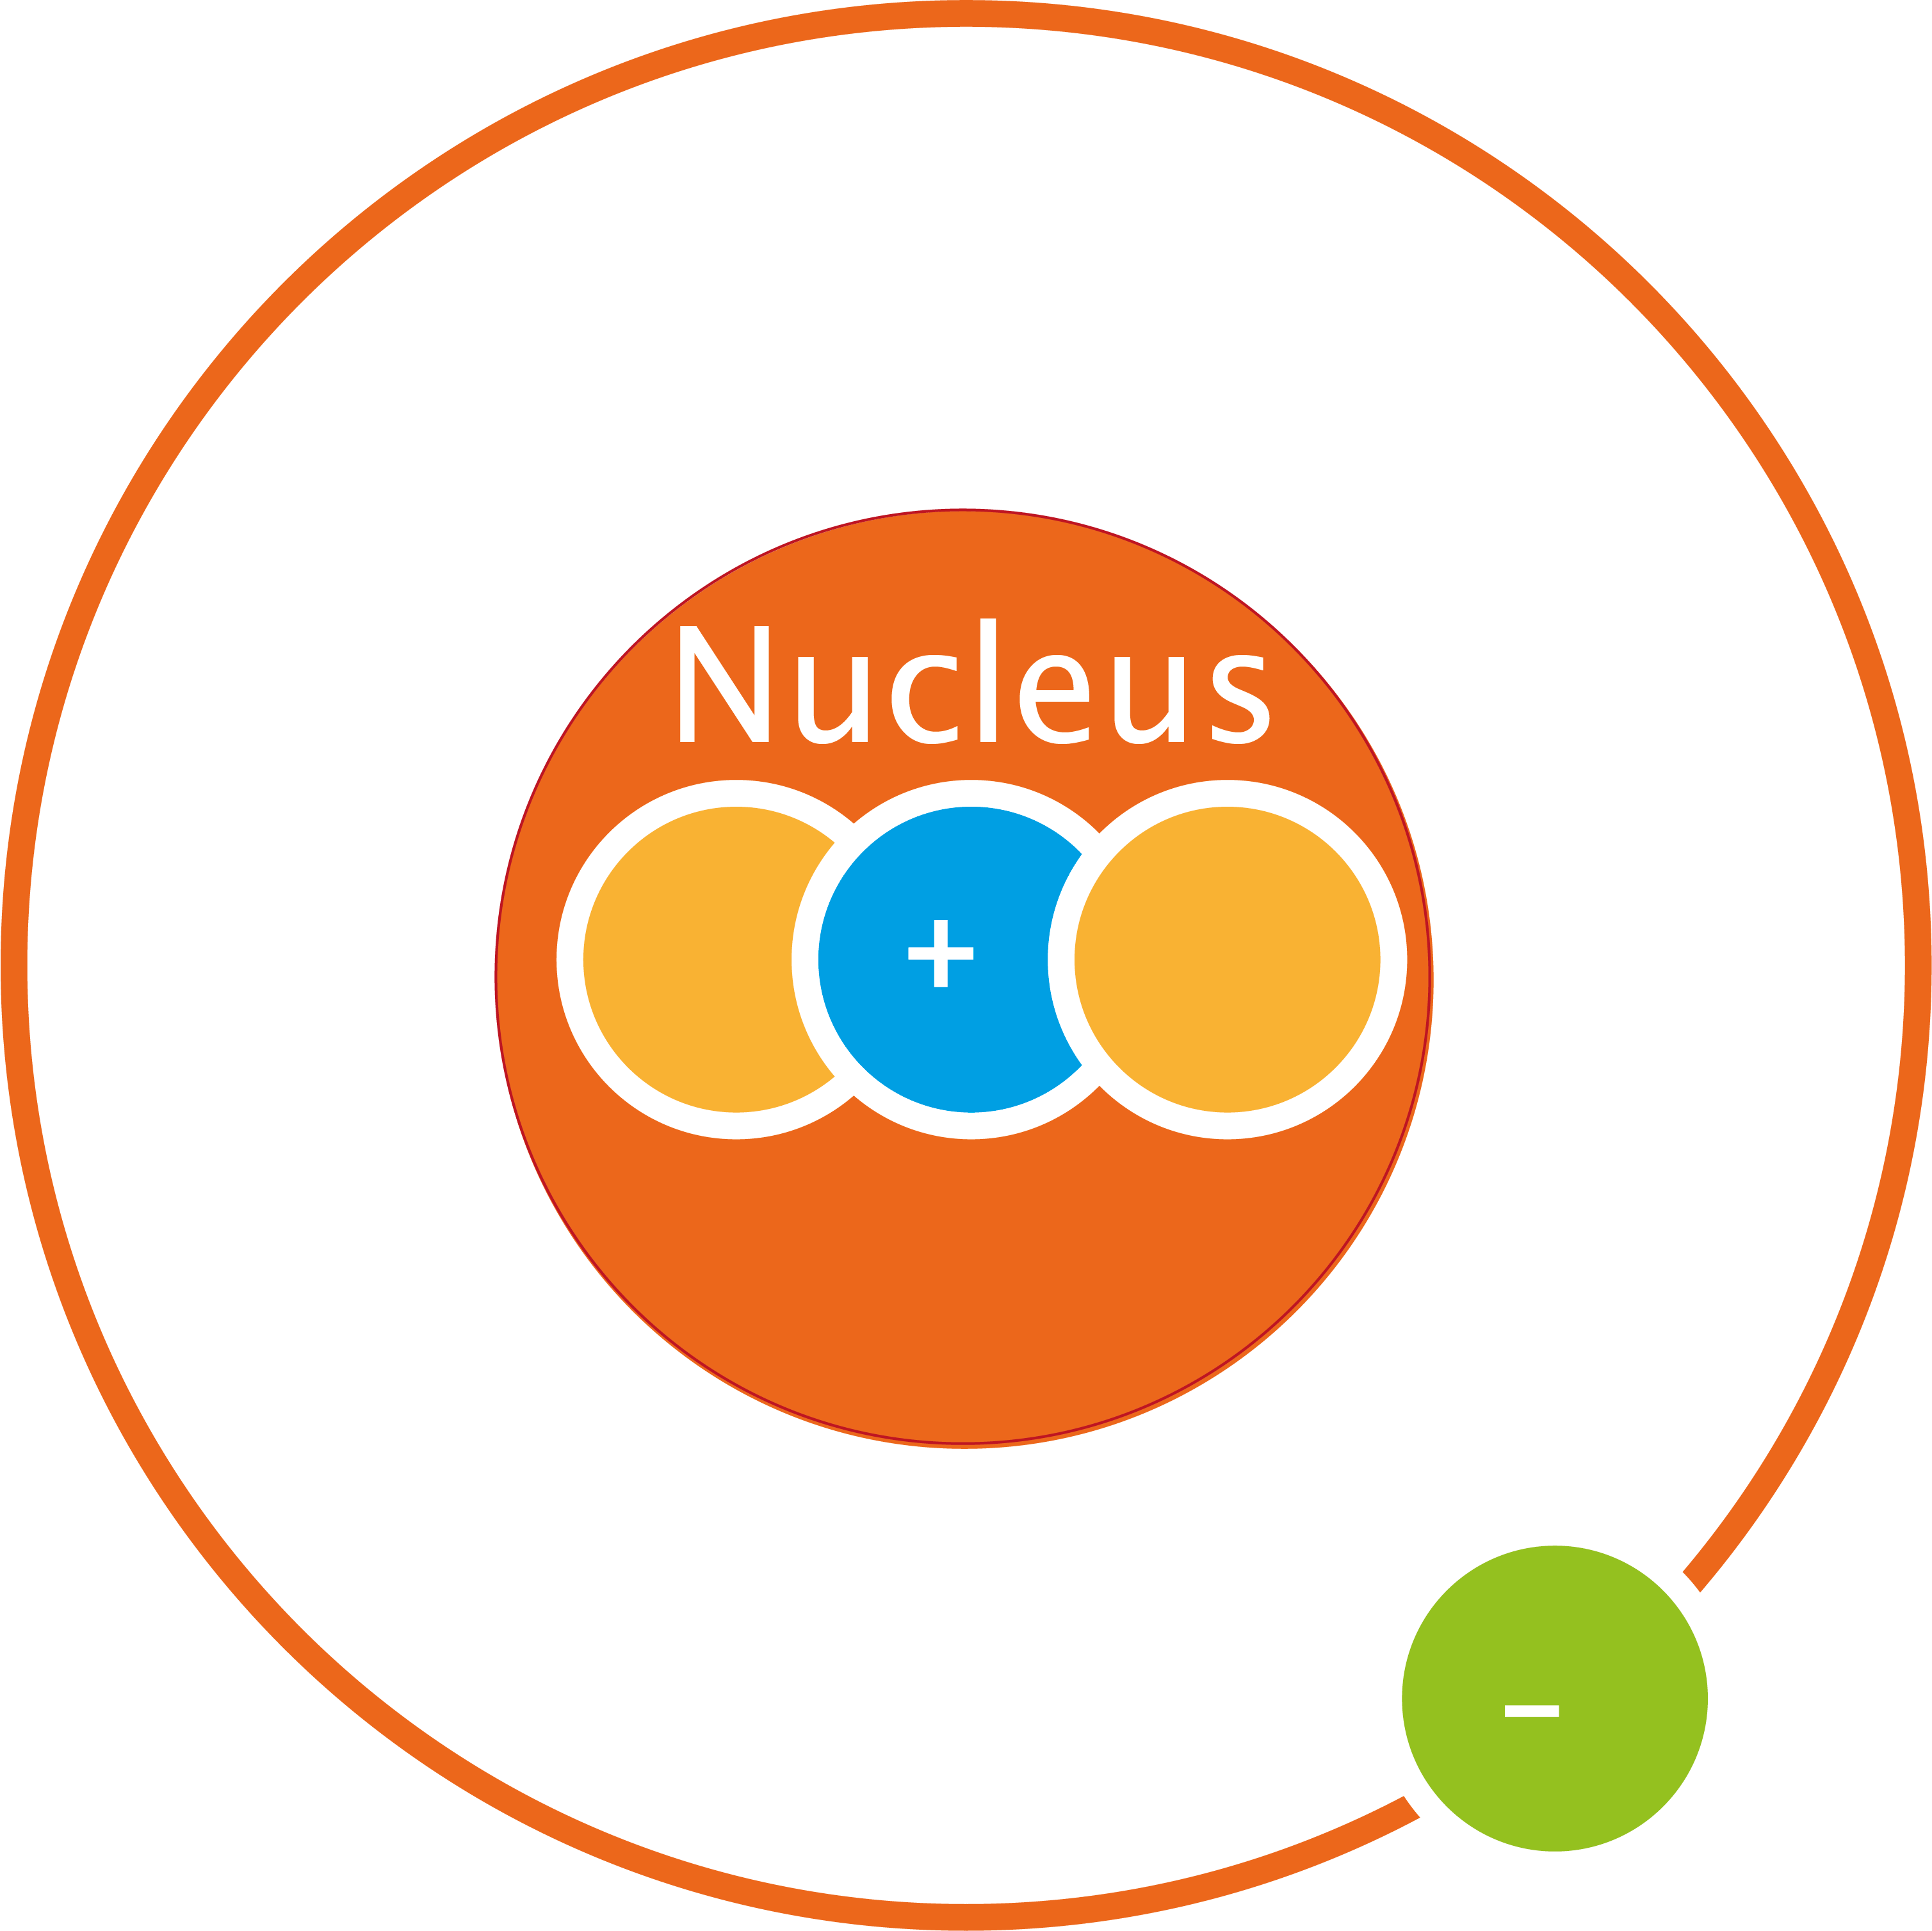
Isotopes
Hydrogen
Deuterium
Tritium

Slide 10
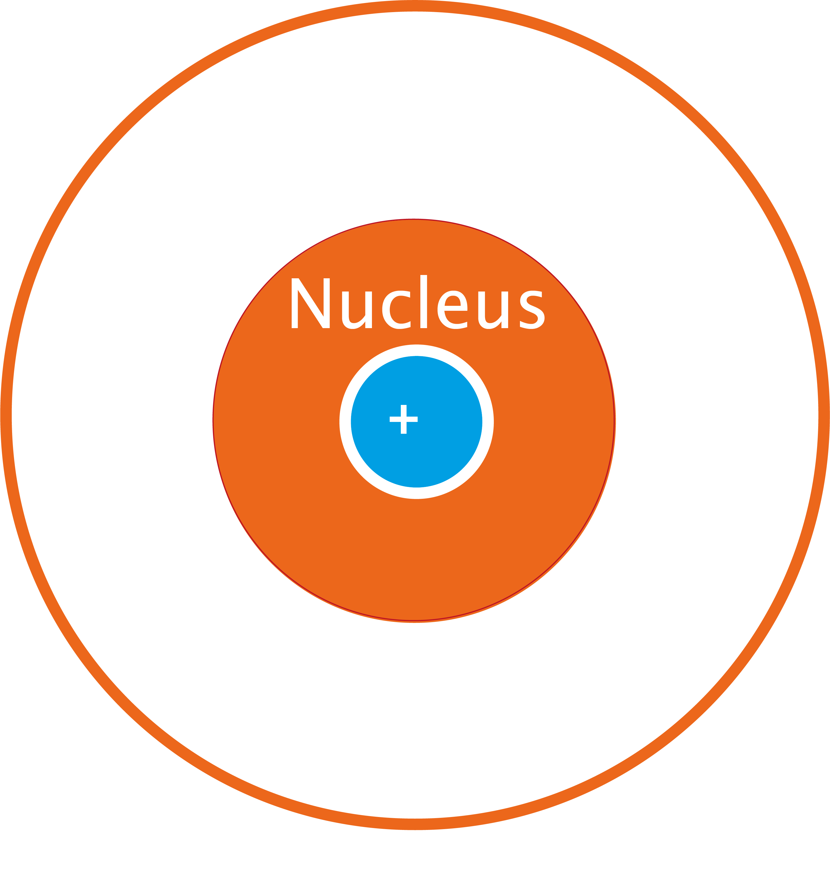
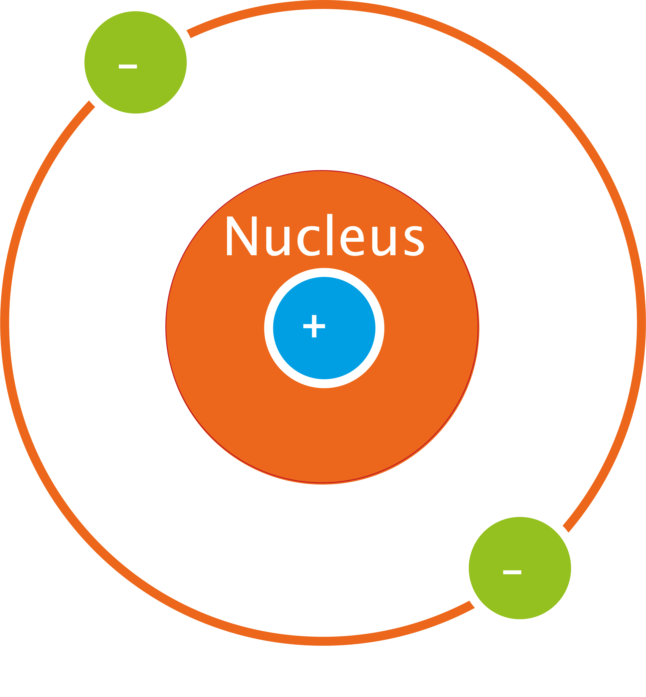
Atoms and ions
Atoms
  Neutral
Ions
  Charged
  Can be positive
H
H⁺
H⁻
or negative

Slide 11

Charge
Charged particles interact with each other
Attraction: (+/-)
Repulsion: (+/+) or (-/-)

Slide 12
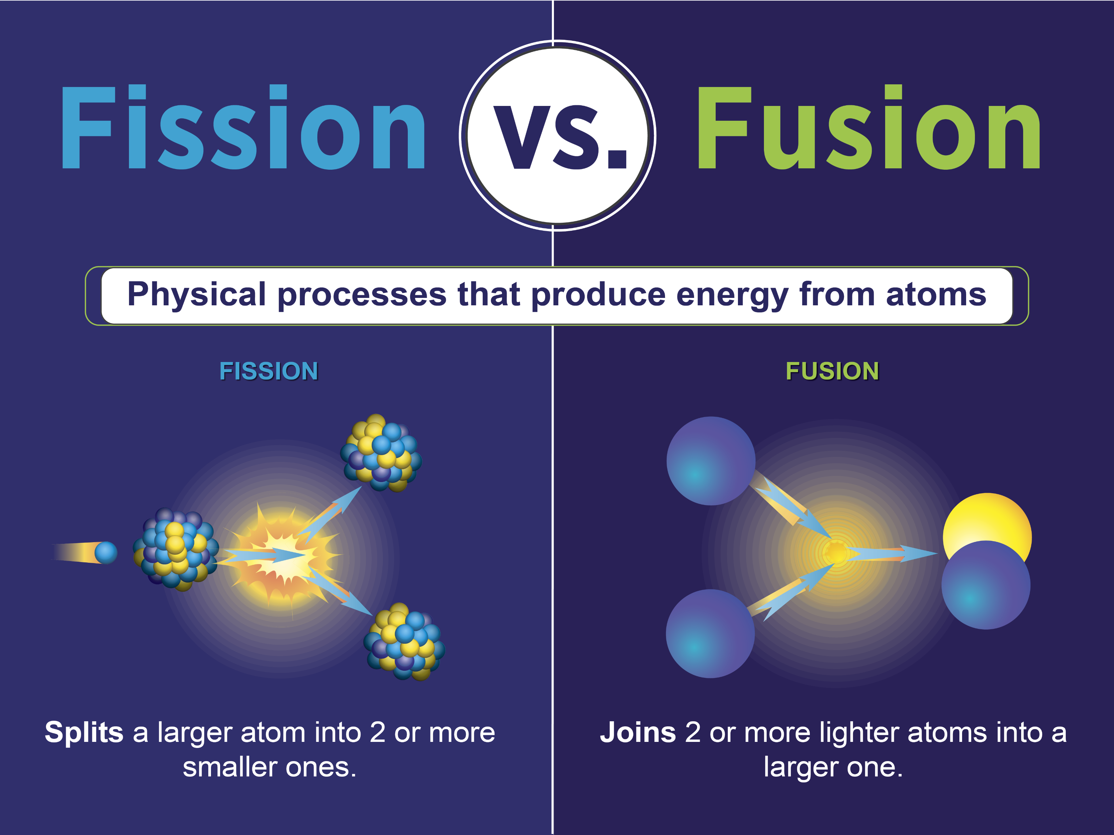
Nuclear reactions
Fission
  One heavy nucleus splits into
  two (or more) parts and
  releases energy
Fusion
  Two light nuclei fuse together
  to form one heavier nucleus
  and release energy
Graphic by Sarah Harman | U.S. Department of Energy

Slide 13

The nuclear fusion reaction
Easiest: D-T fusion
  Deuterium and tritium
  Two isotopes of hydrogen
  17.6 MeV = 0.00000000000282 Joules
  1 amu = 1.661 x 10⁻²⁷ kg
  = 0.000000000000000000000000001661 kg
$${}_{1}^{2}{\text{H}}\text{ +}{}_{1}^{3}{\text{H}}→{}_{2}^{4}{\text{H}\text{e}}+n+17.6 MeV$$
$→$ a lot of energy from two very small particles!

Slide 14
Classroom exercise 1.2
The concept of energy density is an important one in physics and although it sounds difficult, it boils down to “how much energy is inside a certain volume of stuff”. If you burn 1 litre of gasoline and measure the amount of energy that is released (in the form of heat) and divide it by the volume that was burned, then you end up with a measure for the energy density. For all fuels, an energy density can be determined.
Out of the fuels listed below, which one would you guess has the highest energy density? Which one would you guess to have the lowest energy density? Order them from highest to lowest.
Compare your ranked list with the list of at least one other student. Discuss why you placed them in this order.
Look up the energy densities. Compare your ranked lists to the data. Were your estimates close?
Gasoline – oil – coal – wood – hydrogen (gas) – ethanol – Deuterium – Uranium

Slide 15
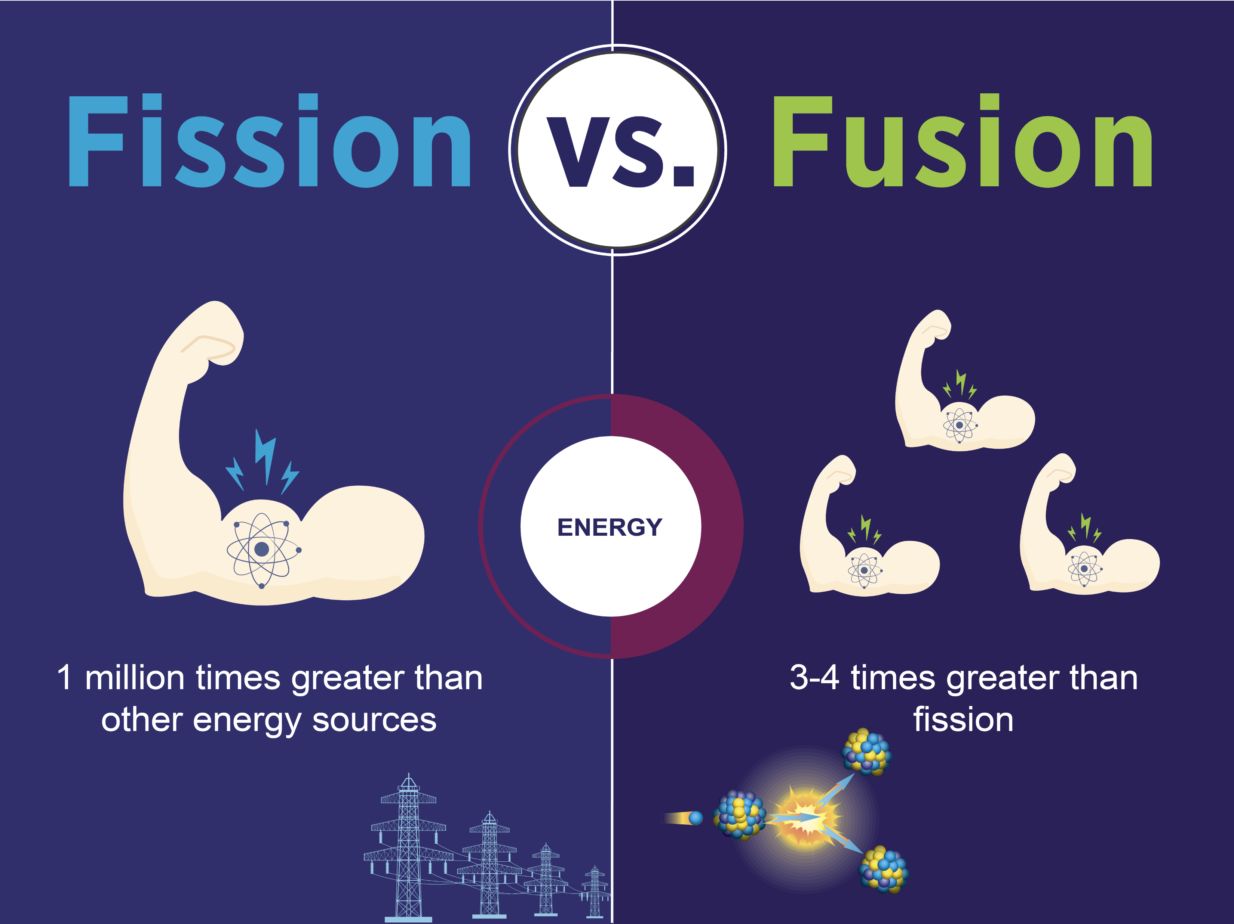
Classroom exercise 1.2 – answers
From high to low:
Deuterium
Uranium
Coal
Oil
Gasoline
Ethanol
Wood
Hydrogen (gas)
Graphic by Sarah Harman | U.S. Department of Energy

Slide 16


Criteria for fusion
We need:
  High temperature
  (= high velocity)
  High density
And:
  Energy confinement time

Slide 17
Criteria for fusion
In the sun: gravity
  Leads to extreme conditions and confines the energy for a long time
On earth: we need another way
  Fusion reactors
  Plasma!

Slide 18
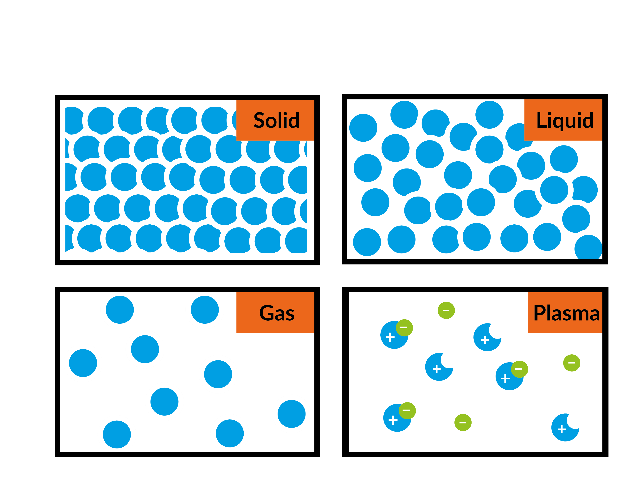
1.3 Plasma
The ‘fourth’ state of matter
Ionised gas
  Contains free moving charges:
    Positive ions
    Negative electrons
  Fully ionised plasma
    If it has only ions and electrons

Slide 19
Ionisation vs phase change
Ionisation
Gas
High pressure and temperature
Breakdown:
bonds within atom break
Condition for breakdown
  Energy higher than ionisation energy
Phase change
Solid/liquid/gas
At specific pressure and temperature
Breakdown:
bonds between atoms break
Condition for breakdown
  Energy higher than
  threshold energy

Slide 20
Plasma conductivity
Plasma consists of freely moving charged particles
Can conduct electricity
  Currents in plasma
Sensitive to
  Electric fields
  Magnetic fields

Slide 21
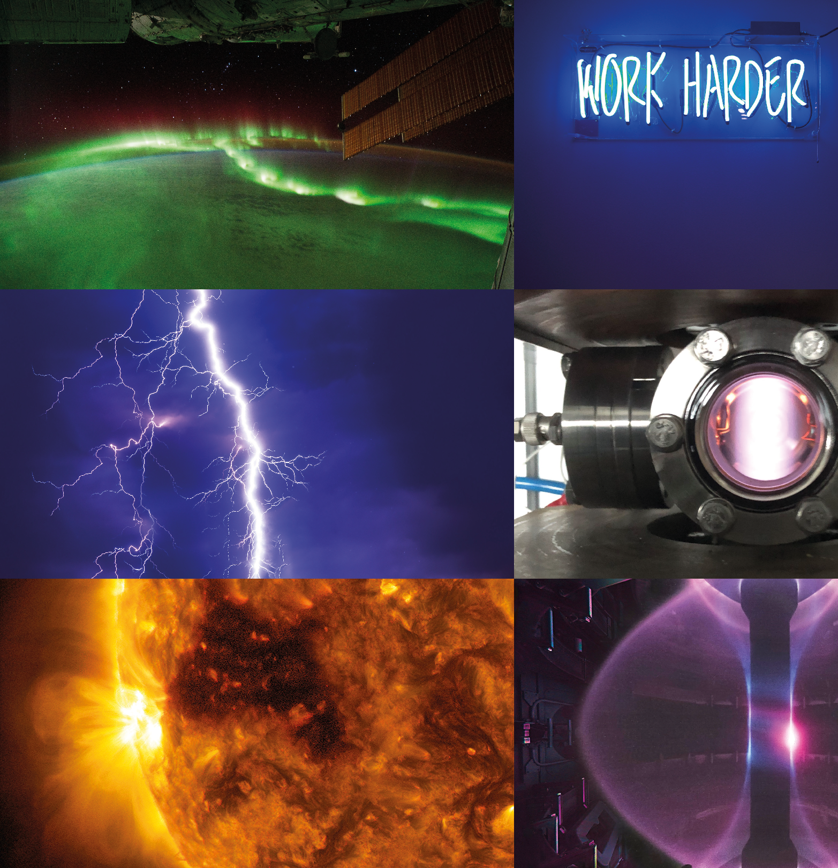
Examples of plasmas
Most common state
of matter in the universe!
Northern lights (Aurora Borealis)
Neon lights
Lightning
Plasma discharge
Sun
Inside a tokamak

Slide 22
Classroom exercise 1.3 – multiple choice
So, the difference between a plasma and a gas lies in the bulk of the particles being charged or neutral. However, most plasmas can be observed to glow, while gases are often colourless and definitely don’t glow. So why do plasmas glow?
At sufficiently high temperature everything will start to radiate, so plasmas naturally glow due to the high temperature.
The charged particles move freely and once a free electron and an ion collide, there is a chance that they recombine. In this recombination process the charged particles combine into a neutral particle and light is emitted. If the emitted light lies in the visible spectrum, the plasma will start to glow.
In some nuclear reactions, light is emitted. If the emitted light lies in the visible spectrum, the plasma will start to glow.

Slide 23
Classroom exercise 1.3 – answer
So, the difference between a plasma and a gas lies in the bulk of the particles being charged or neutral. However, most plasmas can be observed to glow, while gases are often colourless and definitely don’t glow. So why do plasmas glow?
At sufficiently high temperature everything will start to radiate, so plasmas naturally glow due to the high temperature.
The charged particles move freely and once a free electron and an ion collide, there is a chance that they recombine. In this recombination process the charged particles combine into a neutral particle and light is emitted. If the emitted light lies in the visible spectrum, the plasma will start to glow.
In some nuclear reactions, light is emitted. If the emitted light lies in the visible spectrum, the plasma will start to glow.

Slide 24
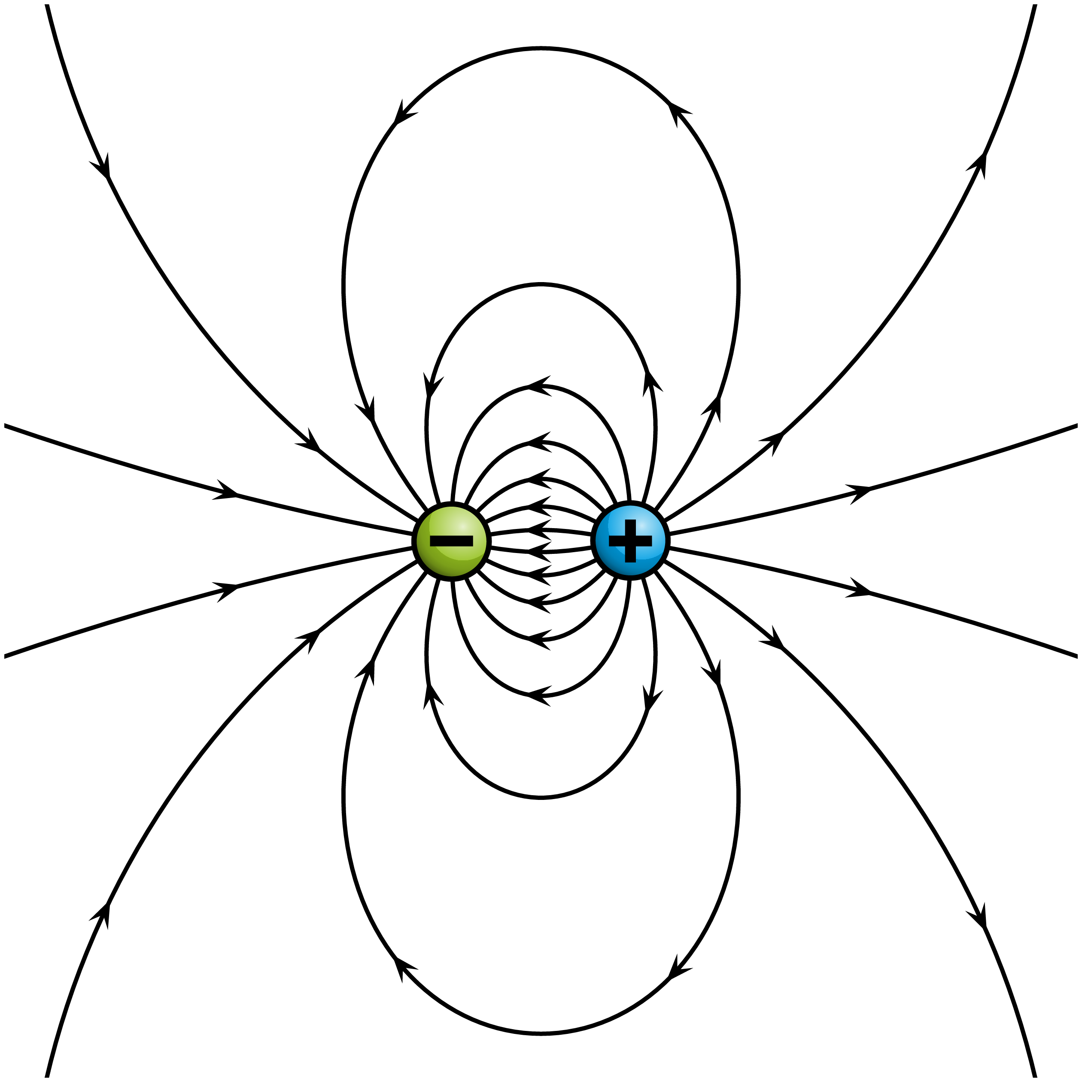
Electric field
Influence of charge on the surroundings
Strong field close to charge
Electric field lines
  Imaginary
  Never cross
  Close = strong!
  From + to -

Slide 25
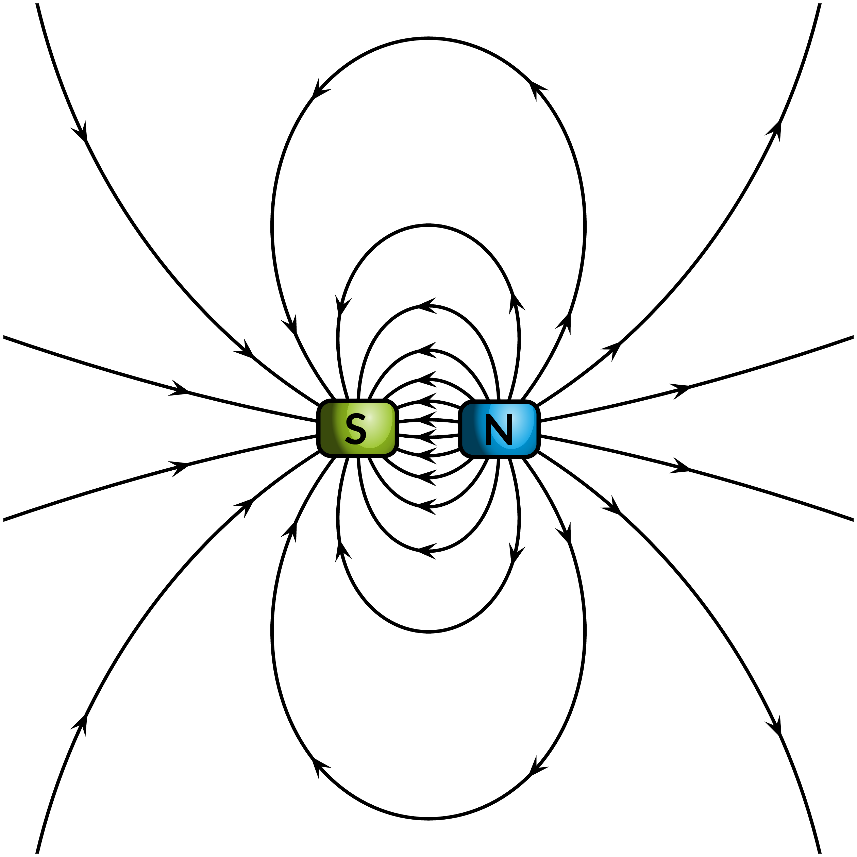
Magnetic field
Influence of charge on the surroundings
Strong field close to poles
Magnetic field lines
  Imaginary
  Never cross
  Close = strong!
  From N to S
  Always closed loops

Slide 26
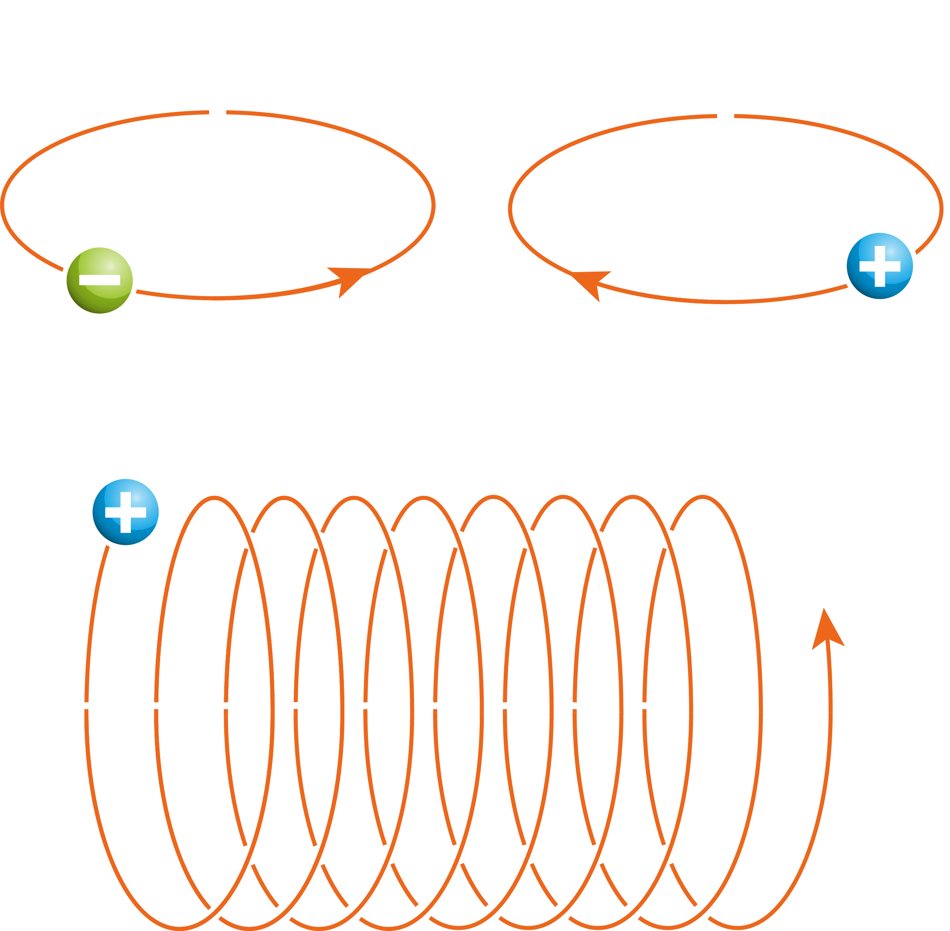
Charges in a magnetic field
Gyromotion
  Charge interacts with magnetic field
  Circular motion around the field line
If particle has velocity in direction of field line:
  Helical trajectory around the field line

Slide 27
Plasma confinement
Why do we need electric and magnetic fields in fusion?
To confine the plasma!
Plasma → high temperature and high velocity particles
If the particles reach the reactor wall, it will melt
We can use a magnetic field to keep the particles away from the wall!

Slide 28
Classroom exercise 1.4
The direction of the magnetic field (that is, the direction of the magnetic
field lines) depends on the direction of moving charges. Draw the direction of the magnetic field by drawing several magnetic field lines for the following situations:
A straight wire through which a current runs.
A circular loop of wire through which a current runs in the anti-clockwise direction.
An electron moving in a circle (clockwise) and a proton moving in a circle (anti-clockwise). Compare this with the directions of question b: what do you notice?
What can you say about the direction of the magnetic field compared to the direction of motion in general?

Slide 29
Classroom exercise 1.4 – answers
The current goes out of the paper.
The magnetic field curls anti-clockwise.
The magnetic field inside the loop is out of the paper
The magnetic field outside the loop is into the paper.
Because of opposite charge and opposite motion the magnetic field has the same direction for both particles
The direction of the magnetic field is always perpendicular to the direction of the current

Slide 30
1.4 Building a fusion device
Magnetic confinement fusion (MCF)
  Confine a plasma with a magnetic field
  Heat the plasma to fusion conditions
Best known type of fusion device:
Tokamak
Russian:
“Toroidal chamber with magnetic coils”
MAST (Mega Ampere Spherical Tokamak) | Source: CCFE

Slide 31

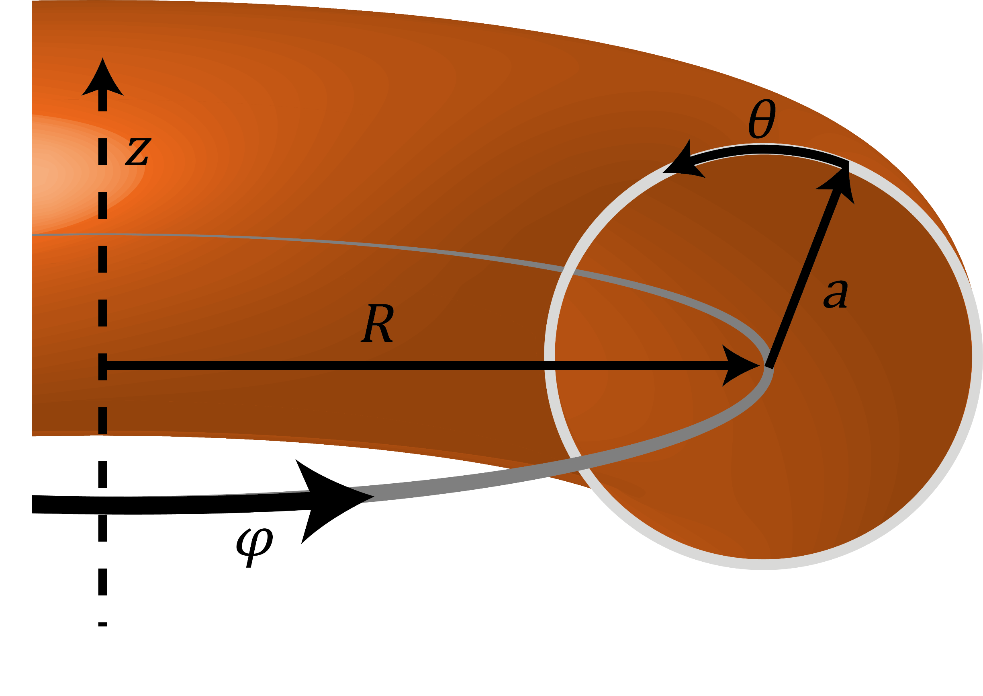
The tokamak
Doughnut shape (torus)
  Inside donut: plasma
  Outside donut: magnetic coils
Geometry
  major radius R
  minor radius a
  poloidal angle θ
  toroidal angle φ
Source: Powerpoint stock image

Slide 32
Classroom exercise 1.5
Different tokamaks and toroidal fusion devices have different ‘aspect ratios’: the ratio between the major radius R and the minor radius a. As a result the shapes of these tori can vary quite a bit. Let’s take a closer look at these different shapes.
Make a sketch of a torus with a large major radius, but with a small minor radius. What does this look like?
Now make a sketch of a torus with a small major radius and a large minor radius. Why is it more difficult to draw?
What would happen if you make the major radius increasingly small while keeping a large minor radius? What shape do you end up with?
Now look at the aspect ratios of the two sketches from (a) and (b).
What happens if the aspect ratio changes?
What is the lowest possible aspect ratio for a torus?

Slide 33
Classroom exercise 1.5 – answers
A doughnut
The doughnut becomes more spherical, the minor radius cannot be larger than the major radius (otherwise it is no longer a torus!)
If we allow the minor radius to be larger than the major radius and take the limiting case we get a sphere
The torus changes shape
The minor radius cannot be larger than the major radius. If they are equal the aspect ratio is at its minimum, so aspect ratio = 1.

Slide 34
Classroom exercise 1.6
As we have seen, there are two main directions on a torus: the “toroidal” and “poloidal” directions. These can be quite confusing, so let’s take a closer look.
Make a sketch of the two possible cross-sections of a torus.
Which cross-section is the poloidal cross-section? Which one is the toroidal cross-section? What do you notice about the toroidal/poloidal direction and their respective cross-sections?

Slide 35
Classroom exercise 1.6 – answers
Poloidal cross-section
Toroidal cross-section

Slide 36
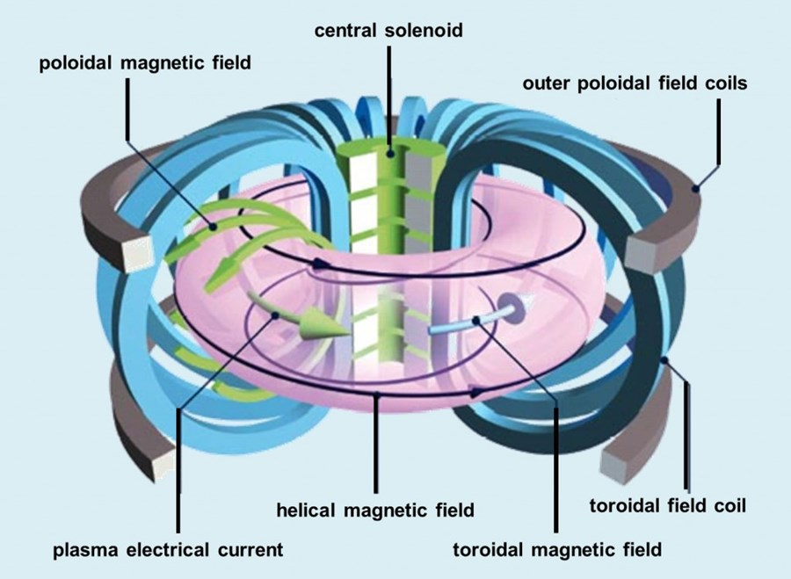
Magnetic coils of a tokamak
Three main magnet systems:
Toroidal field coils
Central solenoid
Poloidal field coils
Credit: S. Li et al. https://tinyurl.com/4ybcpw65 (CC BY 4.0)

Slide 37
Classroom exercise 1.7
Let us take a look at a standard tokamak, focusing on its three
main magnet systems.
Which magnets can be seen
to lie in the poloidal cross section?
How are these magnets called
and does this name make sense?
Explain the names of the other
two groups of magnets.
Credit: S. Li et al. https://tinyurl.com/4ybcpw65 (CC BY 4.0)

Slide 38
Classroom exercise 1.7 – answers
Toroidal field coils – lie in the poloidal cross-section of the tokamak
Central solenoid – lies in the hole of the doughnut, i.e. in the centre
Poloidal field coils – lie at the top and bottom of the torus

Slide 39
Toroidal field coils
Strongest field in tokamak
D-shaped
Wrap around doughnut
Additional magnetic fields needed
for stable confinement
Credit: ITER

Slide 40
Central solenoid
Stacked set of coils located in the hole of the doughnut
Field used indirectly:
magnetic induction to create a current in the plasma
This current creates a poloidal magnetic field
Toroidal + poloidal field → helical magnetic field
Helical field necessary for stable confinement

Slide 41

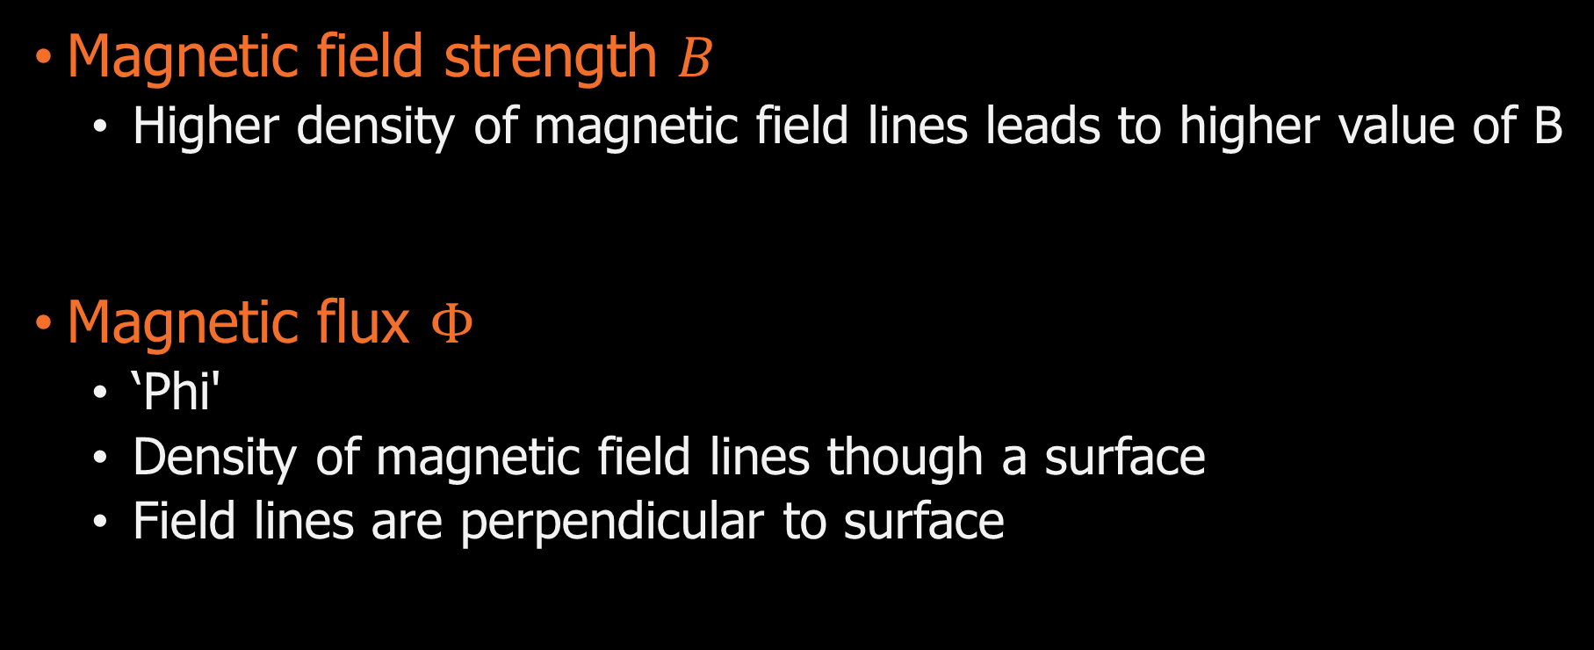
Magnetic properties
Magnetic field strength $B$
  Higher density of magnetic field lines leads to higher value of B
Magnetic flux $Φ$
  ‘Phi'
  Density of magnetic field lines though a surface
  Field lines are perpendicular to surface
$$Φ=B∙A \text{cos}\text{(}α)$$

Slide 42
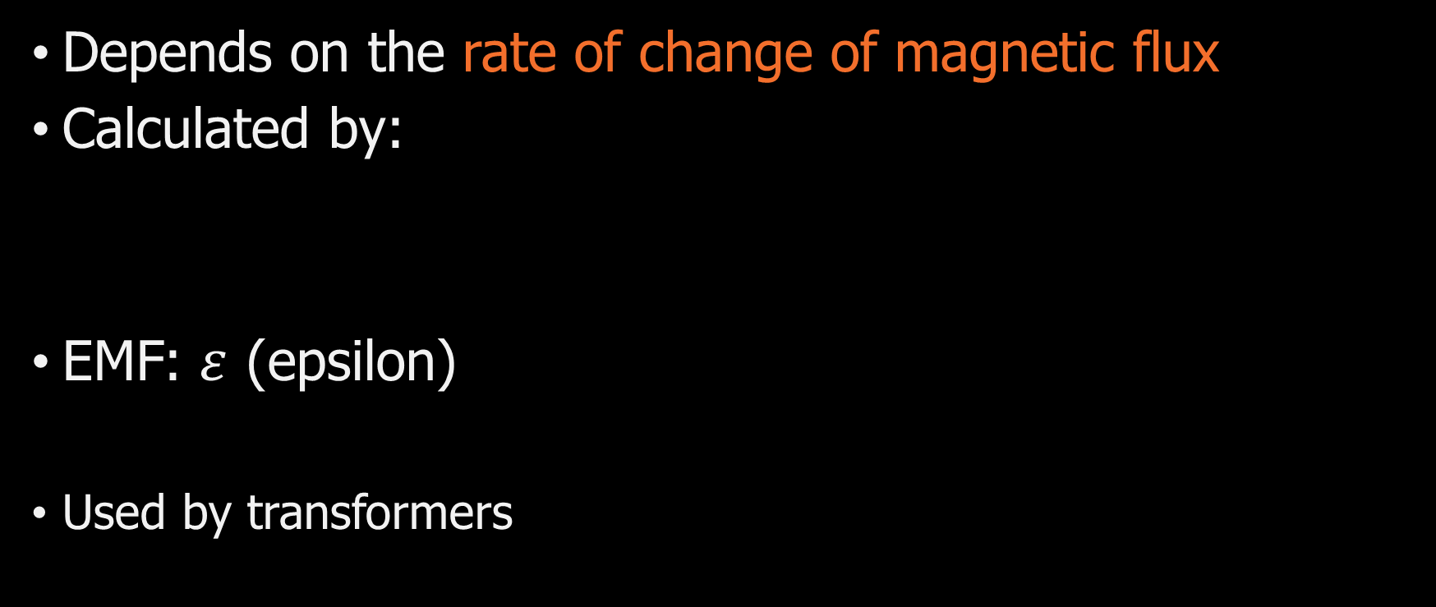

Electromotive force (EMF)
Depends on the rate of change of magnetic flux
Calculated by:
EMF: $ε$ (epsilon)
Used by transformers
$\text{Number} \text{of} \text{windings} \text{of} \text{the} \text{coil} ×\text{change} \text{in} \text{magnetic} \text{flux}$
$$ε=N∙−\frac{\text{d}Φ}{\text{d}t}$$

Slide 43
EMF & Magnetic induction
EMF counteracts the change in magnetic flux
  Creating a voltage
  Voltage creating current
  Current creating opposing magnetic field
  So an opposing magnetic field is induced by the EMF:
  Magnetic induction
This way, varying current through one loop can induce a current in another loop when the loops are not connected!

Slide 44
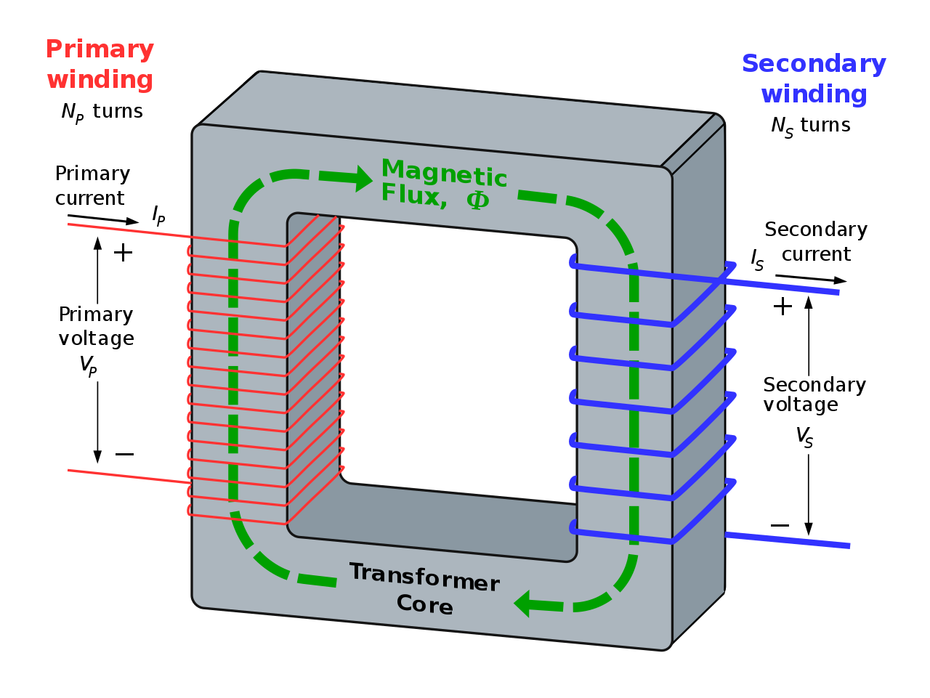

Transformers
Consist out of two coils
  Primary coil
  Secondary coil
  Different amount of windings
  Uses magnetic induction
Ideal transformer
  No power loss: P_{coil1} = P_{coil2}
Remember!
$$\text{Power} = \text{V}\text{oltage} × \text{Current} \\ \text{P} \text{= }\text{V} × \text{I}$$
Credit: By BillC at the English-language Wikipedia, CC BY-SA 3.0, https://tinyurl.com/ye55fpxv

Slide 45
Poloidal field coils
Help control the shape and position of the plasma
  Necessary to keep plasma stable
So not used to create a poloidal
field!
(Central solenoid creates poloidal
field through magnetic induction)
Credit: S. Li et al. https://tinyurl.com/4ybcpw65 (CC BY 4.0)

Slide 46
Classroom exercise 1.8
The use of induction to generate a plasma current
which creates our poloidal field has one major drawback:
it makes a tokamak a pulsed device.
How does magnetic induction lead to pulsed operation?
Why is this a problem for a fusion reactor?

Slide 47
Classroom exercise 1.8 – answers
Induction depends on a change of the magnetic flux.
The magnetic flux cannot keep changing continuously, at some point the magnets are at their limit.
Hence, the central solenoid operates in pulses, leading to pulsed operation
Ideally, a fusion reactor runs non-stop. If it is pulsed, there are times in which no energy is generated

Slide 48
Magnetic confinement
Pressure balance in tokamak
  Outward pressure: plasma
  Inward pressure: magnetic field
  → Lorentz force!
  Equilibrium!
  Allows for fusion on Earth!

Slide 49
Want to learn more about fusion?
Have a look at the other 4 modules!
Module 2: Road to fusion
Module 3: Plasma control
Module 4: Fusion materials
Module 5: Fusion deployment
Or look at ‘Further reading’ in the student reader

Slide 50

This module has been written as part of the FuseNet educational materials for secondary school and can be found in the FuseNet educational materials browser: https://fusenet.eu/education/materials
For more information, see https://fusenet.eu
Created by: Sander Korteweg
Chief editors: Sjoukje Tijmensen-Hoekstra, Sander Korteweg

