Slide 1
Motions of fast ions during a sawtooth reconnection in the core of a tokamak plasma
Fabien Jaulmes
CPP-HT, DIFFER, Netherlands

Slide 2
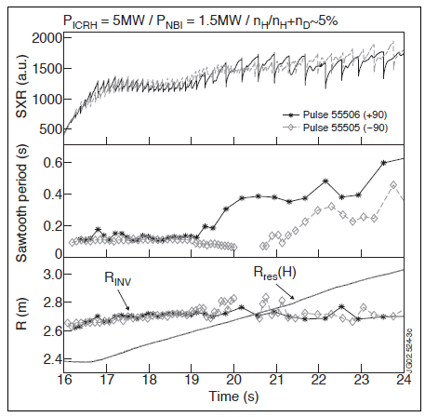
Overview of the talk
Sawtooth collapse
Orbits of fast ions
Energy study
Sample burning plasma
M.J. Mantsinen et al., Proceedings of the 17th Topical Conference on Radio Frequency Power in Plasmas, (Clearwater, Florida, USA, 7-9th May 2007

Slide 3
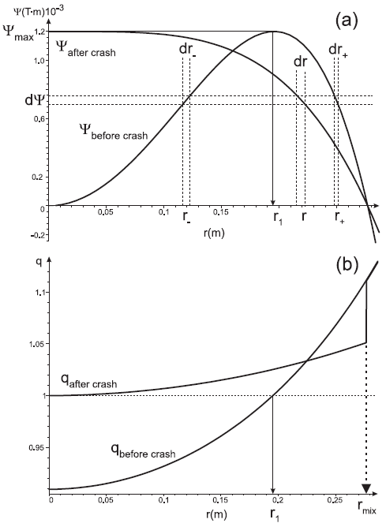
The sawtooth collapse
Kadomtsev reconnection
Around the q=1 surface, in a narrow resistive layer, the reconnection of flux surfaces begins to occur
This narrow current layer is pushed up to the mixing region
Volume conservation during the reconnection of identical helical flux values
dV=dV₊+dV₋

Slide 4
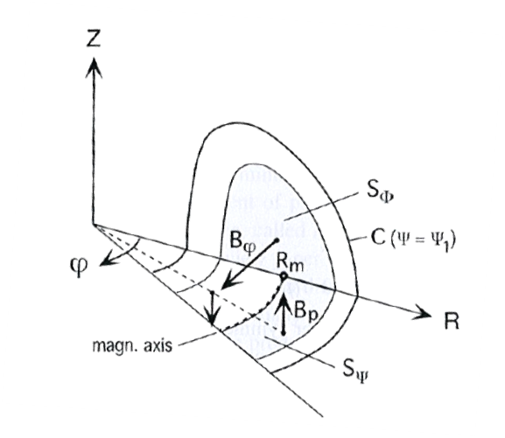
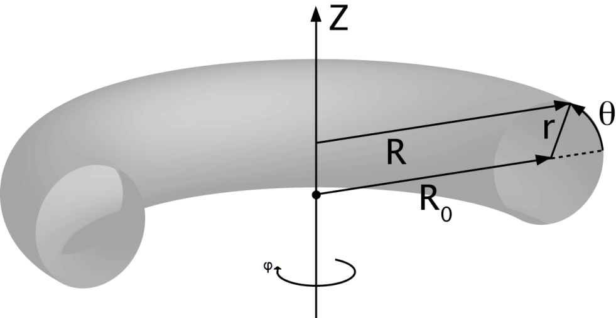
Magnetic confinement in a torus
Equilibrium description with FINESSE
CIEMAT wiki
Ψ
J.P. Goedbloed, R. Keppens, S. Poedts
Advanced Magnetohydrodynamics
F=RB_{φ} ; P ; n ; u_{φ}
flux surface quantities

Slide 5
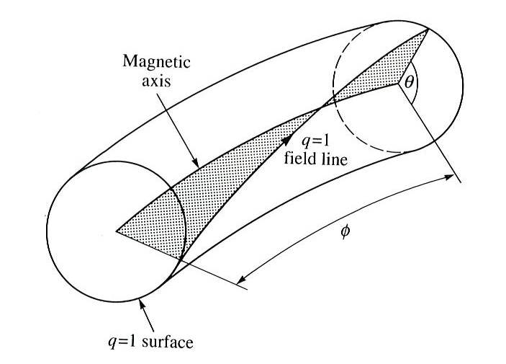
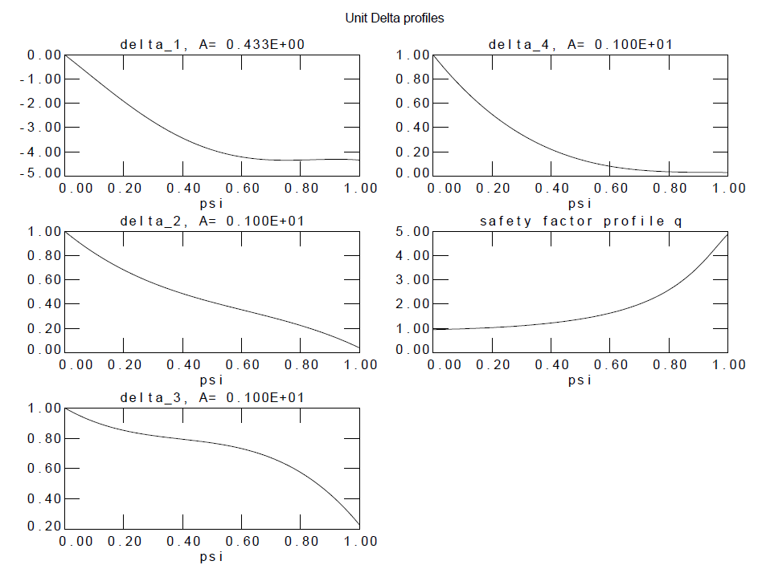
Magnetic confinement in a torus
Equilibrium description with FINESSE
u_{φ}/u_{φ0}
F²-F₀²
J. Wesson
Tokamaks
q
Ψ*
P/P₀
…and poloidal angle grid θ(X,Z)
n_{e}/n_{e0}

Slide 6
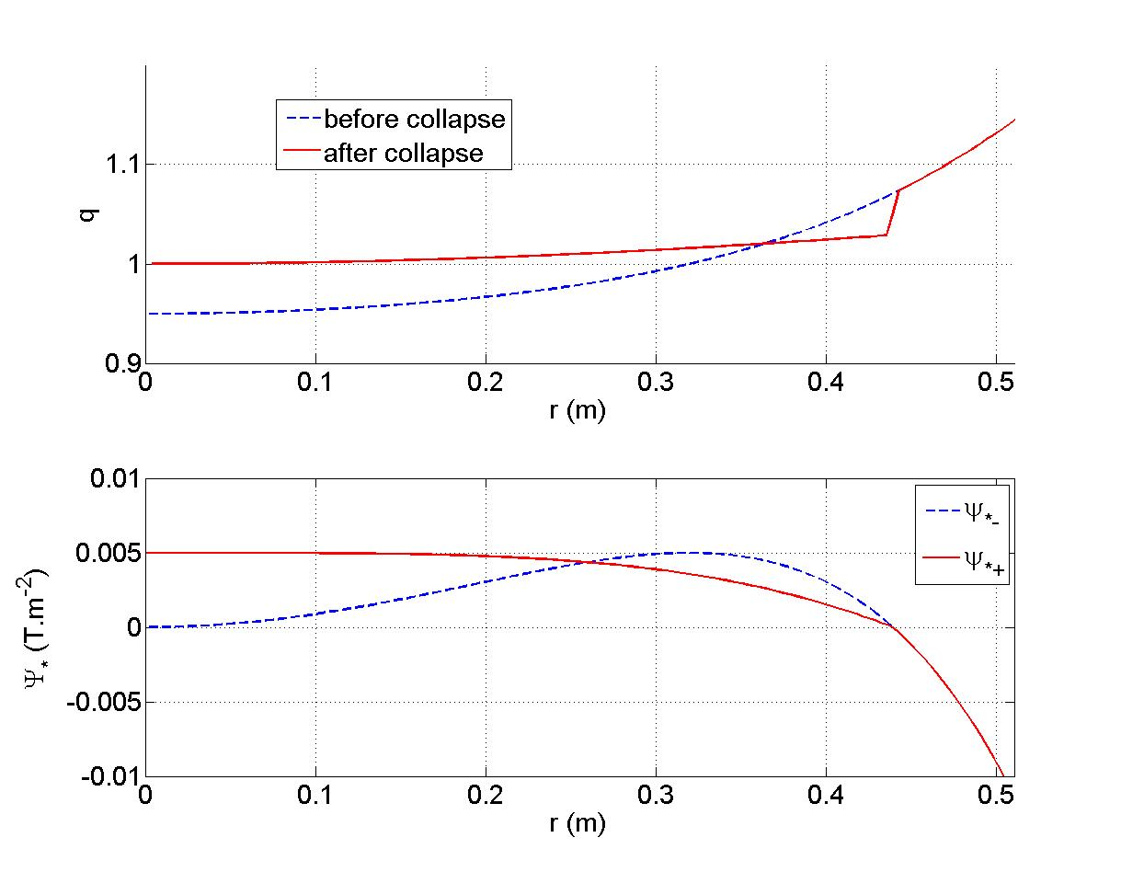
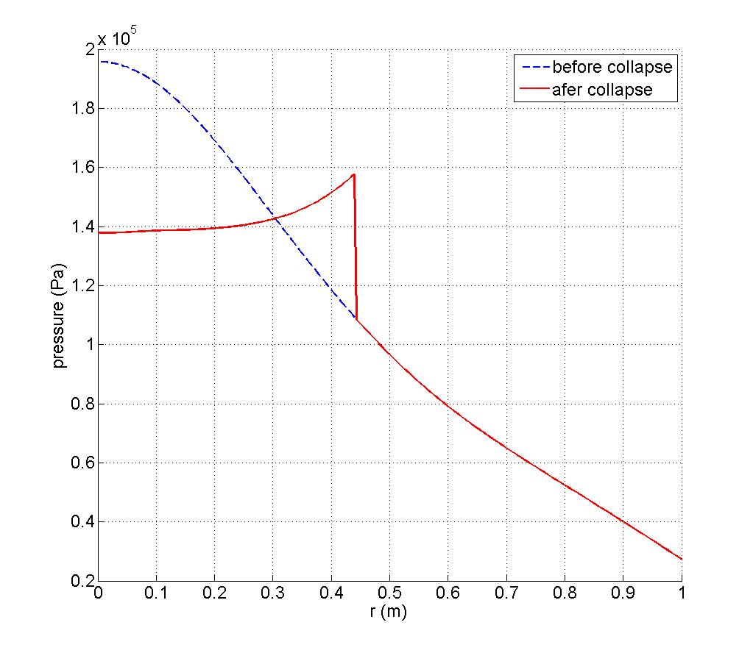
Global collapse illustration
Kadomtsev: no current diffusion, sharp discontinuities
q
P
Ψ*

Slide 7
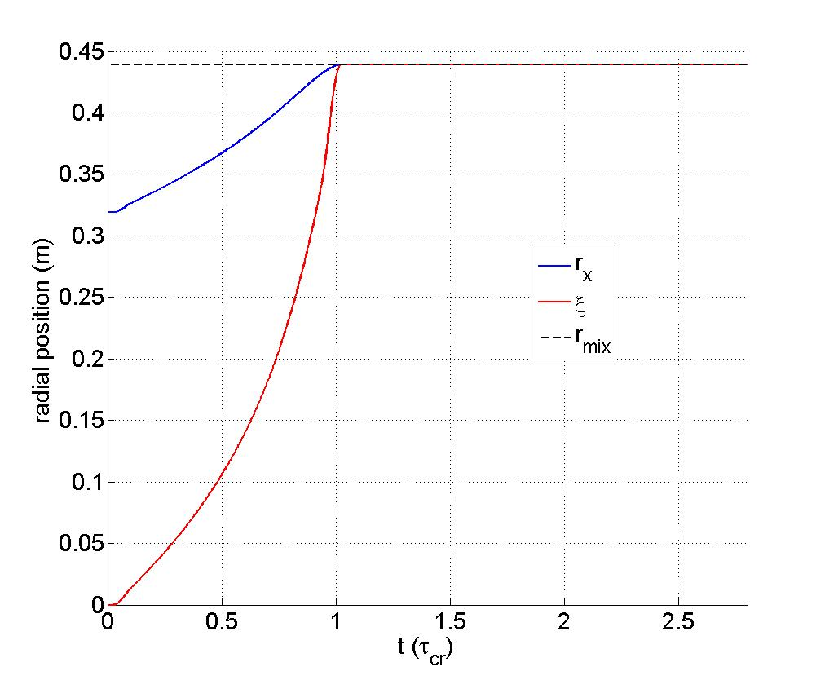
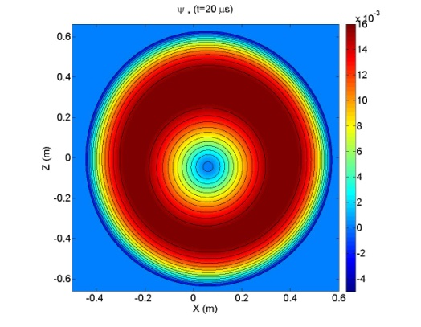
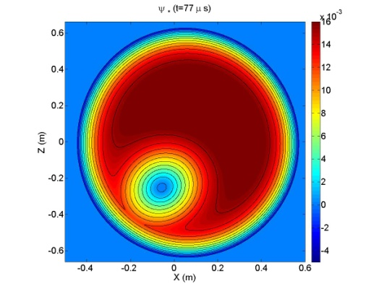
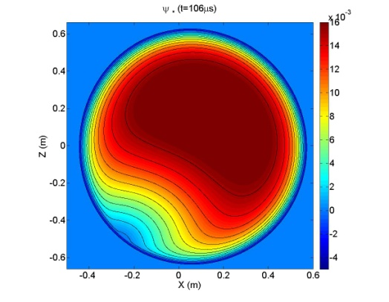
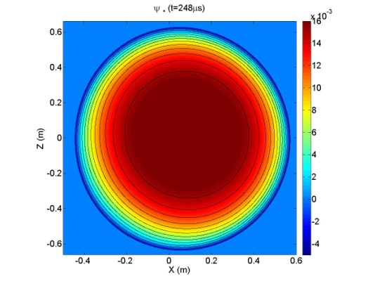
Dynamical evolution
3D mapping of the collapse
Ψ*
A
r_{x}
B
A
ξ
Ψ*
B
A two-step process

Slide 8
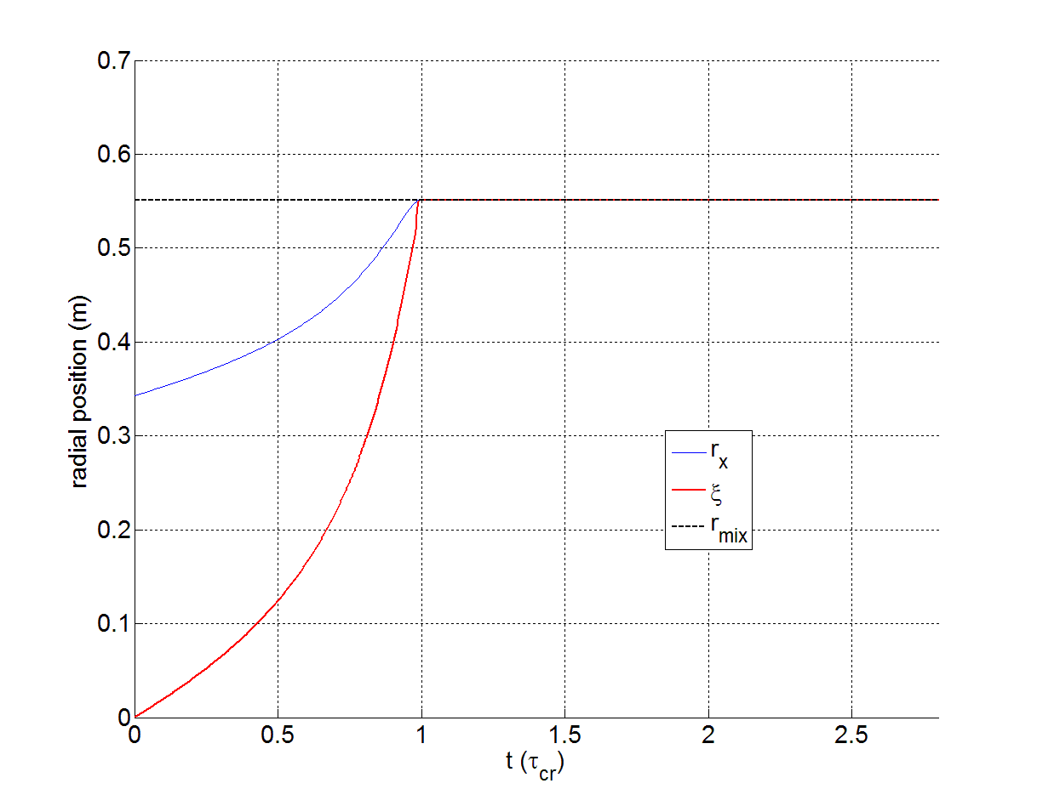
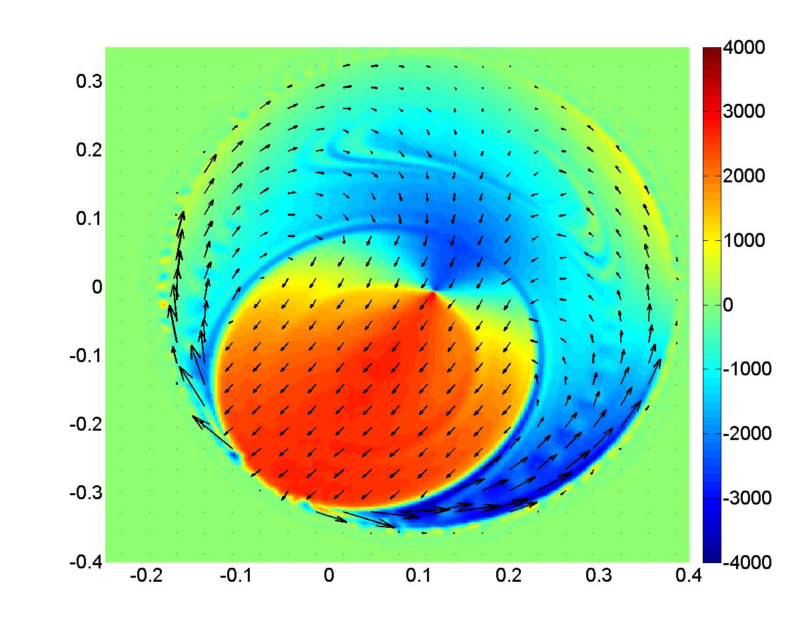
400 microseconds
The sawtooth collapse : a two-step process
A
B
radial v_{E} (m/s)
A
~130-266 μs
~70-144 μs
τ_{cr}
radial v_{E} drift

Slide 9
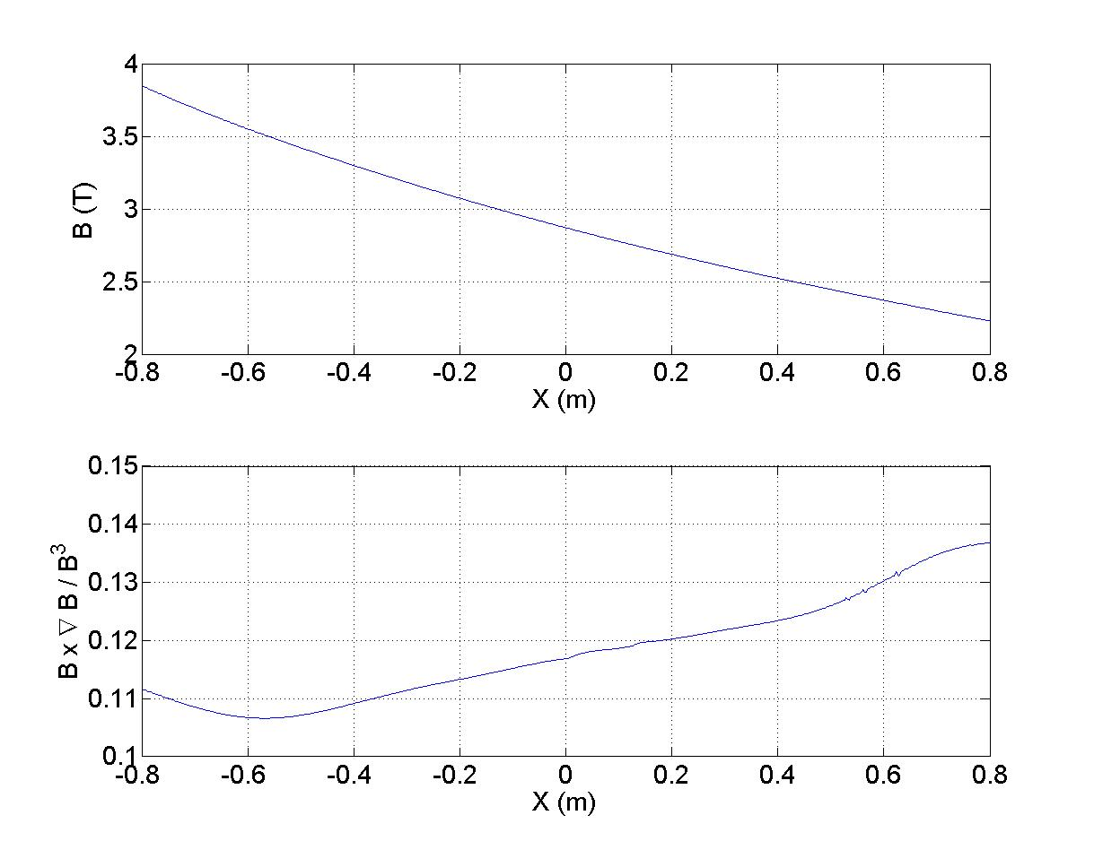
redistribution of fast ions
Sawtooth collapse
Orbits of fast ions
Energy study
Sample burning plasma

Slide 10
Orbits of fast ions
Evolution of motion invariants in perturbed EM fields
Evolution of magnetic moment on discontinuities of the field
Precession motion of trapped and potato orbits

Slide 11
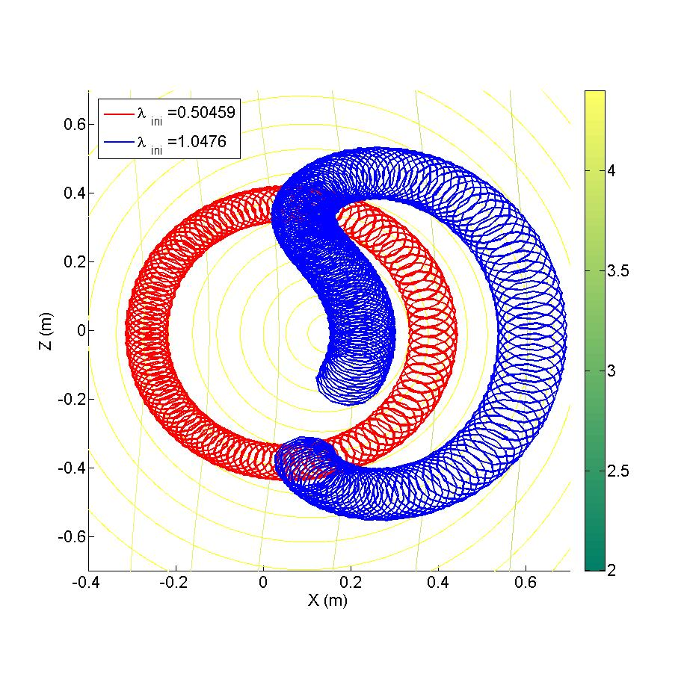
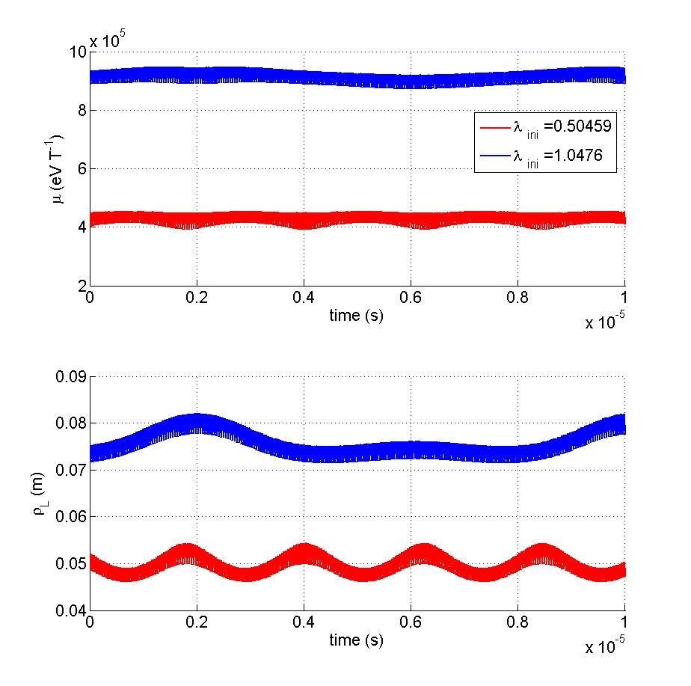
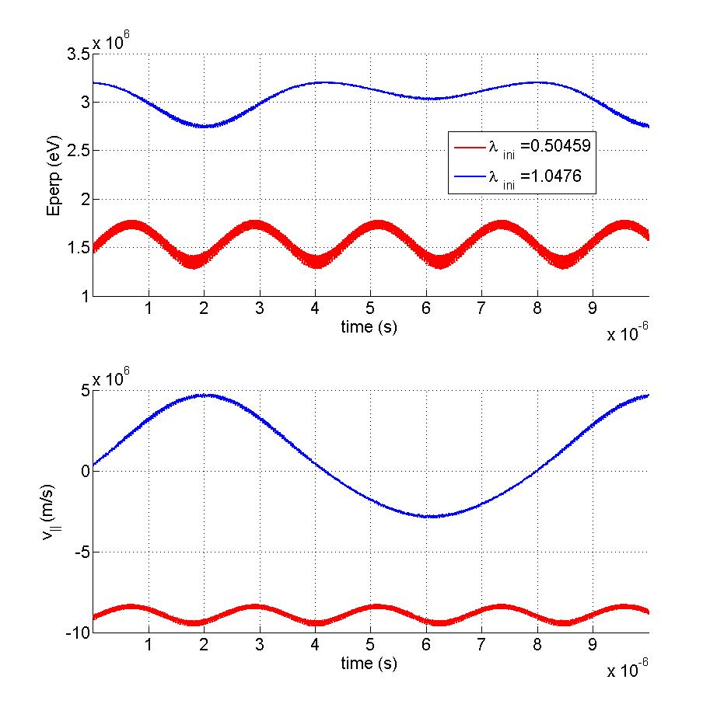
Orbits of fast ions
Illustration of the full-orbit motion of 3.2 MeV counter-passing and trapped ions
counter-passing
trapped
The speed of the ions is up to 1.4 10⁷ m/s
The Larmor radius is up to 0.15 m

Slide 12
Orbits of fast ions
Motion of passing fast ions is not attached to a flux surface position
v_{ǁ}>0
v_{ǁ}<0
τ_{ψ}
Orbit width
τ_{ψ}
J. Graves et al.
Furthermore, the passing particles have a fast poloidal excursion along the flux surface

Slide 13
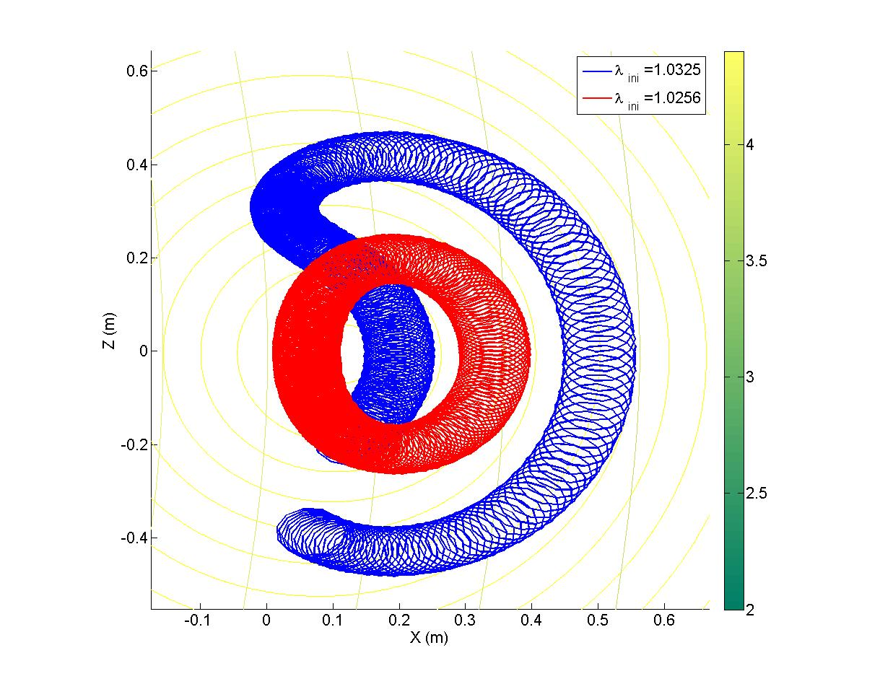
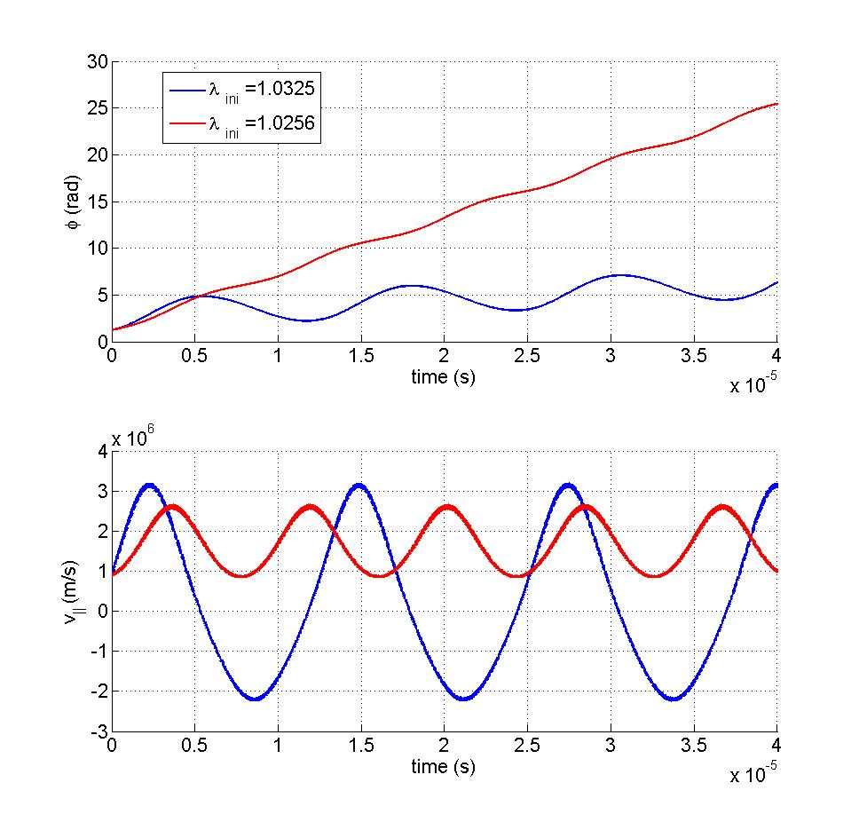
Orbits of fast ions
Illustration of precession motion for a 3.2 MeV ion
Precession motion
τ_{pr}
Co-passing
trapped
(banana)

Slide 14
Orbits of fast ions
Summary of characteristics times
Kolesnichenko et al.
Nuclear Fusion 36, feb.1996, p. 159
trapped
passing
τ_{ψ}
τ_{pr}
Kolesnichenko et al.
Physics of Plasmas 10, May 2003
For trapped ions

Slide 15
redistribution of fast ions
Sawtooth collapse
Orbits of fast ions
Energy study
Sample burning plasma

Slide 16
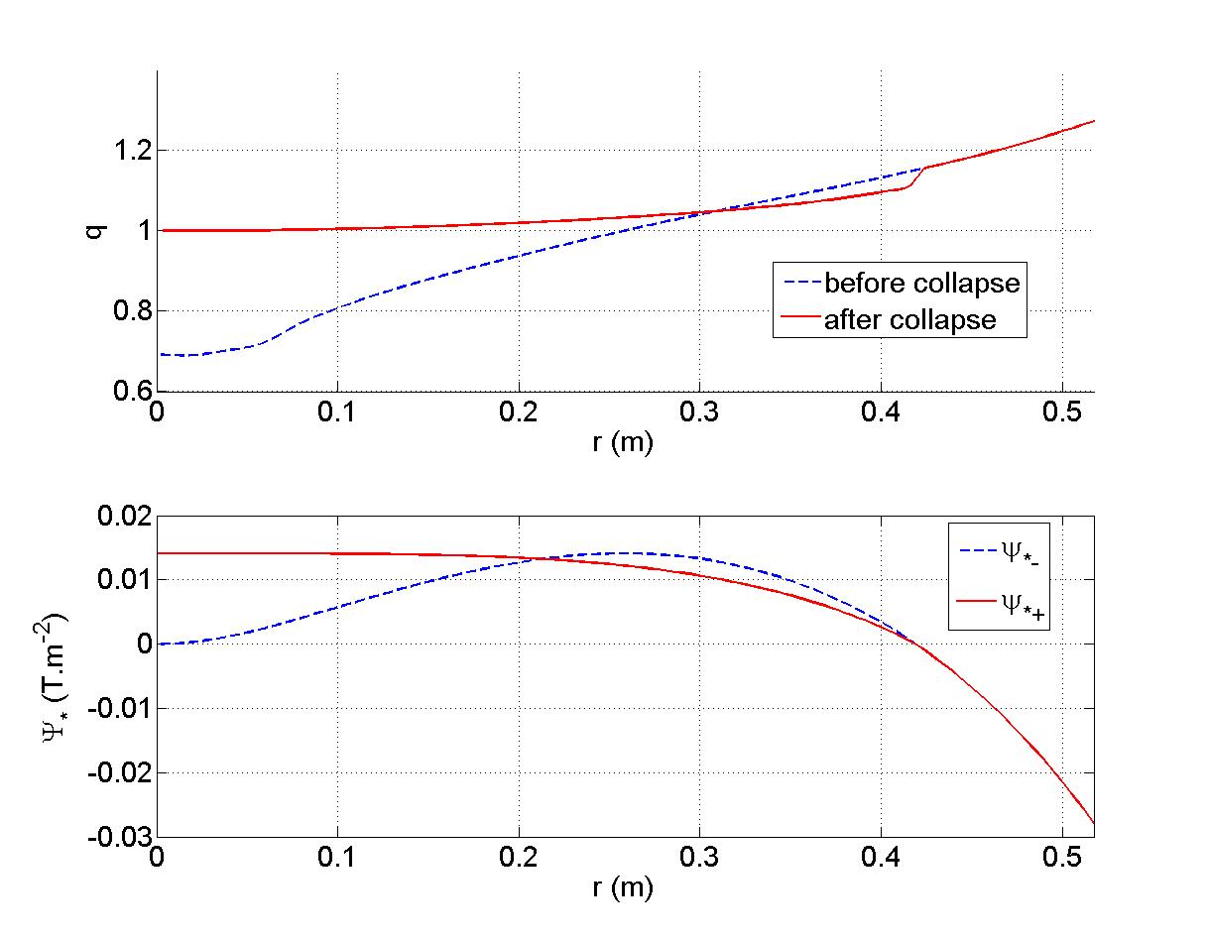
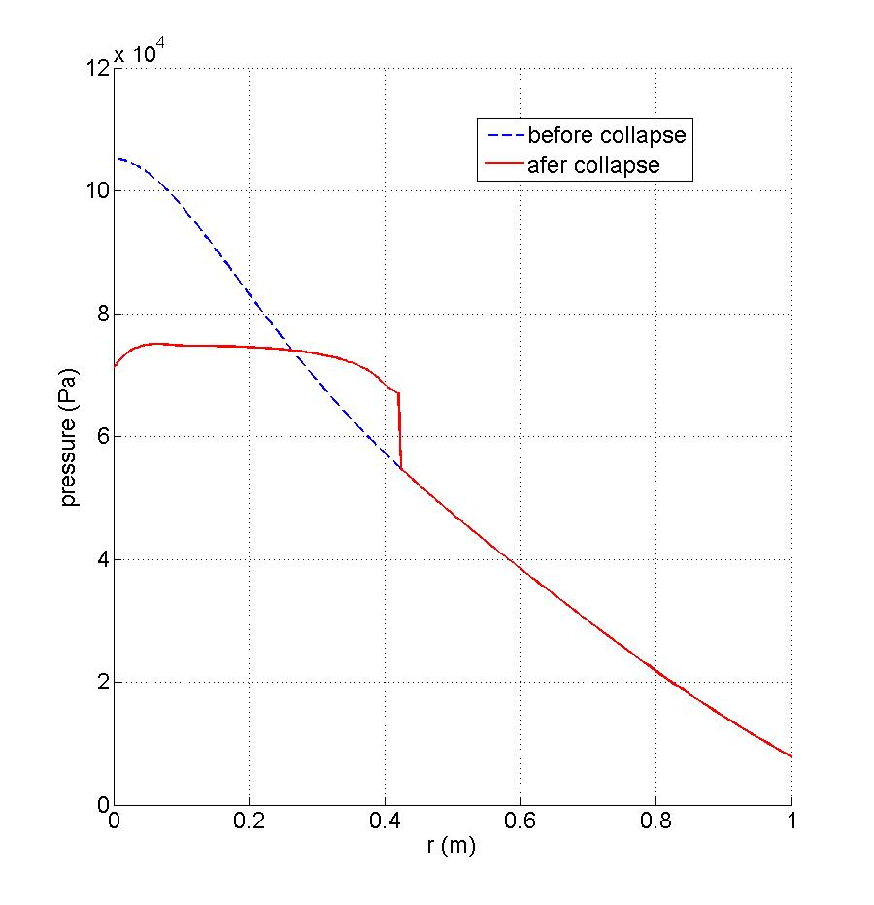
Global collapse illustration
An hypothetical hybrid discharge with sawteeth
q
P
Ψ*
+ simplistic initial distribution of ions with equal kinetic energy

Slide 17
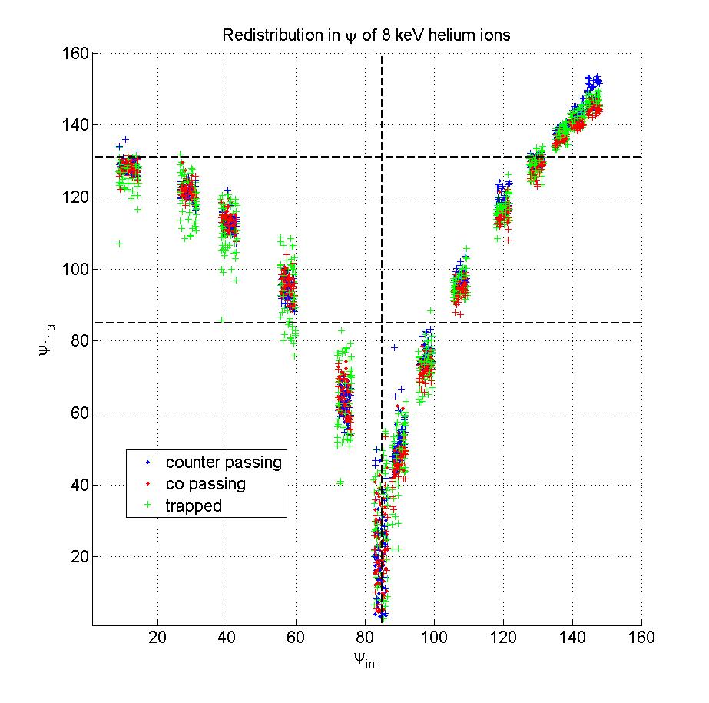
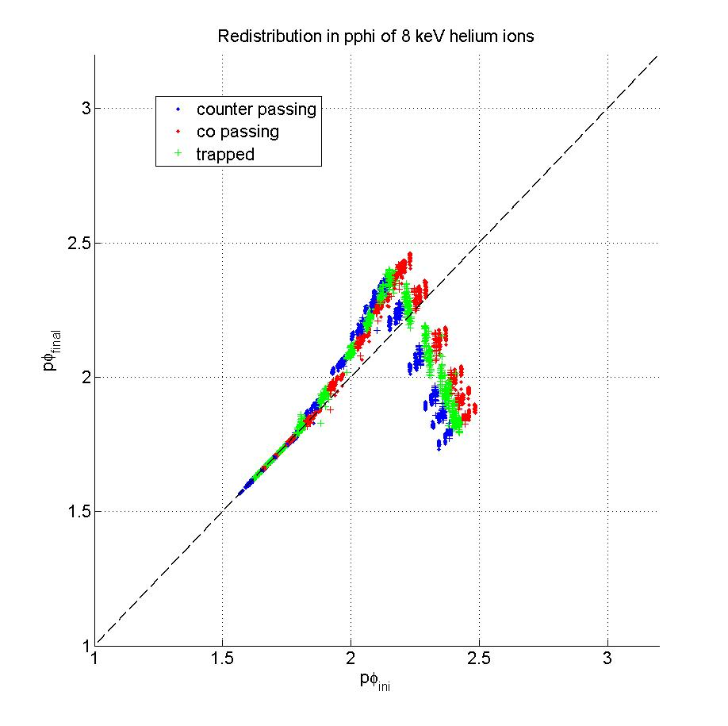
Redistribution of fast ions
Thermal ions redistribution (8 keV)
Ψ_{final}
Ψ_{ini}

Slide 18
Redistribution of fast ions
Averaging the ExB drift for energetic ions:
Trapped particles : Toroidal drift (precession motion) (this is averaging the radial drift to zero, as long as the precession frequency in helical angle is non zero (a precession period should cover the crash time))
For passing particles : many rotations along the field lines (this averages out the toroidal precession for |q-1|≥0.1, and low pitch angle, thus they are mostly redistributed, but this can be discussed according to the magnetic configuration)
Large orbit width compared with mixing radius (radial weakening effect, only for high energies, potatoes)

Slide 19
Redistribution of fast ions
Increasing kinetic energy : equaling precession time with crash time gives a critical energy for trapped energetic ions :
~0.42m
Kolesnichenko et al.
Physics of Plasmas 4, July 1997
~0.00014s
(this is averaging the radial drift to zero, as long as the precession frequency in helical angle is non zero (some particles are resonant with the kink motion))

Slide 20
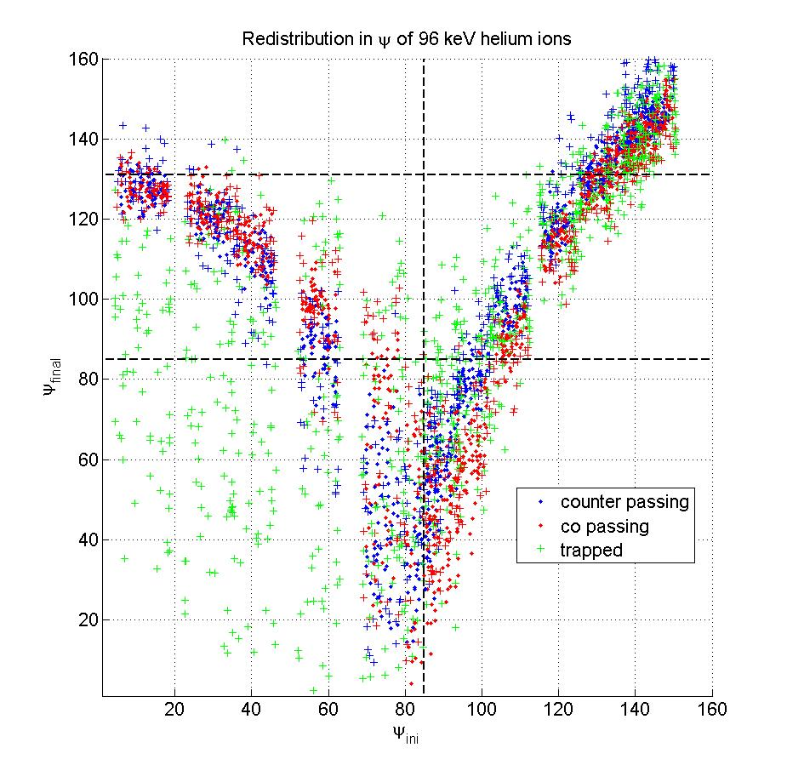
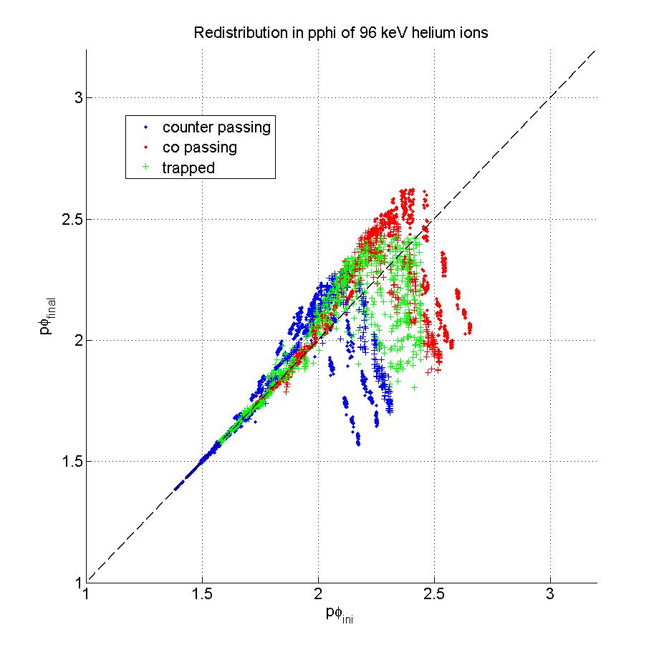
Redistribution of fast ions
Increasing kinetic energy: 96 keV (critical energy)
Ψ_{final}
Ψ_{ini}

Slide 21
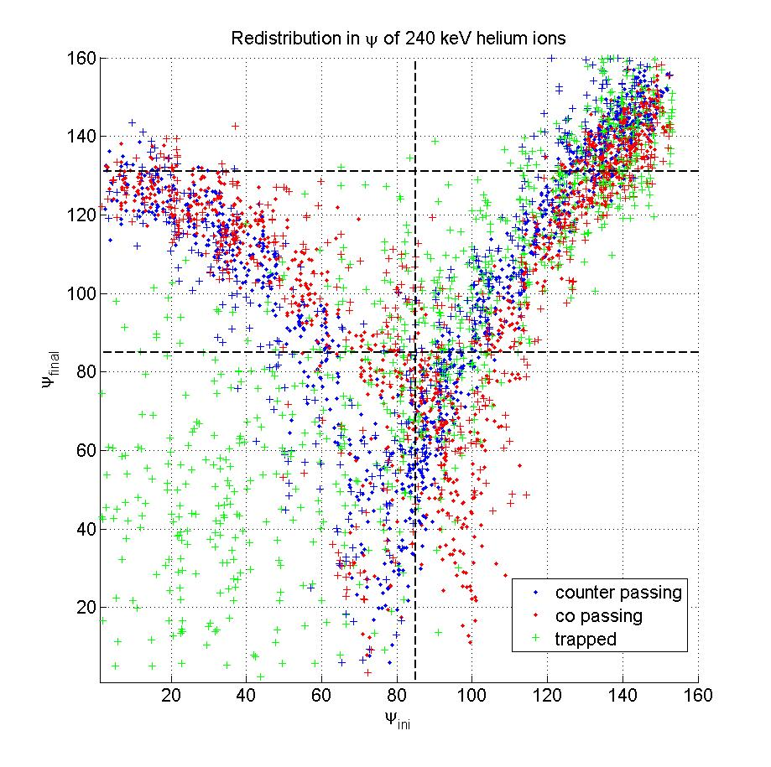
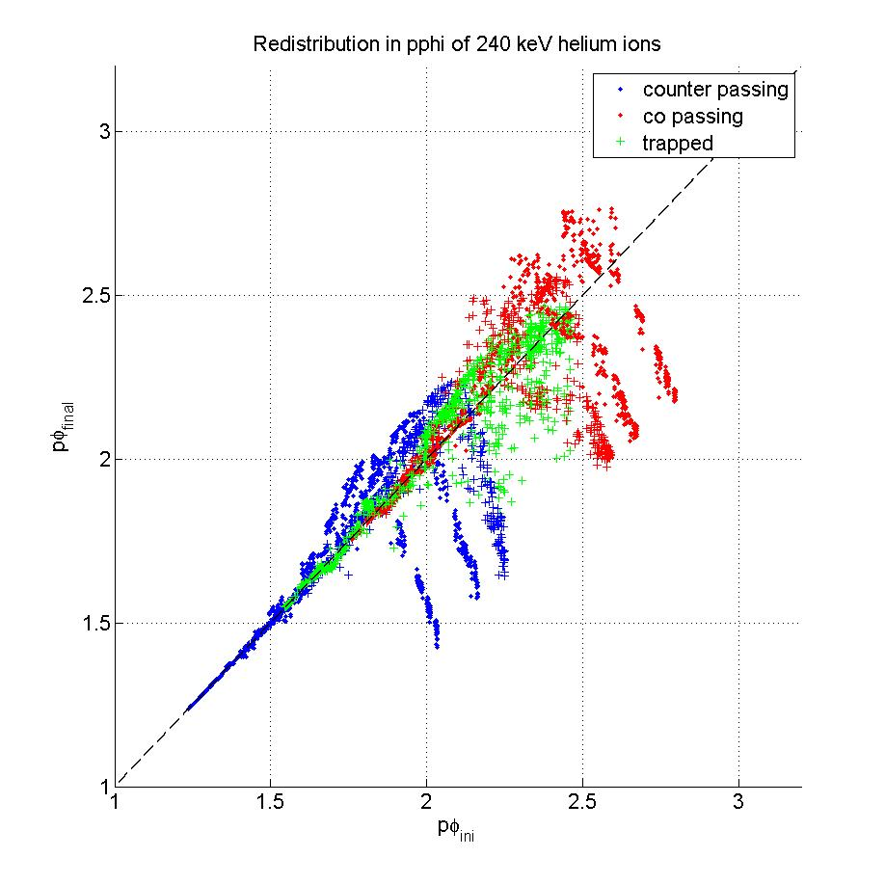
Redistribution of fast ions
Increasing kinetic energy: 240 keV
Ψ_{final}
Ψ_{ini}

Slide 22
Redistribution of fast ions
Increasing kinetic energy: consequence for trapped ion
8 keV
240 keV

Slide 23
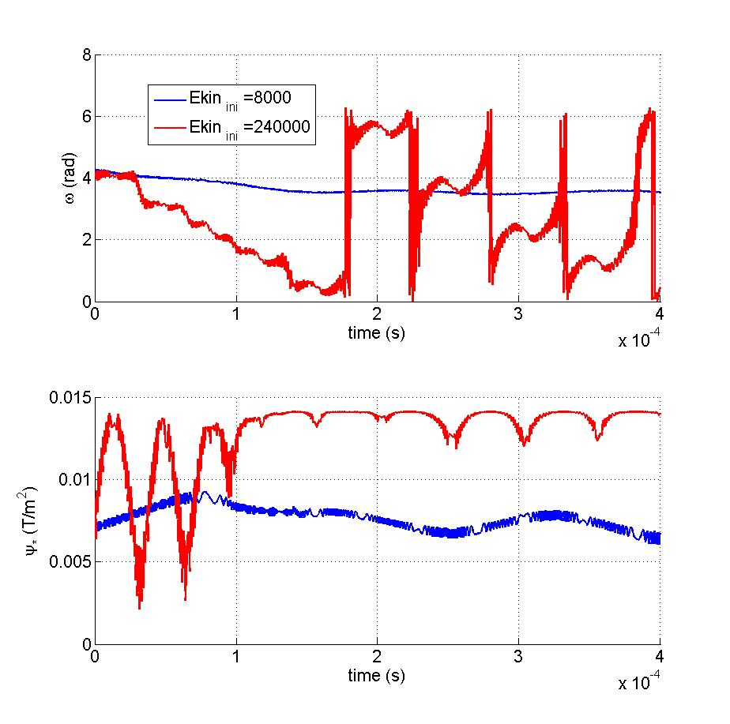
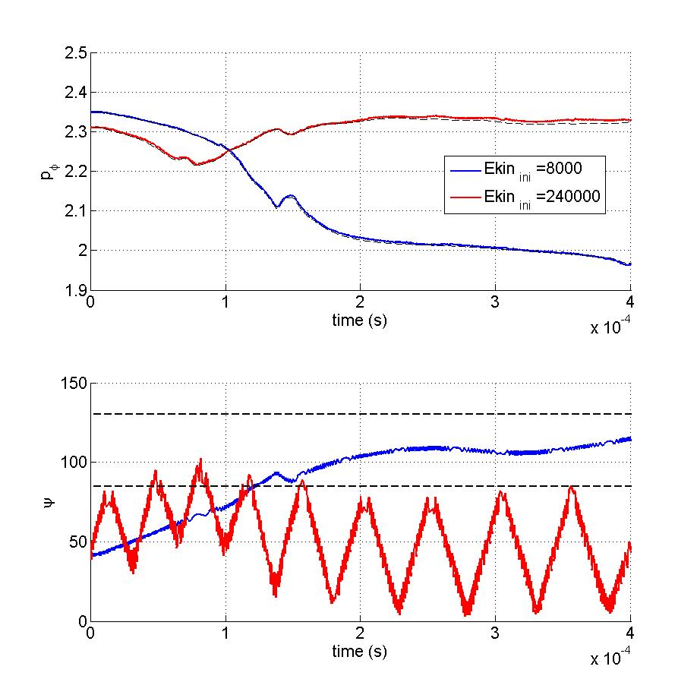
Redistribution of fast ions
Motion in ω is averaging out the perturbation
ω
Ψ
Ψ*

Slide 24
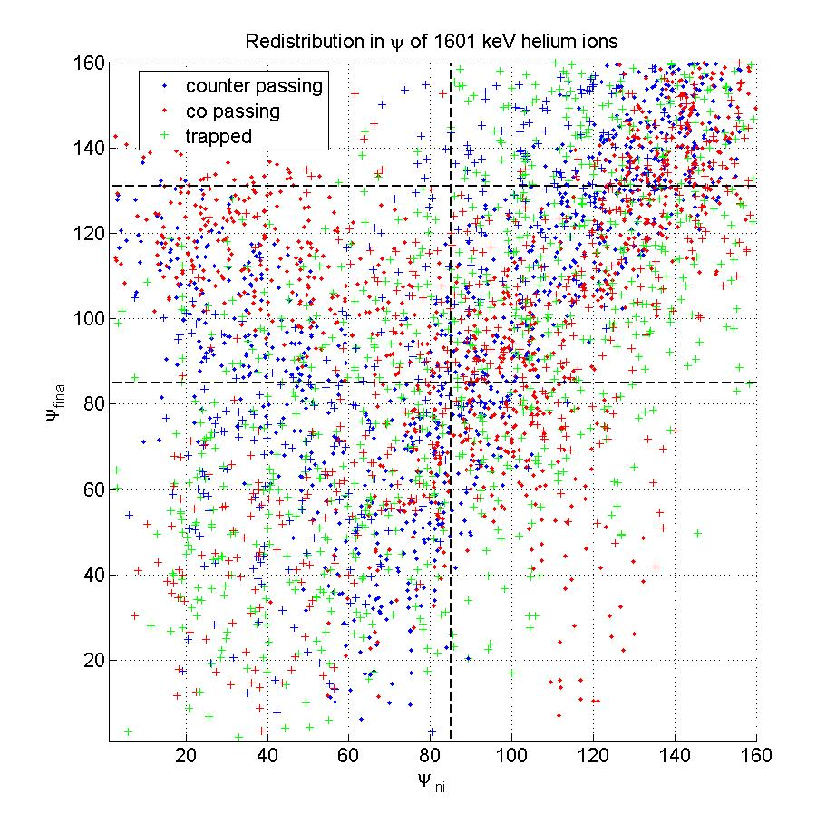
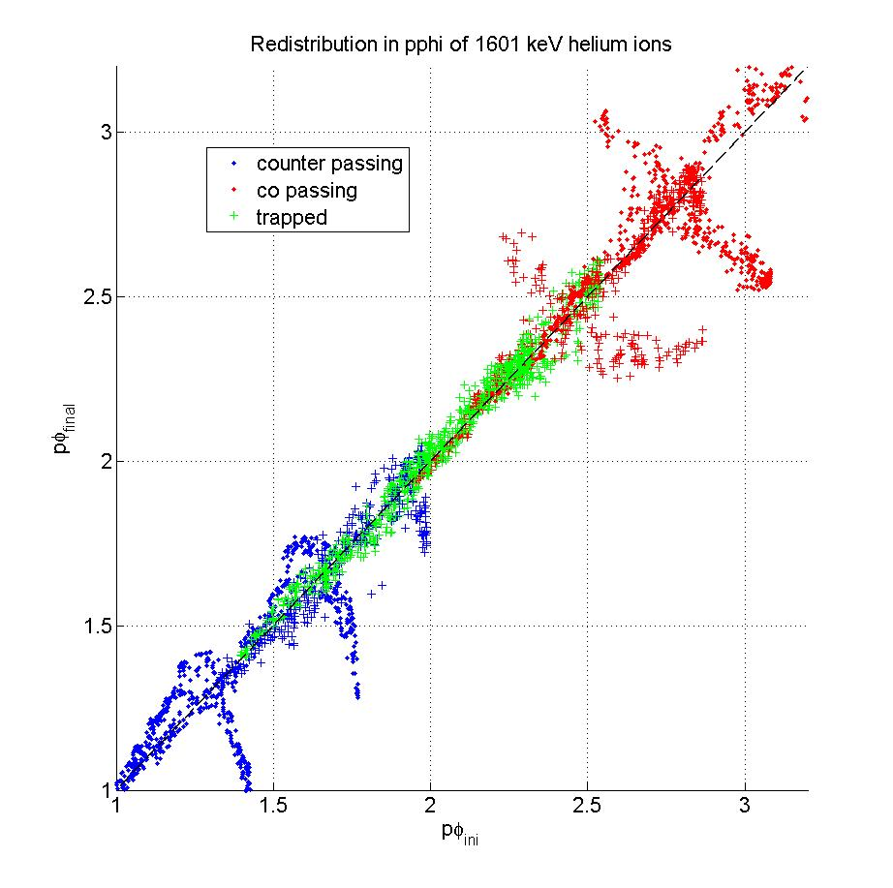
Redistribution of fast ions
Increasing kinetic energy: 1600 keV
Ψ_{final}
Ψ_{ini}
(some counter-passing particles ejected)

Slide 25
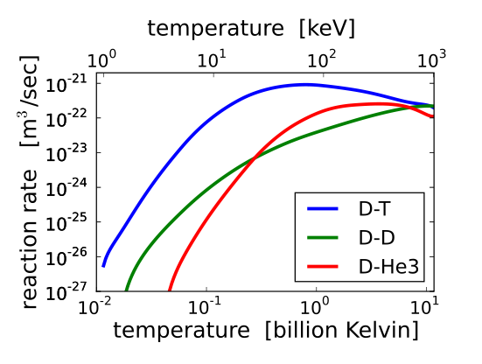
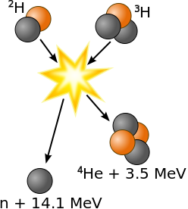
redistribution of fast ions
Sawtooth collapse
Orbits of fast ions
Energy study
Sample burning plasma
CIEMAT wiki

Slide 26
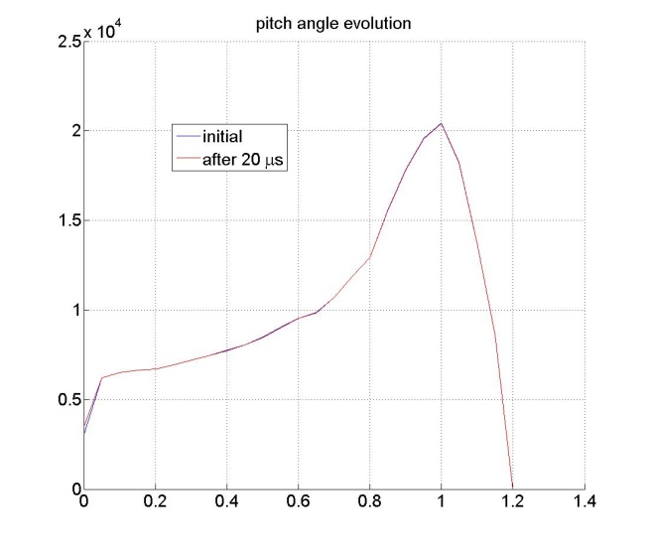
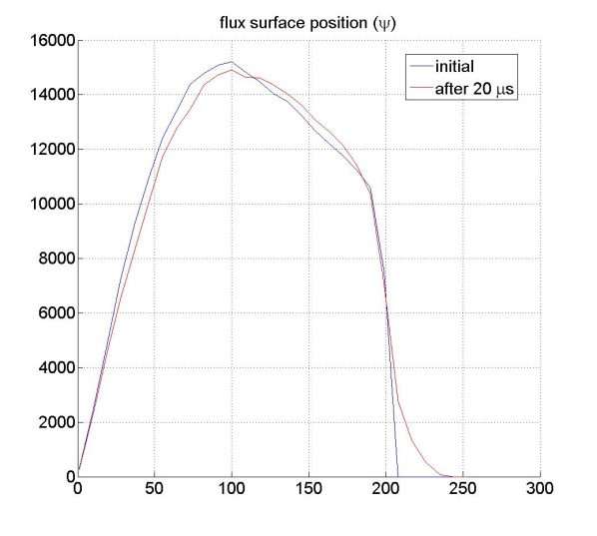
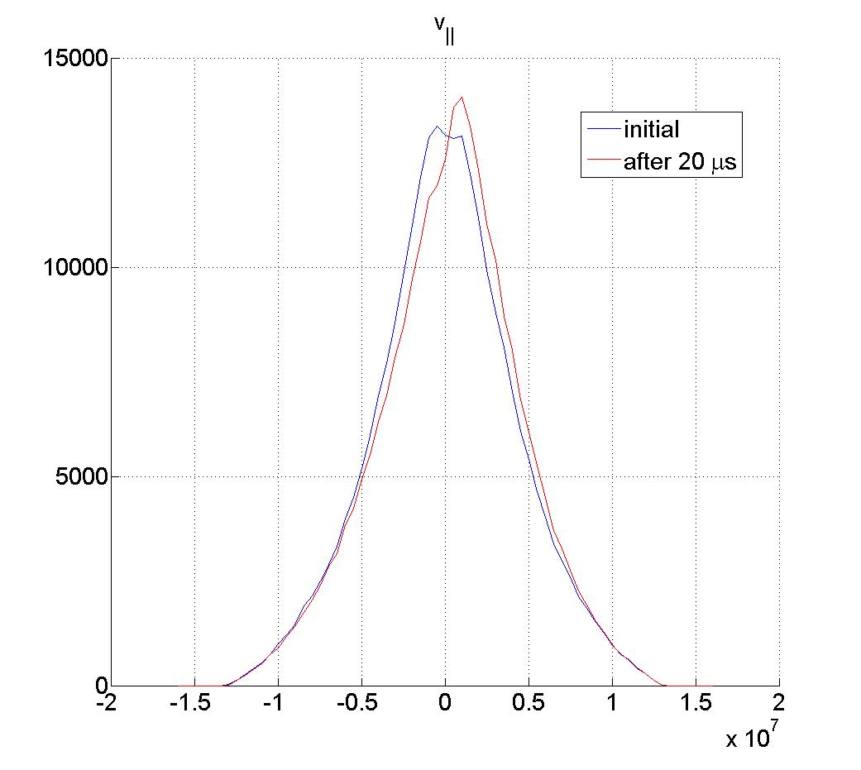
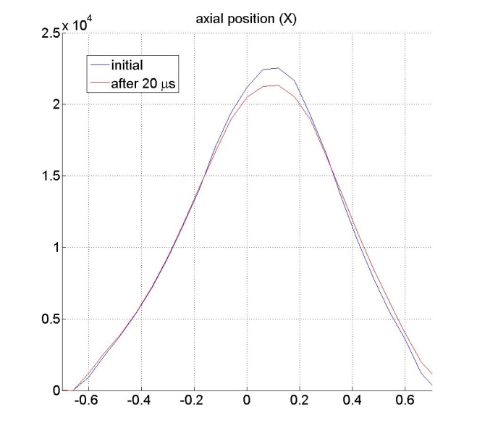
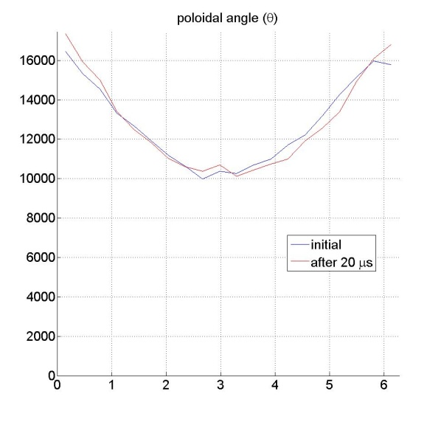
Evolution in equilibrium
The initial distribution reaches a new steady-state after a few microseconds
λ
v_{ǁ}
ψ
θ
X
~252000 ions
_{…. long simulation times}

Slide 27
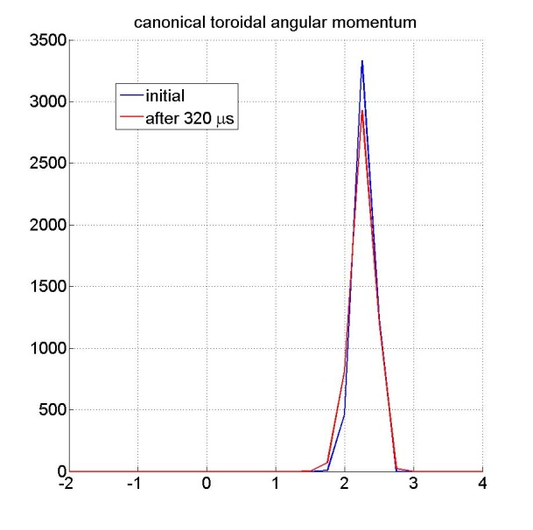
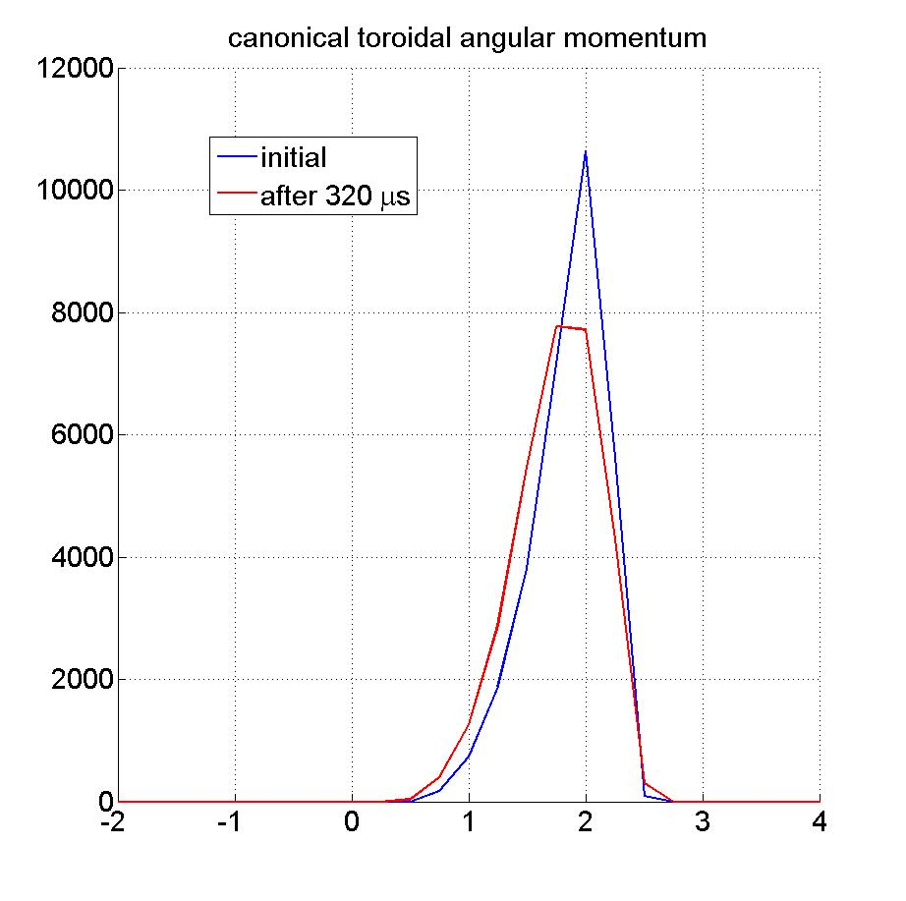
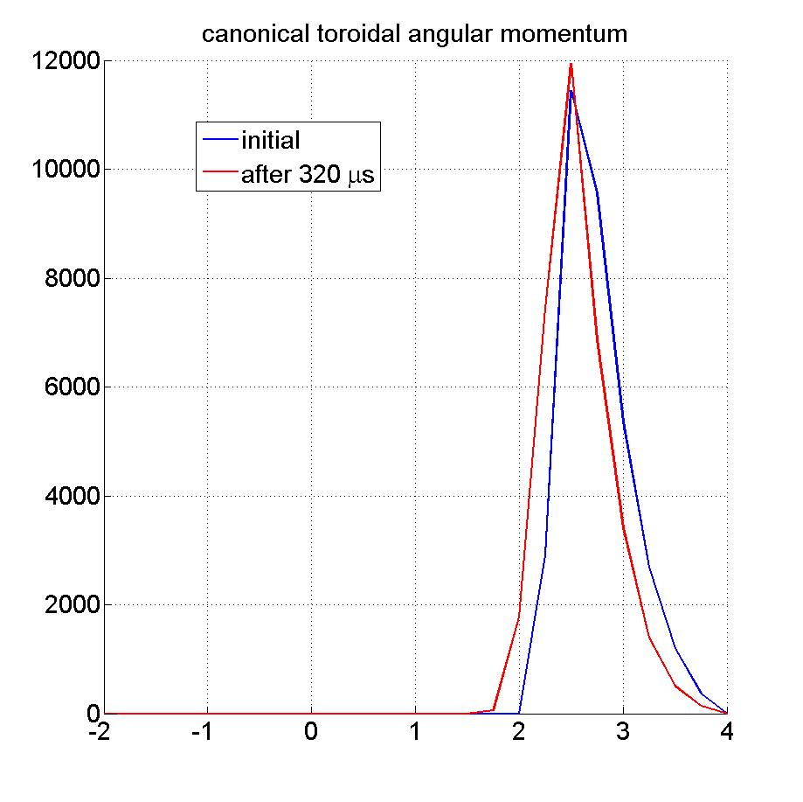
Evolution during the crash
Particles initially inside q=1
The difference between trapped and passing of energy >E_{crit} is clear
~5000 trapped ions
p_{φ}
p_{φ}
p_{φ}
~30000 counter-passing ions
~33000 co-passing ions

Slide 28
Conclusions
Phenomenological description of sawtooth collapse
Growth rate set according to the kinetic theory
Orbits of fast ions Main parameter : the toroidal precession of the fast ions (related to v_{D})
Motions during the collapse The study of the motion during the collapse confirms previous results: there is an Ekin limit beyond which trapped particles stay confined Resonance effects on trapped particles under investigation The magnetic configuration (|q-1|) changes the behavior of passing ions
Global distribution evolution Possibility to do before/after pictures of given initial distributions of fast ions

Slide 29
Motions of fast ions during a sawtooth reconnection in the core of a tokamak plasma
Questions?

Slide 30
Magnetic confinement in a torus
Equilibrium description with FINESSE
CIEMAT wiki
Ψ
F²-F₀²
u_{φ}/u_{φ0}
J.P. Goedbloed, R. Keppens, S. Poedts
Advanced Magnetohydrodynamics
P/P₀
q
n_{e}/n_{e0}

Slide 31
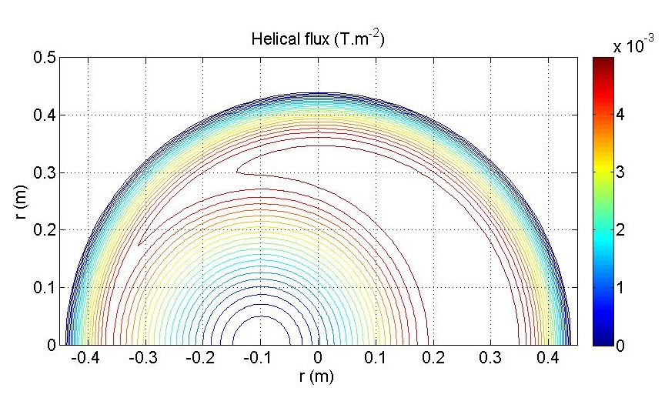
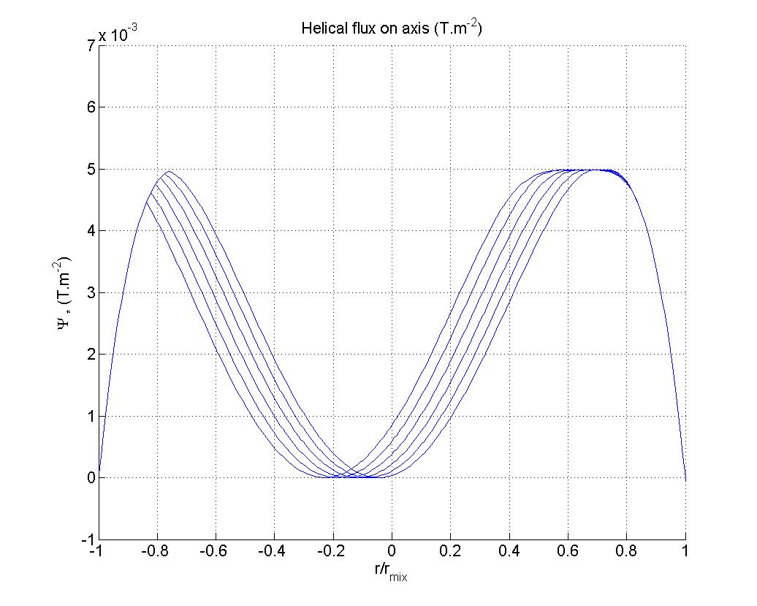
Kolesnichenko modelling
Ψ*
2
3
1
3
2
1
a₁
a₂

Slide 32
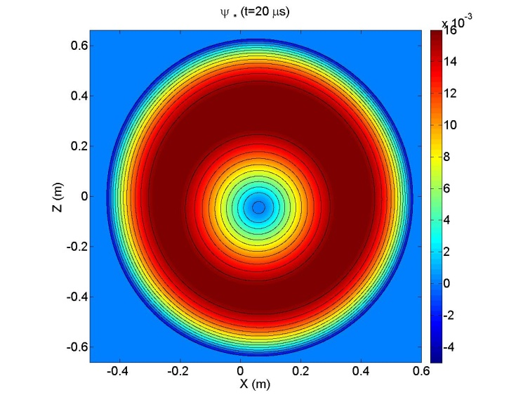
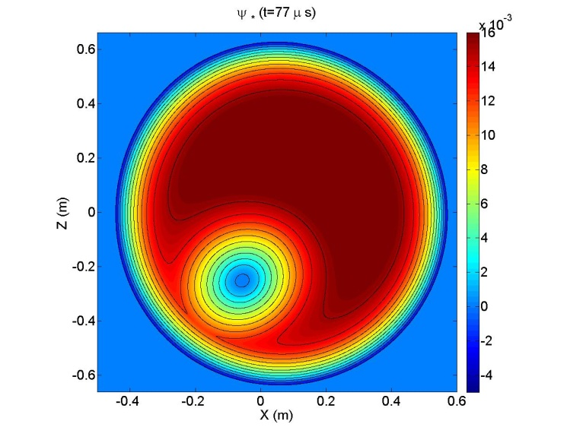
Evolution of helical flux
A
Electromagnetic fields evolve accordingly
B

Slide 33
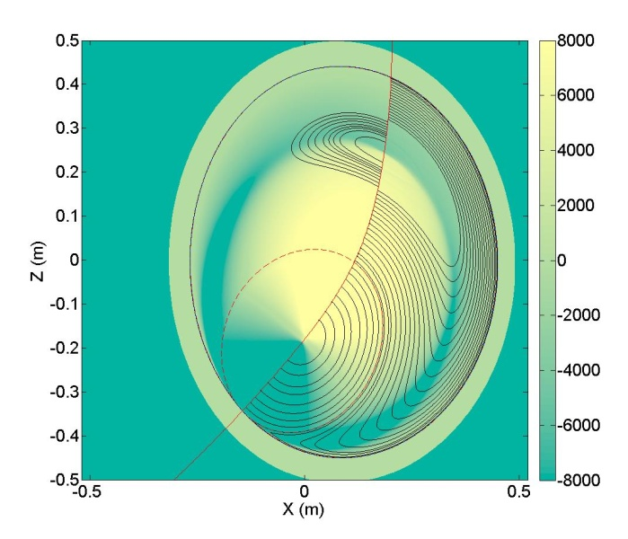
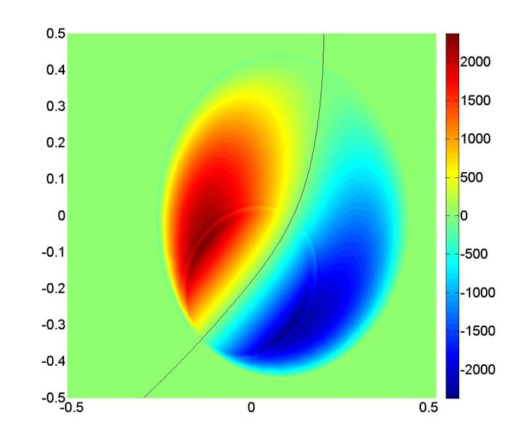
Evolution of the fields
From we have the relation:
The electrostatic potential is recovered by a contour integration along ψ* :
Φ
B = B_{H} +B*

Slide 34
MATLAB scripts
FINESSE output
Plasma shape
Equilibrium data
B_{H} (q=1)
ψ* (initial)
θ mesh
Global collapse flux
Particle motions
ψ* (final)
ψ_{mix}
Reconnection evolution
ψ* (ψ,ω,t)
Field reconstruction
B = B_{H} +B*
(ψ ,θ,φ,t) and (R,Z,φ,t) maps
ɸ, E

Slide 35
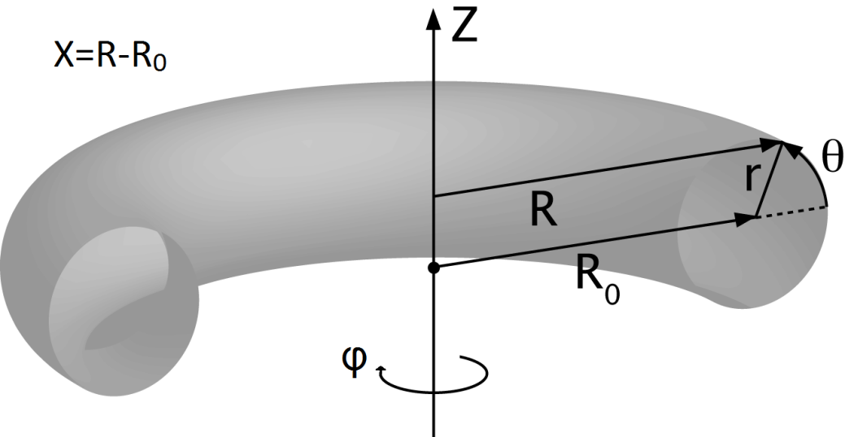
Motion of particles
We are using cylindrical coordinate for a tokamak
Motion is integrated using a Leap-Frog algorithm
U_{n-1/2}

Slide 36
Orbits of fast ions

Slide 37
Orbits of fast ions
Complete elliptic integrals
R. White
Wikipedia

Slide 38
Orbits of fast ions
Precession time for κ<1
Roscoe B. White
(The Theory of toroidally confined plasmas), pp. 87-88
Trapped
Transit-Bounce time
passing
trapped

Slide 39
Orbits of fast ions
Precession time
Kolesnichenko et al.
Nuclear Fusion 36, feb.1996, p. 159
passing
trapped

Slide 40
Orbits of fast ions
Illustration of the motion compared with guiding center algorithm for 800 keV ions
The full-orbit motion differs mostly for the bouncing part of trapped orbits

Slide 41
Orbits of fast ions
Illustration of a stagnation orbit for a 3.2 MeV ion
trapped
(banana)
“An orbit that has always non zero positive parallel velocity but does not circle the magnetic axis is referred to as a stagnation orbit”
“An orbit that circles the magnetic axis but should be trapped (v_{ǁ} changes sign) because of its pitch angle is called a potato orbit”
Stagnation
(potato)
v_{ǁ}
Roscoe B. White
(The Theory of toroidally confined plasmas)

Slide 42
Orbits of fast ions
Illustration of a potato orbit for a 3.2 MeV ion
Precession motion
potato
Co-passing

Slide 43
Initial distribution of alphas
For a given background pressure, It is possible to derive an expression of the distribution of the fast particles in total speed
…then uniform distribution in v_{ǁ}

Slide 44
Initial distribution of alphas
For a given energy level, we may derive the distribution in pitch angle (distribution in v_{ǁ} values)
v┴
ring of dv_{ǁ}
v₀+dv₀
v₀
v_{ǁ}
v_{ǁ}
Uniform distribution in v_{ǁ}

