Slide 1
Obtaining Global Mode Structures From the Local Gyrokinetic Codes
P.A. Abdoul¹, D. Dickinson², C.M. Roach² & H.R. Wilson¹
1- University of York / York Plasma Institute
2- Culham Centre for Fusion Energy / Oxford
26 – 06 – 2013
York Plasma Institute

Slide 2
Outline
Introduction
Fusion Confinement, Plasma Transport Processes & Plasma Models
Ballooning Transformation
My PhD Study
Global Results From Local GK Codes
The Procedure & Results
Summary & Outlook
FuseNet 3rd
York Plasma Institute

Slide 3
Outline
Introduction
Fusion Confinement, Plasma Transport Processes & Plasma Models
Ballooning Transformation
My PhD Study
Global Results From Local GK Codes
The Procedure & Results
Summary & Outlook
FuseNet 3rd
York Plasma Institute

Slide 4
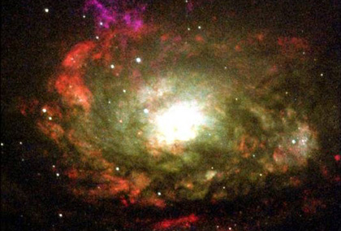
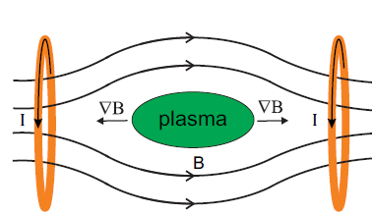
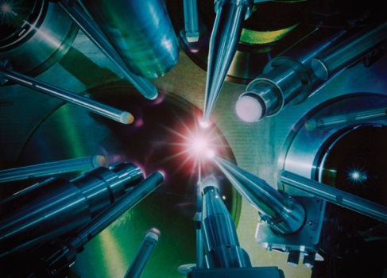
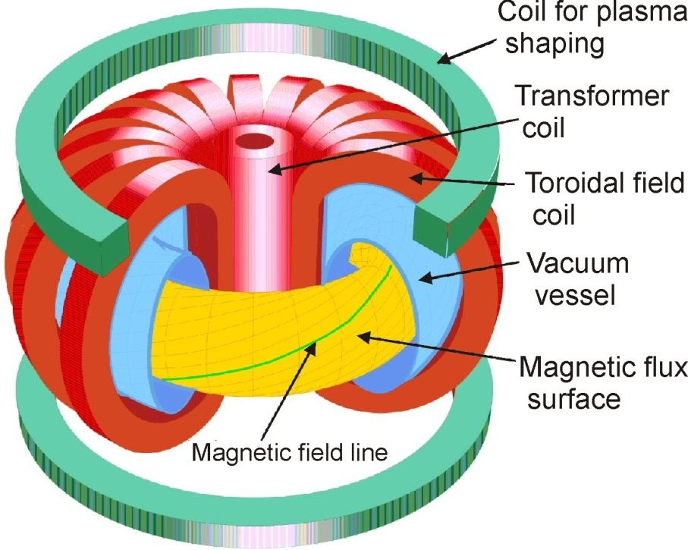
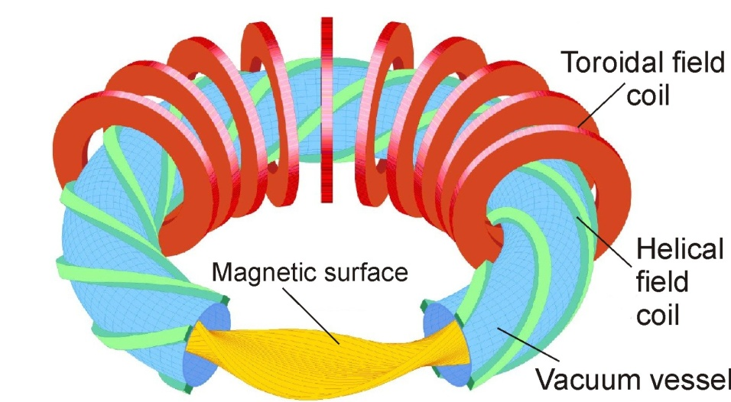
Fusion Confinement Approaches
Fusion confinement approaches
Gravitational confinement Fusion
Magnetic confinement Fusion
Linear confinement
Magnetic Mirror
Inertial confinement Fusion
Toroidal confinement
Toroidal + poloidal magnetic field
Pure toroidal magnetic field
Tokamak
Stellarator
V_{d} ~ E X B
With Poloidal Component
FuseNet 3rd
York Plasma Institute

Slide 5
Fusion Confinement Approaches
Fusion confinement approaches
Gravitational confinement Fusion
Magnetic confinement Fusion
Linear confinement
Magnetic Mirror
Inertial confinement Fusion
Toroidal confinement
Toroidal + poloidal magnetic field
Pure toroidal magnetic field
Tokamak
Stellarator
My PhD study focuses on Tokamak
V_{d} ~ E X B
With Poloidal Component
FuseNet 3rd
York Plasma Institute

Slide 6
Transport Processes
Why don’t we have a single fusion reactor as yet? Why? Why? Why? Why? ……
Transport of both energy and particle across the magnetic flux surfaces:
1- Classical transport → Purely collisional
2- Neo-classical transport → Magnetic topology (trapped particles)
3- Turbulent transport → Fluctuation in the plasma parameters, density and temperature for example.
They tell you how big your reactor should be in order to get a self sustained fusion energy
Microinstabilities are the main derives of turbulent transport.
→ Due to gradient in plasma profiles, temperature and density for example
They are characterised by: λ‖ >> λ┴ ~ ρ_{i} → They elongate parallel to the magnetic field lines with relatively very short wavelengths perpendicular to it. ω << Ω_{i} → Very small frequency compare to the ion cyclotron frequency
→ Examples are: Drift waves, Ion temperature gradient instabilities and many others……
Density fluctuation TJK - Torsatron By Dr. M Ramisch IPF/Stuttgart/Germany
FuseNet 3rd
York Plasma Institute

Slide 7
Transport Processes
Why don’t we have a single fusion reactor as yet? Why? Why? Why? Why? ……
Transport of both energy and particle across the magnetic flux surfaces:
1- Classical transport → Purely collisional
2- Neo-classical transport → Magnetic topology (trapped particles)
3- Turbulent transport → Fluctuation in the plasma parameters, density and temperature for example.
They tell you how big your reactor should be in order to get a self sustained fusion energy
Microinstabilities are the main derives of turbulent transport.
→ Due to gradient in plasma profiles, temperature and density for example
They are characterised by: λ‖ >> λ┴ ~ ρ_{i} → They elongate parallel to the magnetic field lines with relatively very short wavelengths perpendicular to it. ω << Ω_{i} → Very small frequency compare to the ion cyclotron frequency
→ Examples are: Drift waves, Ion temperature gradient instabilities and many others……
My PhD study
Density fluctuation TJK - Torsatron By Dr. M Ramisch IPF/Stuttgart/Germany
FuseNet 3rd
York Plasma Institute

Slide 8
Plasma Models
To describe the electromagnetic fields and plasma motion we need:
Maxwell’s equations for the E&M fields:
Vlasov equation → hot plasmas → Collision is neglected. To Obtain $ρ_{0} and J$ required in Maxwell’s equations. and
$$∇∙E=\frac{ρ_{0}}{ε_{0}}$$
$$∇×E=−\frac{∂B}{∂t}$$
$${{∇×B= μ}_{0}(J+∈}_{0}\frac{∂E}{∂t})$$
$$∇∙B=0$$
$\frac{∂f}{∂t}+v∙\frac{∂f}{∂x}$ + $\frac{q}{m}\left(E+v×B\right)∙\frac{∂f}{∂v}=0, \text{and}$ $f=f\left(x,v,t\right)$
$ρ_{0}$=$\sum_{j}{q_{j}}\int{f_{j}d^{3}v }$
$J$ =$\sum_{j}{q_{j}}\int{f_{j} v{ d}^{3}v }$
The problem is nonlinear. Solving these set of equations is impossible for most problems → We need to make approximations
Self-consistent problem
FuseNet 3rd
York Plasma Institute

Slide 9
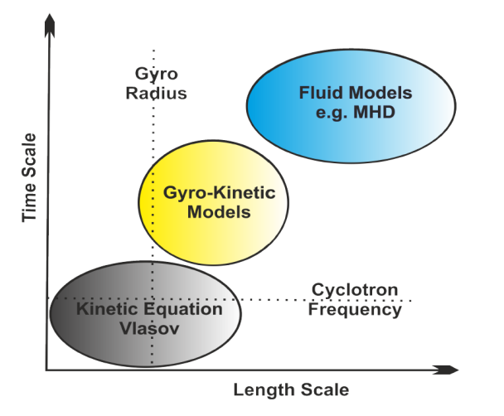
Plasma Models
Models are classified into “kinetic” and “fluid”
Vlasov Fokker-Plank 6D equation
- Remove high frequencies ~ Ω_{i} - Remove small scales ~ ρ_{i}
Take moments
Two-fluid equation
e.g. Braginskii
Gyro average:
- Remove high frequencies ~ Ω_{i} - Retain small scales ~ ρ_{i}
Simplify further
Kinetic models
Gyrokinetics 5D equation
Non-ideal MHD (single fluid)
Fluid models
Take moments
Remove dissipation
Gyro-fluid
Ideal MHD
FuseNet 3rd
York Plasma Institute

Slide 10
Plasma Models
Models are classified into “kinetic” and “fluid”
Vlasov Fokker-Plank 6D equation
- Remove high frequencies ~ Ω_{i} - Remove small scales ~ ρ_{i}
Take moments
Two-fluid equation
e.g. Braginskii
Gyro average:
- Remove high frequencies ~ Ω_{i} - Retain small scales ~ ρ_{i}
Simplify further
Kinetic models
Gyrokinetics 5D equation
Non-ideal MHD (single fluid)
My PhD study focuses on this model
Fluid models
Take moments
Remove dissipation
Gyro-fluid
Ideal MHD
FuseNet 3rd
York Plasma Institute

Slide 11
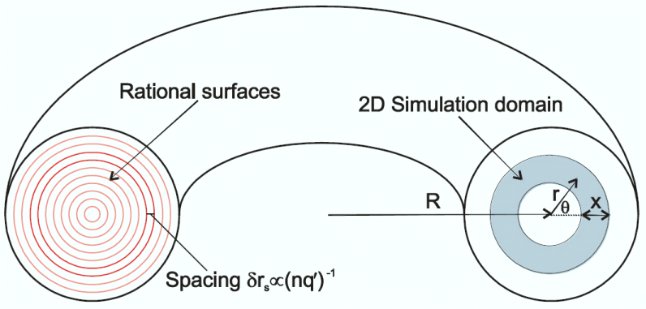
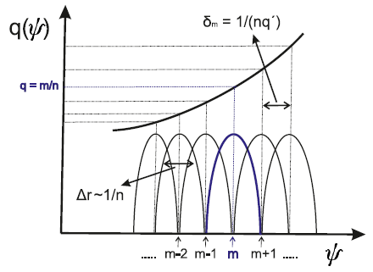
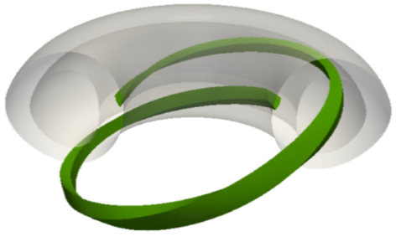
Ballooning transformation: An example
Global 2D model:
Simplified 2D gyrokinetic ITG model for large aspect ratio and circular magnetic flux surfaces
ITG derive given by where
Local (1D) model:
Ω₀ is the local complex mode frequency which gives real frequency $ω$and growthrate $γ$. Relation to actual frequency Ω undetermined at this order
X and P are free parameters at this order, but there choice can be restricted at higher orders
Radial variation and their effects are neglected.
a is the equilibrium length scale
Applying Ballooning Transformation
Ballooning angle
P
P
P
Lowest order ballooning equation
By Dr. Colin Roach/ CCFE
FuseNet 3rd
York Plasma Institute

Slide 12
Ballooning transformation: An example
A Global 2D eigenmode Code to solve this equation
Global 2D model:
Simplified 2D gyrokinetic ITG model for large aspect ratio and circular magnetic flux surfaces
ITG derive given by where
Local (1D) model:
Ω₀ is the local complex mode frequency which gives real frequency $ω$and growthrate $γ$. Relation to actual frequency Ω undetermined at this order
X and P are free parameters at this order, but there choice can be restricted at higher orders
Radial variation and their effects are neglected.
a is the equilibrium length scale
Applying Ballooning Transformation
Ballooning angle
P
P
P
Lowest order ballooning equation
By Dr. Colin Roach/ CCFE
FuseNet 3rd
York Plasma Institute

Slide 13
Ballooning transformation: An example
A Global 2D eigenmode Code to solve this equation
Global 2D model:
Simplified 2D gyrokinetic ITG model for large aspect ratio and circular magnetic flux surfaces
ITG derive given by where
Local (1D) model:
Ω₀ is the local complex mode frequency which gives real frequency $ω$and growthrate $γ$. Relation to actual frequency Ω undetermined at this order
X and P are free parameters at this order, but there choice can be restricted at higher orders
Radial variation and their effects are neglected.
a is the equilibrium length scale
Applying Ballooning Transformation
Ballooning angle
P
P
P
Lowest order ballooning equation
A Local 1D eigenmode Code to solve this equation
By Dr. Colin Roach/ CCFE
FuseNet 3rd
York Plasma Institute

Slide 14
Outline
Introduction
Fusion Confinement, Plasma Transport Processes & Plasma Models
Ballooning Transformation
My PhD Study
Global Results From Local GK Codes
The Procedure & Results
Summary & Outlook
FuseNet 3rd
York Plasma Institute

Slide 15
Outline
Introduction
Fusion Confinement, Plasma Transport Processes & Plasma Models
Ballooning Transformation
My PhD Study
Global Results From Local GK Codes
The Procedure & Results
Summary & Outlook
FuseNet 3rd
York Plasma Institute

Slide 16
Global Results From Local GK Codes
Complex Mode Frequency (Ω₀)
The procedure:
The Local code, GS2, is scanned over a range of radial (x) and ballooning angle (P) coordinates, to map out the complex mode frequency Ω₀(x, P).
Two different types of profiles have been investigated:
A quadratic profile → Ω₀(x, P) has a stationary point.
A linear profile → Ω₀(x, P) dose not have a stationary point.
X - 0.2
Linear
quadratic
[1] J.B. Taylor, H.R. Wilson and J.W. Connor PPCF 38, 243-250 (1996)
FuseNet 3rd
York Plasma Institute

Slide 17
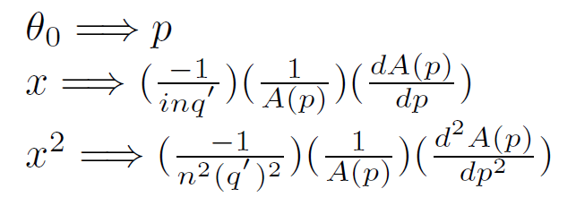
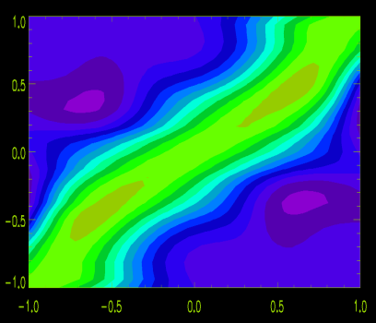
Global Results From Local GK Codes
Fourier-Ballooning Transformation:
Complex Mode Frequency (Ω₀)
: [1]
Global Mode Structure
Local Mode Structure From
GS2 Code
Toroidal Mode number
Can be Obtained From the Complex Mode Frequency
Ω₀(x, p) ≈ a + b * x^{d} + c * cos(p)
d=1 Linear profile d=2 Quadratic profile
X - 0.2
REAL PART
Imaginary PART
P / π
θ /π
[1] J.B. Taylor, H.R. Wilson and J.W. Connor PPCF 38, 243-250 (1996)
FuseNet 3rd
York Plasma Institute

Slide 18
Global Results From Local GK Codes
Results:
S-alpha equilibrium model:
Circular magnetic flux surfaces
Large aspect ratio (r/R → 0)
Only linear electrostatic ITG modes has been studied
X – X0
Two Types of modes are recognized:
Quadratic ƞ_{i} profile → Isolated Modes
Isolated Modes usually peak at outboard mid plane at
Poloidal Cross Section
Simulation domain
X
(Z)/ρ_{i}
(R – R₀)/ρ_{i}
FuseNet 3rd
York Plasma Institute

Slide 19
Global Results From Local GK Codes
Results:
S-alpha equilibrium model:
Circular magnetic flux surfaces
Large aspect ratio (r/R → 0)
Only linear electrostatic ITG modes has been studied
X – X0
Two Types of modes are recognized:
Linear ƞ_{i} profile → General Modes
General Modes peak elsewhere ( ) For the model considered here
Poloidal Cross Section
Simulation domain
X
(Z)/ρ_{i}
(R – R₀)/ρ_{i}
FuseNet 3rd
York Plasma Institute

Slide 20
Outline
Introduction
Fusion Confinement, Plasma Transport Processes & Plasma Models
Ballooning Transformation
My PhD Study
Global Results From Local GK Codes
The Procedure & Results
Summary & Outlook
FuseNet 3rd
York Plasma Institute

Slide 21
Summary & Outlook
Summary:
Global mode structures have been obtained from only solutions of the local gyrokinetic code, GS2.
Only linear electrostatic ITG modes has been investigated for a so-called s-alpha equilibrium model in which large aspect ratio and circular magnetic flux surfaces have been assumed
Future plans:
Experimentally relevant simulations will be performed, which, along with the procedure outlined here, can be used to predict the global mode structures.
Explore mode structures as plasma evolves toward L-H transition.
Finally, the influence of flow shear on the mode structures will be also studied
FuseNet 3rd
York Plasma Institute

Slide 22
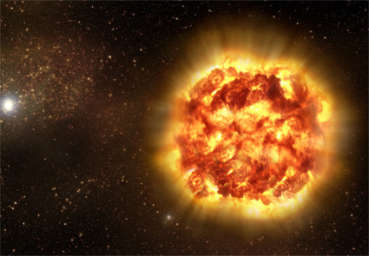
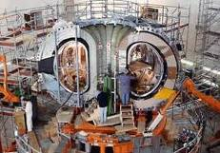
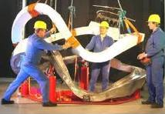
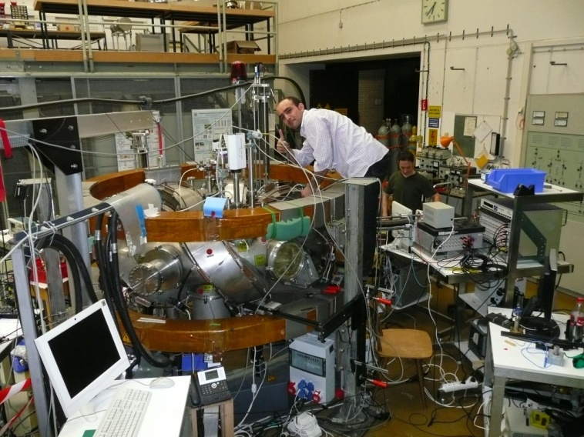
Thanks For Your Attention
My PhD study is funded by the Ministry of Higher Education in Kurdistan Region - Iraq

