Slide 1
What makes human beings unique?
UNIT C
Our dreams in the 21st century!
Notes:
In the speaker notes you find easy-to-consult short sentences that sum up the instructions presented in the Lesson Plan.

Slide 2
GOAL 7:
Let’s Remember?
Notes:
Ask pupils to share with the class what they remember about SDGs and Goal 7 studied in the previous unit

Slide 3
ACTIVITY C1
How much energy do we need?
Notes:
Read the question and check pupils' opinions regarding our energy needs.

Slide 4
ACTIVITY C1
1 Incandescent Light bulb uses about 100 Watts
Watt - unit of power in the International System of Units (SI)
100 W
Notes:
Inform that you will compare energy needs using incandescent 100 W lightbulbs as comparison

Slide 5
ACTIVITY C1
=
The power our body needs at any given time
is equivalent to a 100 W light bulb.
Notes:
Discuss the comparison between the human body's energy needs and the light bulb.

Slide 6
Math Time
How many light bulbs do you need?
Notes:
Ask pupils to complete activity #C1.1 and activity #C1.2 on the student sheet.

Slide 7
ACTIVITY C2
Discussion Time
Notes:
Tell pupils that they are going to discuss a theme together.

Slide 8
Do you know any renewable energy source?
Notes:
Read the question and check pupils’ previous knowledge on renewable energy sources.

Slide 9
ACTIVITY C2
Reading Time
‘’Green Energy: Alternatives!’’
Notes:
Ask pupils to read the text “Green Energy: Alternatives!” in activity #C2.1 on the student sheet. After the reading, ask pupils to complete activity #C2.2 on the student sheet.

Slide 10
ACTIVITY C2
F U S I O N
Have you ever heard this word?
What does this word bring to mind?
Notes:
Read the word “FUSION” and ask pupils the questions in the slide.

Slide 11
ACTIVITY C2
Reading Time
‘’Dreaming about Energy: Fusion’’
Notes:
Invite pupils to read the text “Dreaming About Energy: Fusion” in activity #C2.3 on the student sheet. Then, ask pupils to complete activity #C2.4 on the student sheet.

Slide 12
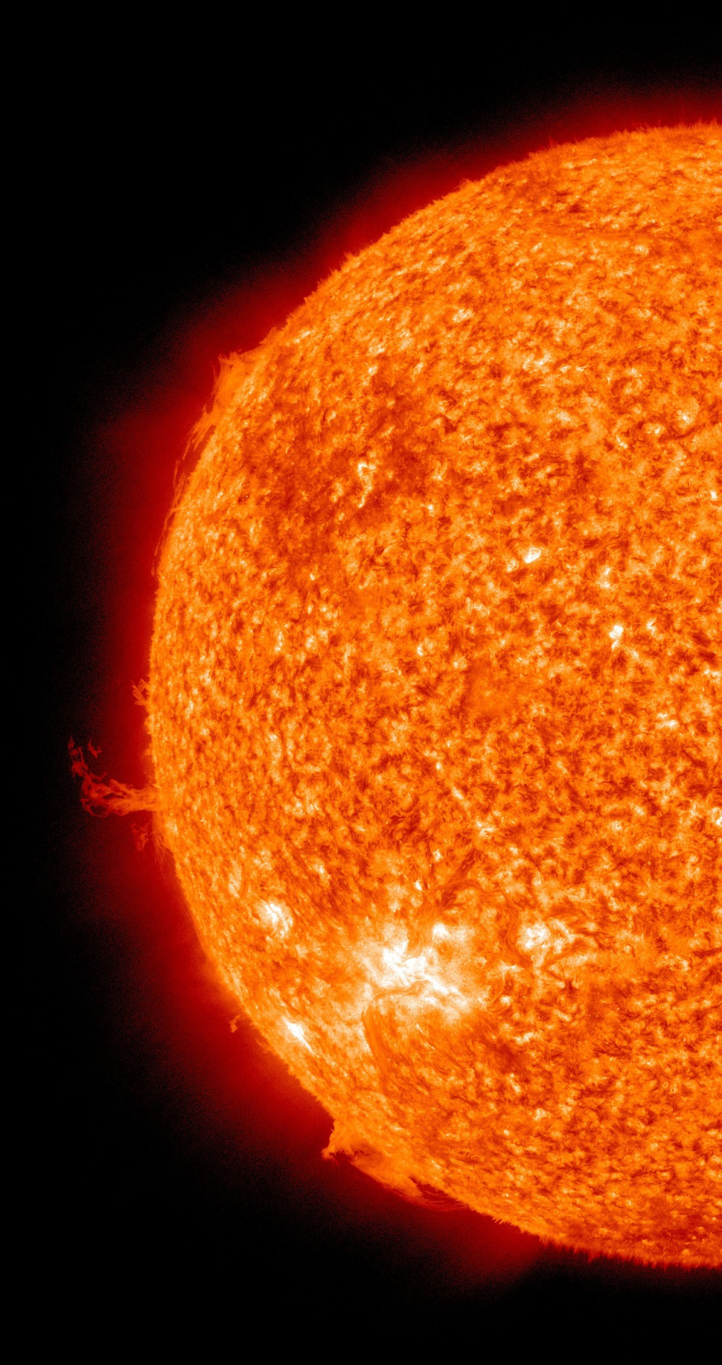
ACTIVITY C1
Fusion reactions are the ones that release the energy that fuels the Sun and every other star!
Notes:
Reiterate that fusion reaction is essential for life on Earth.

Slide 13
Energy Sources
P R O S
C O N S
Produces enormous quantities of CO₂ (Climate Change)
Burning fossil fuels [ coal, oil, gas ]
Easy to use
Very diluted energy source and large fluctuations
(No wind=No energy)
Renewables [Sun, Wind, Hydro, Biomass]
Produce little CO₂
Nuclear Energy [Fission]
Produce very little CO₂
Waste is difficult to treat
It would produce massive amounts of energy and would be sustainable
Still in scientific and technological development: OUR DREAM
Fusion Energy
Notes:
Discuss the advantages and disadvantages of different energy sources.

Slide 14
ACTIVITY C3
Creativity Time
You are a scientist in the energy field. What would be your scientific dream? What would you like to solve?
What would you like to invent to make your scientific dream come true?
Notes:
Invite pupils to think about their scientific dream by reading the questions in the slide.

Slide 15
Conclusion
MAIN MESSAGES
Energy production often pollutes and emits greenhouse gasses like CO₂ which are responsible for global warming
Energy consumption is increasing so we have to find clean energy sources such as fusion
What is the most interesting thing you have learned from this lesson?
Notes:
Reiterate the key messages and invite pupils to write down the most interesting thing they have learnt with this lesson.

Slide 16
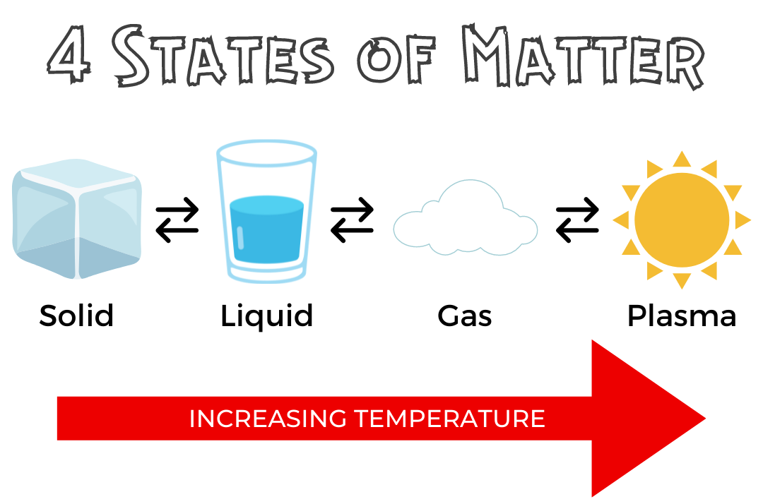
ACTIVITY C2
Extra Resource: 4 States of Matter
Notes:
Extra Resource: If you want to explore the concept of states of matter and/or plasma, use this slide to help to illustrate.

